Slide 1
PARCC Assessment Math Shifts
Becky Justus
Math Teacher
Greene County Tech Junior High
PARCC Educator Leader Cadre Member

Slide 2
Higher Expectations
ELA/Literacy
Read sufficiently complex texts independently
Write effectively to sources
Math
Build and present knowledge through research
Have fluency with mathematics
Model real-world problems
Reason mathematically
Solve problems: content and mathematical practice

Slide 3
What Are the Shifts at the Heart of PARCC’s Design?
Focus: The PARCC assessment will focus strongly where the Standards focus.
Coherence: Think across grades and link to major topics within grades.
Rigor: In major topics, pursue
conceptual understanding,
procedural skill and fluency,
and application.

Slide 4
Advances in Assessment Demanded by the Shifts
Shift #1 – Focus: The PARCC assessments will focus strongly where the Standards focus
Advance: 70% or more on the major work in grades 3-8.
Focus allows for a variety of problem types to get at concept in multiple ways.
Students will have more time to master concepts at a deeper level.

Slide 5
Advances in Assessment Demanded by the Shifts
Shift #2 - Coherence: Think across grades, and link to major topics within grades
Advance: The assessment design is informed by multi-grade progressions in the Standards and the Model Content Frameworks.
Key beginnings are stressed (e.g., ratio concepts in grade 6), as are key endpoints and takeaway skills (e.g., fluency with the multiplication table in grade 3).

Slide 6
Advances in Assessment Demanded by the Shifts
Shift #2 - Coherence: Think across grades, and link to major topics within grades
Advance: Integrative tasks draw on multiple standards to ensure students are making important connections.
The Standards are not treated
as a checklist.

Slide 7
Advances in assessment demanded by the shifts
Shift #3 - Rigor: In major topics, pursue conceptual understanding, procedural skill and fluency, and application
Advance: PARCC assessments will reach the rigor in the Standards through innovations in technology and item design.

Slide 8
Advances in the PARCC Assessments
Advances in the PARCC Assessments
Better standards require better tests – and the shifts in the standards call for critical advances in assessment quality. PARCC will develop custom items and tasks aligned to the Common Core State Standards.
In regards to the mathematics assessments, this means PARCC will include:
Problems worth doing: Multi-step problems, conceptual questions, applications, and substantial procedures will be common, as in an excellent classroom.
Focus: Instead of randomly sampling a mile-wide array of topics, PARCC assessments will have a strong focus where the standards focus. This will reinforce the concept of “going deep” rather than simply "covering topics."=

Slide 9
PARCC Updates
Performance Level Descriptors
Also grade and subject specific
Makes specific distinctions within the content
Examines engagement and evidence of the practices
Makes fine distinctions in the performance levels
Public comment incorporated

Slide 10
What are Performance Level Descriptors?
Performance Level Descriptors or PLDs describe what students at each performance level know and can do relative to the grade-level or course content standards assessed.
All PLDs can be found on PARCC Online –
Assessments/Assessment Policies
Notes:
What are Performance Level Descriptors?
In July 2012, PARCC released the draft College- and Career-Ready (CCR) Determination Policy and Policy-Level Performance Level Descriptors (PLDs) for Public Feedback. The final versions being adopted in October 2012. These document are being used to develop items and tasks for the PARCC assessments and will ultimately be used as a guidepost for setting the performance levels for the PARCC assessments.
The Performance Level Descriptors describe what students at each performance level know and can do relative to the grade-level or course content standards assessed.

Slide 11
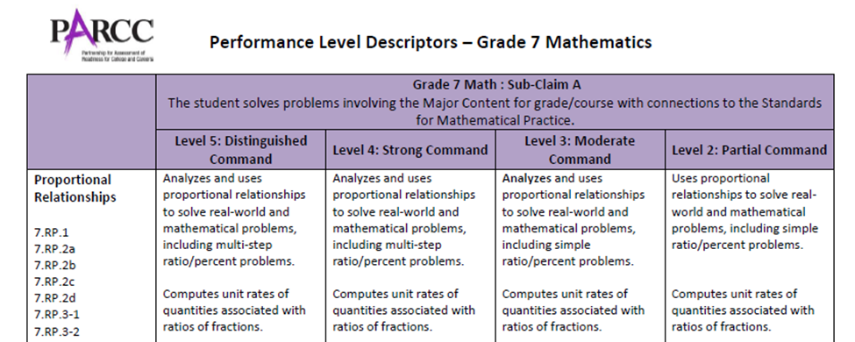
Performance Level Descriptors
Gives the
Sub-Claim
Performance level
ranging from 2 - 5
Concept and Standards
Notes:
Each grade-level or course PLDs have be formatted the same. They are divided by the sub-Claims.
Turn to pg. ____ This is the first page for the Grade 7 PDL. Looking at the top row you will see the indication for Sub-Claim A (Major Content and Practice). The next 4 pages all pertain to Sub-Claim A. You can see the other sub-Claims of subsequent pages.
In the first column you can see the focus of Proportional Relationships and the evidence statements (content standards) associated with this concept.
Just below the Sub-Claim description are the Performance Levels ranging from 2 – 5. Level 1 is not listed but indicates from no work shown to minimal command.

Slide 12
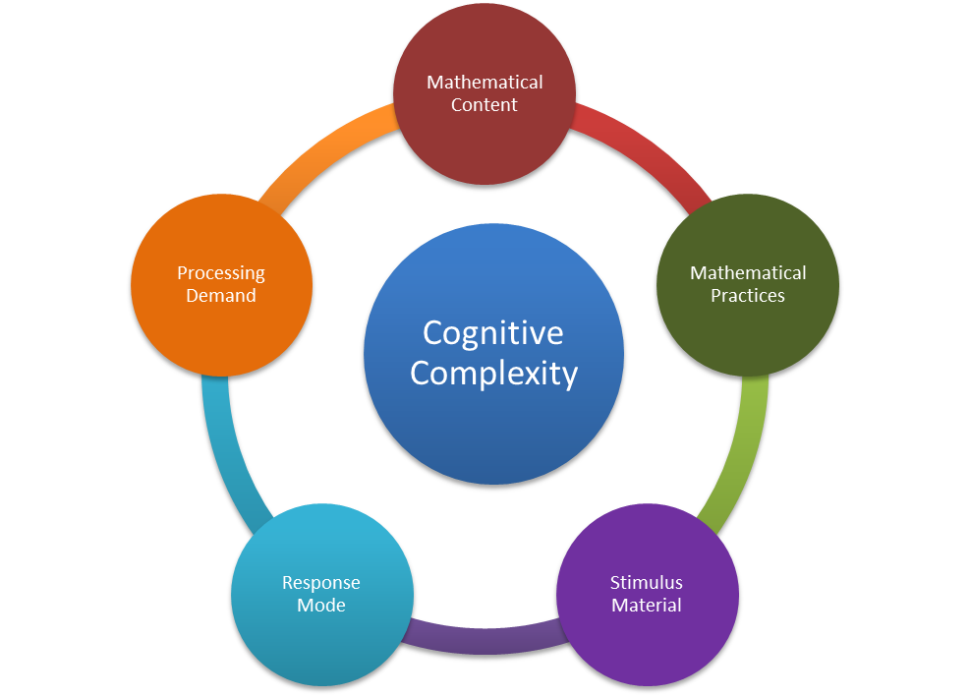
Factors that determine the performance levels (Cognitive Complexity)
Mathematical Content
Mathematical Practices
Stimulus Material
Response Mode
Processing Demand
Notes:
The performance levels within each claim area are differentiated by a number of factors consistent with the Common Core’s inclusion of standards for both mathematical content and mathematical practices and PARCC’s Cognitive Complexity Framework for Mathematics. In addition to the standards the Complexity Framework also include stimulus material, response mode, and processing demand.
For more detailed discussion on the Cognitive Complexity, see “ Proposed Sources of Cognitive Complexity in PARCC Items and Tasks: Mathematics “ August 31, 2012
Information below if for reference only and does not need to be discussed at this time.
1. Math Content: Low – very small to no shifts from previously learned concepts
Medium – slight departure from previously learned concepts
High – most challenging content requires significant departure from previously learned concepts
2. Math Practices: Low – recall and recognize concepts (routine)
Medium – require flexibility in thinking and choice in alternatives
High – require to use reasoning, planning, syntheses, analysis, judgment and creative thought
3. Stimulus Material: e.g. table, graph figure or online tool (incremental technology – drag and drop or transformative – online ruler, graphing tool)
Low – single piece or no stimulus material or online tool
Medium – 2 pieces of stimulus material or single piece of stimulus material and online tool
High – 2 or more stimulus material with online tool or 3 pieces of stimulus with or without online tools. Likely to use transformative tools
4. Response Mode: Low – selected response and producing short responses
Medium – multiple response modes within the same task including selected and short response
High – construct extended written responses may incorporate online tools involve coordinating and organizing details
5. Processing Demands: Low – low reading load and linguistic demand (simply language and few words <25 words)
Medium – moderate reading load and linguistics (simply to grade level language with several sentences in length)
High – high reading demand and linguistic. Generally several sentences in length with grade appropriate language can include five linguistic demands.

Slide 13
PARCC’s Fundamental Advance
PARCC is designed to reward quality instruction aligned to the Standards, so the assessment is worthy of preparation rather than a distraction from good work.

Slide 14
The Partnership for Assessment of Readiness for College and Careers
September 2013
Website: www.PARCConline.org
Sample Items: http://www.parcconline.org/samples/item-task-prototypes
Twitter: @PARCCPlace

