Slide 1

Translating High-Impact Learning to the Resume
Ms. Tiffany D. Johnson
Director, Career Services
Arkansas State University

Slide 2
Mission
Career Services is a bridge between students, alumni, and employers during the career planning process that provides programs and learning strategies in an effort to educate, enhance, and enrich lifelong academic and career goals.
Career Readiness, Workforce and Employability Skills Training, Networking Opportunities

Slide 3
PURPOSE
Assist students create resumes that accurately displays High Impact Practices
Arkansas State University (A-State), Learning Objectives II
  Students will communicate effectively in social, academic, and professional contexts using a variety of means, including written, oral, numeric/quantitative, graphic, and/or visual modes as appropriate to topic, audience, and discipline.

Slide 4
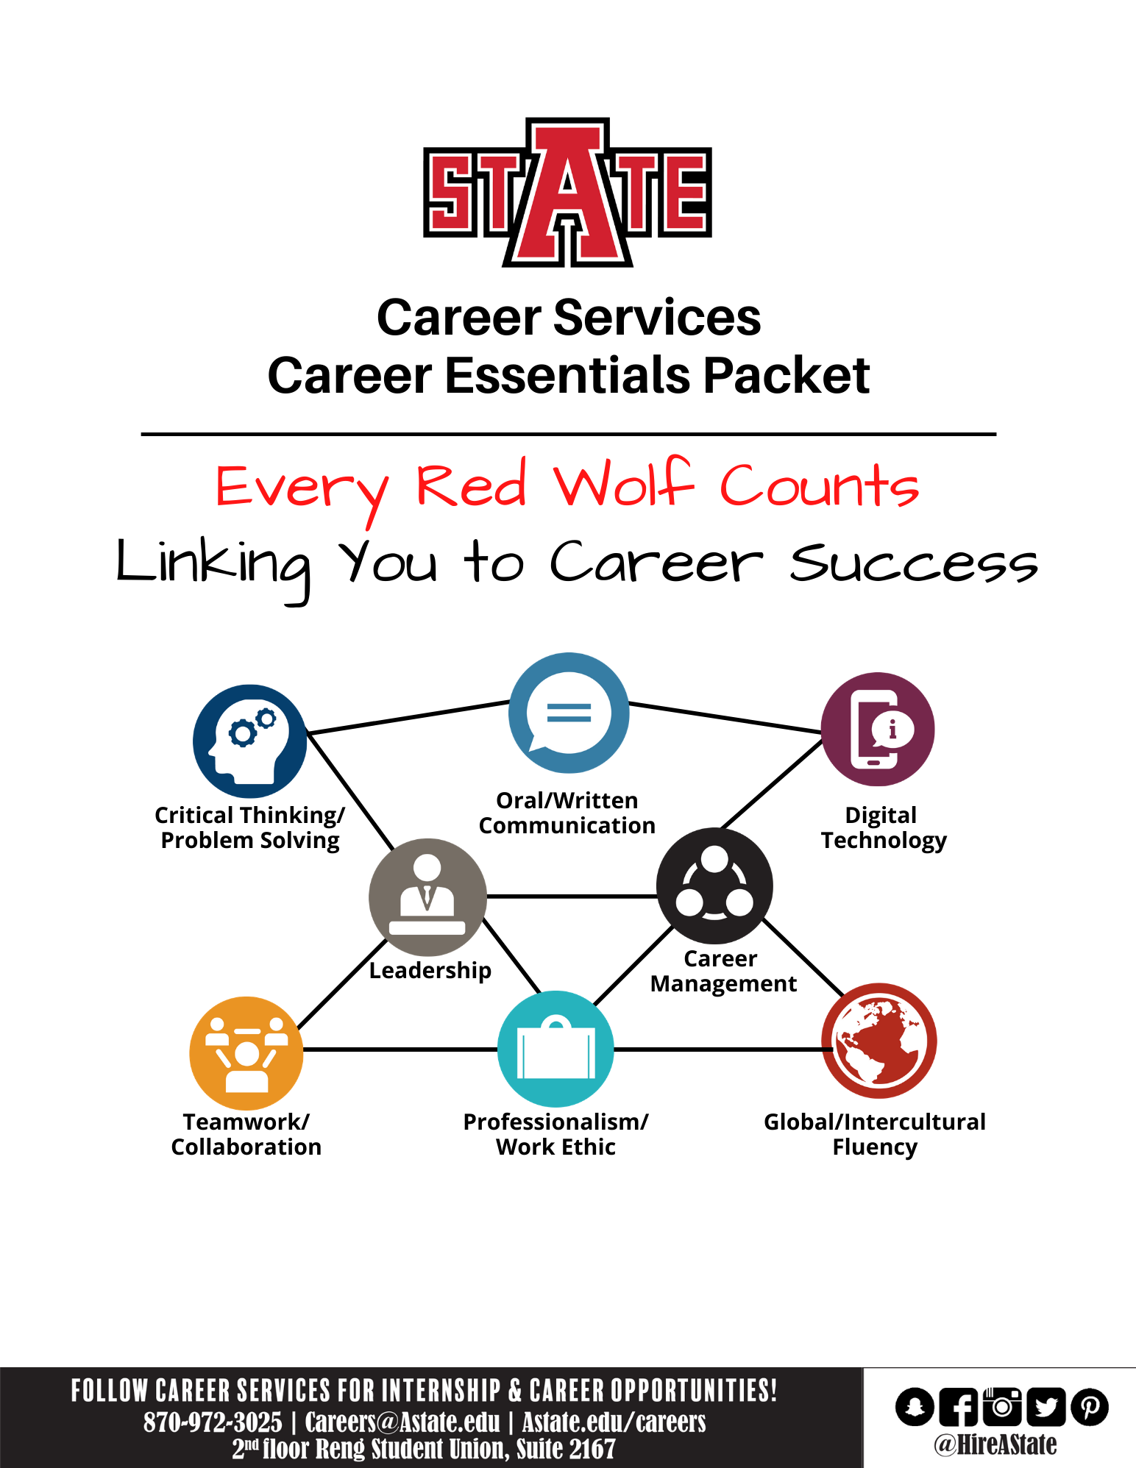
Brief summary of education, skills, abilities, and experience
Directs the interview conversation
Constructed to the position for which individuals are applying
Tool used to market a candidate as the best fit for a job/position

Slide 5

Employers want to see these attributes on students’ resumes
Communication skills (written)
Problem – solving skills
Ability to work in a team
Initiative
Analytical/quantitative skills
Strong work ethic
Communication skills (verbal)
Leadership
Detailed oriented
Technical skills
Data for the Job Outlook 2019 survey were collected from August 1, 2018, through October 8, 2018.
https://www.naceweb.org/talent-acquisition/candidate-selection/employers-want-to-see-these-attributes-on-students-resumes/

Slide 6
High Impact Practices (HIPs)
High-impact practices, or HIPs, are active learning practices that promote deep learning by promoting student engagement as measured by the National Survey on Student Engagement (NSSE).
First-Year Experiences
Common Intellectual Experiences
Learning Communities
Writing-Intensive Courses
Collaborative Assignments and Projects
Undergraduate Research
Diversity/Global Learning
ePortfolios
Service Learning, Community-Based Learning
Internships
Capstone Courses and Projects
Association of American Colleges and Universities
https://www.aacu.org/resources/high-impact-practices

Slide 7
Model 1: Train the Trainer
Phase I. Academic Advisors will learn key skills on how to start student resumes and reflect the application of HIPs.
Phase II. Integrate career development in academic advising appointments/sessions.
Phase III: After the initial appointment, students will be referred to Career Services for further assistance.

Slide 8
Model 2: Online Career Services through Black Board (BB)
Phase I: Design BB course page to train online students on how to apply HIPS on their resumes.
Phase II: Provide additional resources to teach career development in a virtual space through Candid Career Videos, online resume appointments, and career exploration/preparation via Career Services’ online career management tool.

Slide 9
Office of Assessment Approved Resume Rubric
    Likert scale of 1-5; 1 = lowest, 5=highest
Style and appearance
Grammar, Spelling, and Punctuation
Contact Information
Objective/Summary (optional)
Education
Experience
Skills/Qualifications
Awards/Honors/Activities/Community Service/Volunteer Experience/Leadership Experience

Slide 10
Anticipated Outcomes
Models 1 and 2 activities should increase awareness of Career Services, impact internship and full-time employment placement, and meet Arkansas State University’s Learning Objectives II.

