Slide 1



ASSESSMENT OF PROJECT-BASED EFFECTIVE LEARNING
Roadway Safety Problem
53 Students
2/3 Persons/Gr.
8 Elementary Schools in/around Jonesboro
Questions
Pre-test
Traditional Learning
Post-test
Active Project-based Learning
Hypothesis: Students’ learning is expected to improve through collaborative environment
Investigator: Dr. Zahid Hossain, P.E.
Associate Professor of Civil Engineering

Slide 2
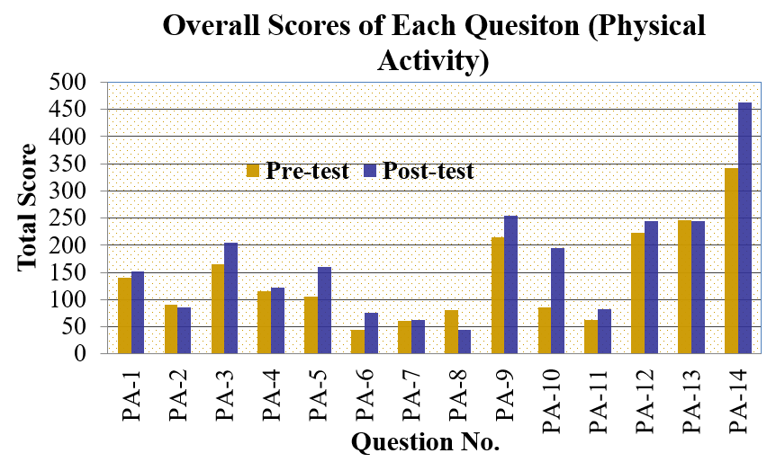
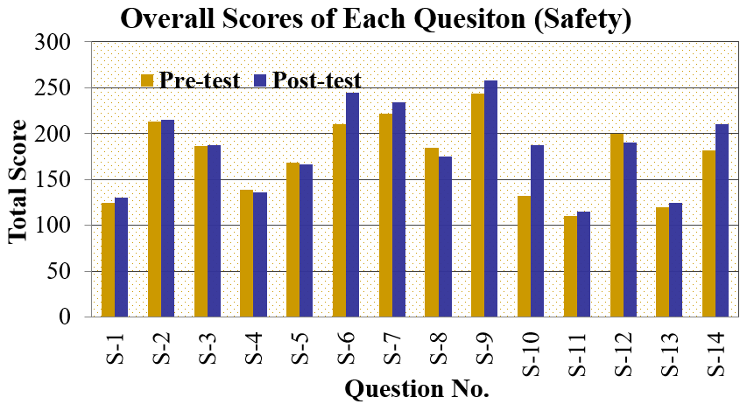
RESULTS
Students’ learning improved in most questions

Slide 3
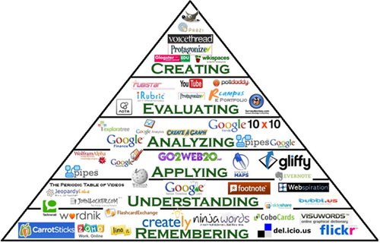
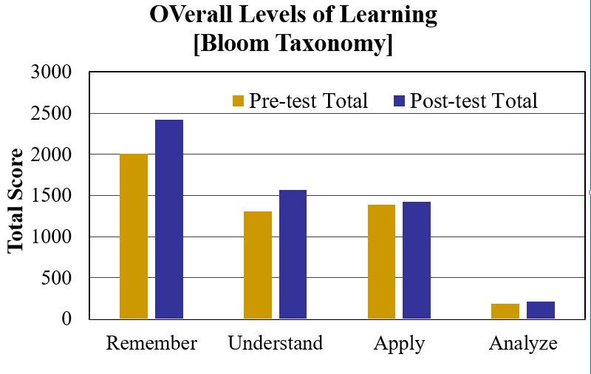
RESULTS
  Significant increase in Remember, Understand questions
  Slight increase in Apply and Analyze questions.
  Learning did not vary significantly (@95% confidence) between groups.
  Hypothesis is true

Slide 4

ACKNOWLEDGMENTS
A-State Office of the Assessment Program for the Mini grant
Transportation classes and GA (Ariful Islam)

