Slide 1

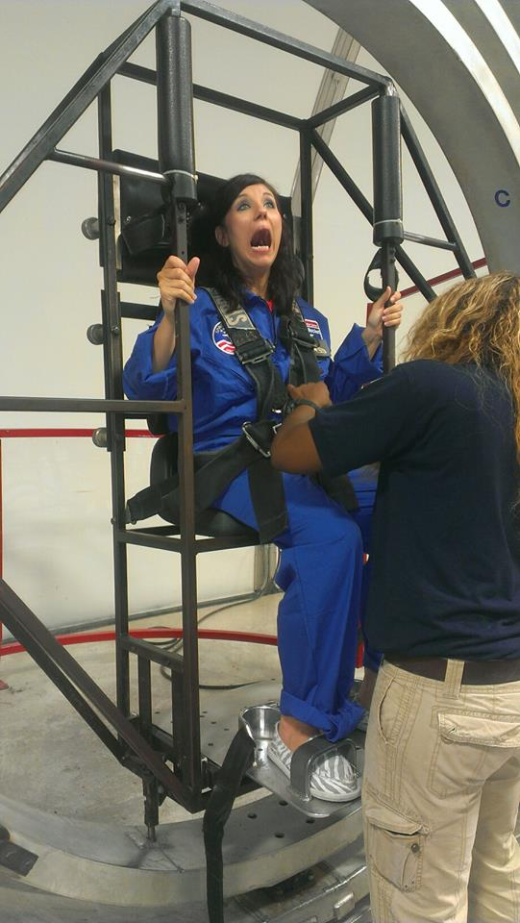
MISSION TO MARS
Sharing the Common Core Shifts…..
with Parents
YOUR FLIGHT COMMANDER:
ALI WEIMER
2013 Arkansas Teacher of the Year
Notes:
Space Camp Story- my inspiration- tell about how you have to pick a

Slide 2

Allow me to introduce
myself

Slide 3
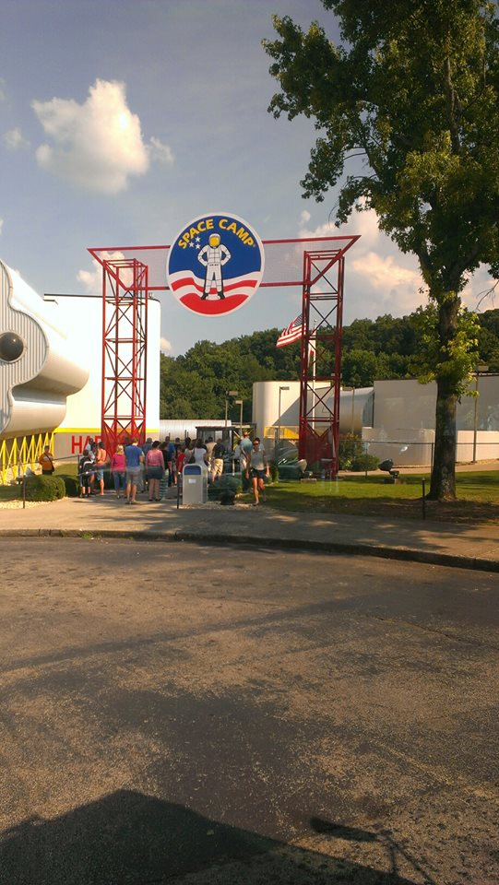
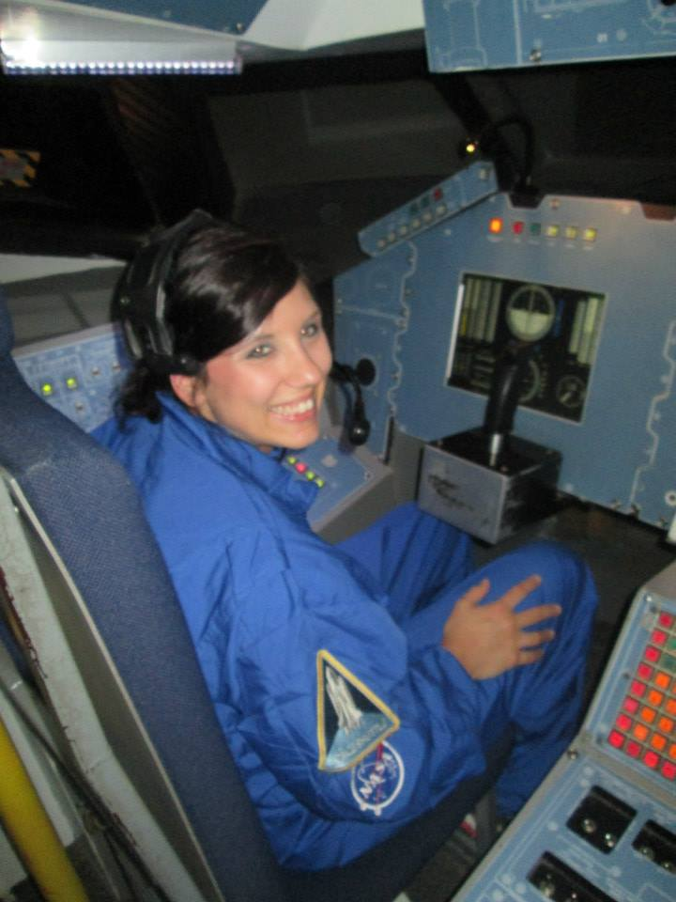
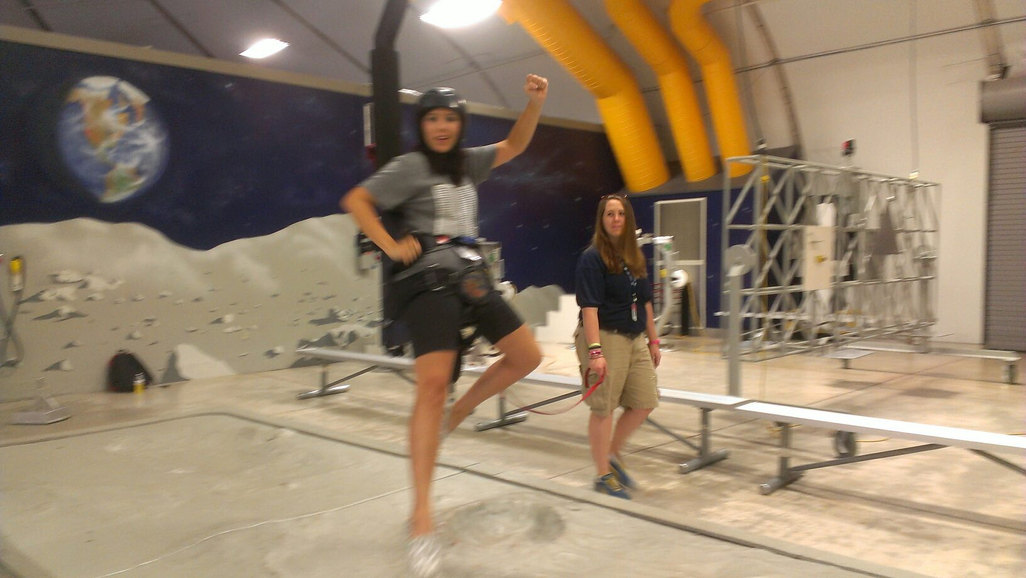

Slide 4
OUR MISSION OBJECTIVE:
To go where no man has gone-
into the uncharted territory of authentic parental involvement.
To colonize this unpopulated area for the betterment of all little Martians.

Slide 5
Eptstein’s Six Types of Parental Involvement
Parenting
Communicating
Volunteering
Learning at Home
Decision Making
Collaborating with Community

Slide 6
Communicating
http://www.cgcs.org/domain/36
http://www.pta.org/files/PTA%20Arkansas%20Assessment%20Guide.pdf
http://pta.org/parents/content.cfm?ItemNumber=2910
http://www.parenttoolkit.com/index.cfm?objectid=313B2E50-2088-11E3-8EC10050569A5318

Slide 7
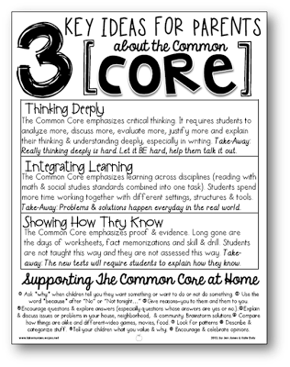
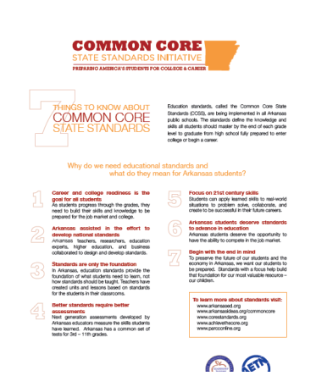

Slide 8

Making your classroom without walls!
Building
Bridges
Between
School & Home
with
Tubs, Bags, & More!
Notes:
Space Camp Story- my inspiration- tell about how you have to pick a

Slide 9



Staying Connecting
Have you thought about communicating through these platforms?
What are the Pros & Cons?
What are the DOs and DON’Ts?

Slide 10

Parent-Teacher Communication
Parent-Teacher Collaboration

Slide 11
Why?
Parent-Teacher Collaboration
The kind of parent involvement that most benefits students is tied to what they’re learning in the classroom, according to Anne Hendersen, top expert in the field of parent involvement.

Slide 12
Why?
Parent-Teacher Collaboration
85% of parents spend 15 minutes helping their children at home. But, would be willing to spend an average of 40 minutes a night helping their children if they had directions from the teacher about how to help their child.

Slide 13


Slide 14
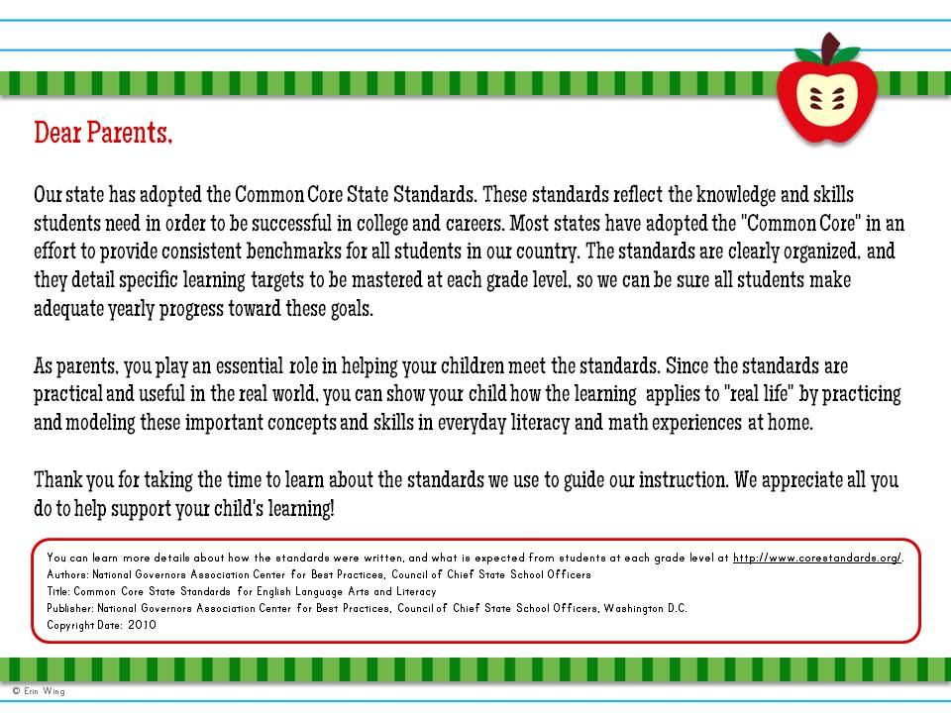

Slide 15
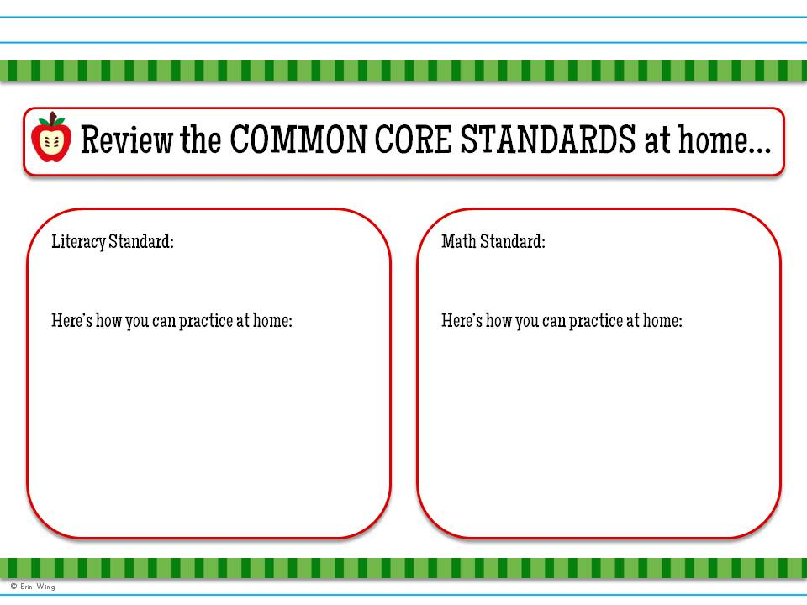
Type standard here.
Type standard here.
Type a simple activity idea here.
Type a simple activity idea here.

Slide 16


Slide 17
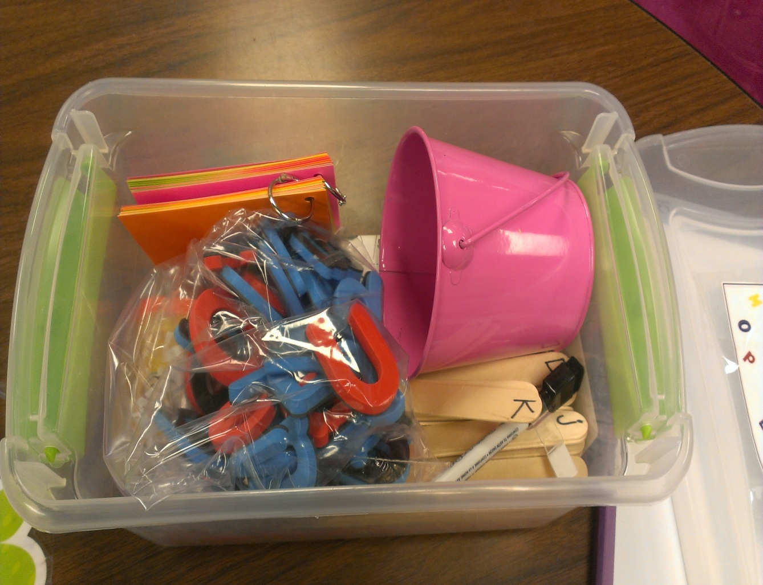
Take Home
Take-Home Tubs at a Glance:
Targets 1 or 2 specific learning skill(s) at a time
Fun, game like activities for parents to use at home (all materials included)

Slide 18
ELA Big Shift #1-
Appropriate Text Complexity
Students have extensive opportunities to engage with complex texts.

Slide 19

ELA Big Shift #1-
Appropriate Text Complexity
myON reader allows families without Internet access to download up to 20 books using a free iTunes app, while at school or near a community hot spot and read them offline.

Slide 20
ELA Big Shift #2-
Increased Reading of Informational Text
Throughout the school day, students at K-5 read a balance of 50% literature and 50% informational texts

Slide 21

ELA Big Shift #2-
Increased Reading of Informational Text
Take Home
Literacy
Bags

Slide 22
ELA Big Shift # 3
Disciplinary Literacy
Students read, write, and speak about discipline-related topics to build content knowledge. In the early grades, students read informational texts that include historical, scientific, and technical texts to prepare for the demands of reading discipline-specific texts in later grades. At grades 6-12, students grapple with discipline-specific complex texts that deepen their understanding of a topic and develop an understanding of the norms and conventions of each discipline; they demonstrate mastery by applying that knowledge when writing or speaking.

Slide 23
ELA Big Shift #7-
Argumentative Writing
Throughout the school day, all students write about topics or texts, some of which have differing viewpoints. In grades K-5, 30% of student writing should be writing opinions. In grades 6-8, 35% of student writing should be writing arguments in which they support claims with reasons and evidence. In grades 9-12, 40% of student writing should be well-developed arguments.

Slide 24

Friday Journals
ANCHOR STANDARD
Write arguments to support claims in an analysis of substantive topics or texts using valid reasoning and relevant and sufficient evidence.
Grade Specific Standard: CCSS 2nd Grade W.2.1-
Write opinion pieces in which they introduce the topic or book they are writing about, state an opinion, supply reasons that support the opinion, use linking words to connect…..

Slide 25
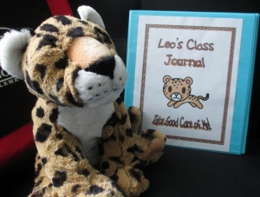
Class Mascot Writing Project
ANCHOR STANDARD
CCSS.ELA-Literacy.CCRA.W.3
Write narratives to develop real or imagined experiences or events using effective technique, well-chosen details and well-structured event sequences.
Grade Specific Standard: CCSS.ELA-Literacy.W.3.3b
Use dialogue and descriptions of actions, thoughts, and feelings to develop experiences and events or show the response of characters to situations.

Slide 26

Are you into blogging?
Anchor Standard:
CCSS.ELA-Literacy.CCRA.W.6
Use technology, including the Internet, to produce and publish writing and to interact and collaborate with others.
Grade Specific Standard:
CCSS-Writing: W.3.6
With guidance and support from adults, use technology to produce and publish writing (using keyboarding skills) as well as to interact and collaborate with others.

Slide 27
ELA Big Shift #8-
Short and Sustained Research Projects
Students conduct research, both short and long term, in which they synthesize information from many sources, construct knowledge, use technology when appropriate, and present findings in a variety of formats.

Slide 28
ELA Big Shift #8-
Short and Sustained Research Projects
Black History Month
Autobiography Project
1st Grade

Slide 29

Sharing Math Shifts through
T.E.A.M.
Activities
More learning time in kindergarten should be devoted to number than any other topic. In order to devote this time, some things that were in the Arkansas Mathematics Frameworks for Kindergarten are not found in the CCSSM.

Slide 30

Team Talks
Call to Action
Q & A
Time
to
Talk

Slide 31
Let’s Stay Connected!
  Email Ali at aweimer13@gmail.com
  Follow Ali on Facebook:
  https://www.facebook.com/2013ArkansasTeacherOfTheYear
  Follow me on Pinterest: Ali Weimer
  Parental Involvement Wiki
  http://atoy.pbworks.com

