Slide 1
The Prediction of National Physical Therapy Examination First Time Pass Rates Using Reading Comprehension and Critical Thinking Skills Tests
Latoya green

Slide 2
Relevance to Higher Education
Increasing mean average enrollment rates in physical therapy (PT) and physical therapist assistant (PTA) programs.
Increasing demand to predict first time pass rates on the National Physical Therapy Examination (NPTE).
Need more research on the combined use of reading comprehension and critical thinking skills for assessing physical therapy and physical therapist assistant students.

Slide 3
Purpose of Study
Will the Nelson Denny Reading Test (NDRT) and Health Sciences Reasoning Test (HSRT) predict first time pass rates on the NPTE in physical therapy and physical therapist assistant programs at Arkansas State University?

Slide 4
Nelson Denny Reading Test (NDRT)
a standardized reading test that measures the reading ability of high school and college students.
consists of vocabulary and comprehension sections.
vocabulary portion has 80 multiple choice questions with five possible answer choices.

Slide 5
Nelson Denny Reading Test (NDRT)
Fifteen minutes are allowed for the completion of this portion of the exam.
The comprehension portion consists of five to eight passages from which students must answer three multiple choice questions based on content of those passages.
Students are given 20 minutes to complete this portion of the exam.

Slide 6
Health Sciences Reasoning Test (HSRT)
a critical thinking test written specifically for health care.
Questions are set within a health care context.
The test is a multiple-choice test that is administered with 45 to 50 minutes.
The test contains five subscale critical thinking areas: analysis and interpretation, inference, evaluation and explanation, deductive reasoning, and inductive reasoning.

Slide 7
Methodology
Physical Therapy students

Slide 8
Methodology
Physical Therapy Assistant students

Slide 9
Methodology
The study will conclude after each physical therapy and physical therapist assistant student has completed his/her respective board exam. The anticipated conclusion date for this study is February 2021.

Slide 10
Results
For the DPT class of 2017, cumulative GPA was the only predictor variable that was significant (p = .019) with the NPTE. Cumulative GPA was also more highly correlated with the NPTE (r = .579) than the other two predictor variables. The combination of HSRT, NDRT and GPA variables could not predict first time attempt success on the NPTE any better than GPA alone.

Slide 11
Results
For the PTA class of 2017, cumulative GPA (p = .001) was significant with the NPTE. Cumulative GPA (r = .612) showed a stronger relationship with the NPTE than the HSRT (r = .408) and NDRT (r = .252). Thirty-eight percent of the variance in the NPTE could be accounted for by the combined predictor variables. Cumulative GPA was the strongest predictor.

Slide 12
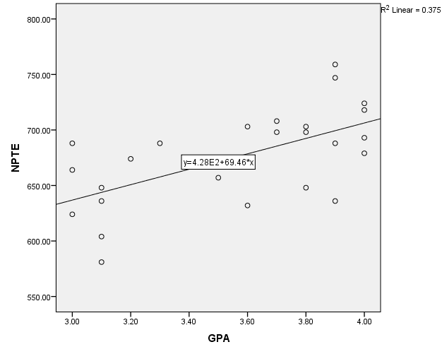
Results
Figure 1. GPA and NPTE relationship for PTA students

Slide 13
Summary and Conclusion
The DPT class of 2017 had a 100% first time pass rate on the NPTE; however, the results of this study did not identify any model/combination of variables that could predict NPTE scores any better than GPA. In contrast, the NDRT, HSRT, and GPA could moderately well predict first time pass rates on the NPTE for the PTA class of 2017. In conclusion, students who perform well, in terms of academic performance, in either the DPT or PTA curricula have a higher likelihood of passing the NPTE on the first attempt. Additionally, the NDRT and the HSRT may be useful predictor variables for PTA students challenging the NPTE.

Slide 14
Anticipated Benefits
If a correlation exists between the NDRT, HSRT, and the NPTE, then early intervention can be provided for at risk students.
The subjects could gain insight to their reading level and critical thinking ability; hence, gaining insight will allow subjects to seek guidance to improve their reading and critical thinking skills. Society could benefit from this research if the NDRT and HSRT can predict first time pass rates on board exams; implementing these tests prior to a student’s matriculation through either the PT or PTA program could lead to early intervention and an increased likelihood of first time pass rates.

