Slide 1
Cats vs Dogs
Jamie Jamison
Making Connections
Annie Everette

Slide 2
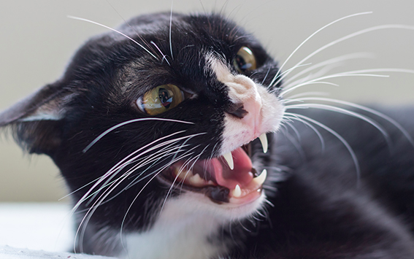
Dogs are a mans best friend

Slide 3
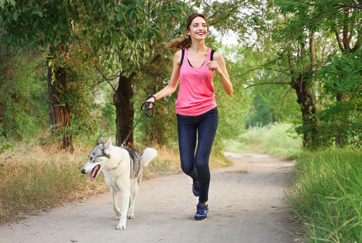
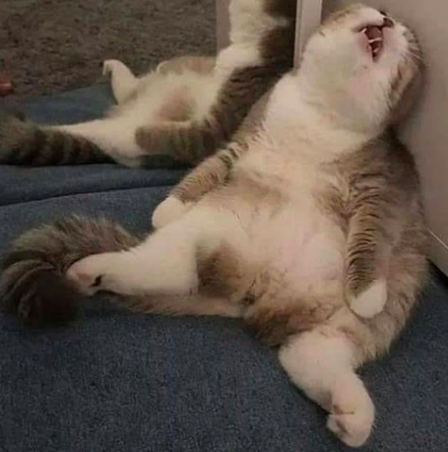
Dogs keep you in shape

Slide 4
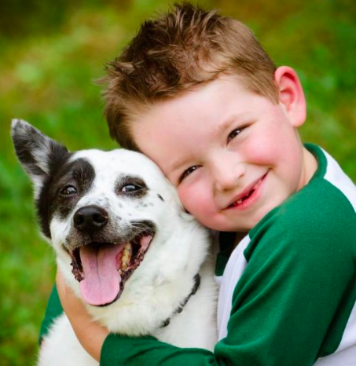
Dogs help learn responsibility

Slide 5
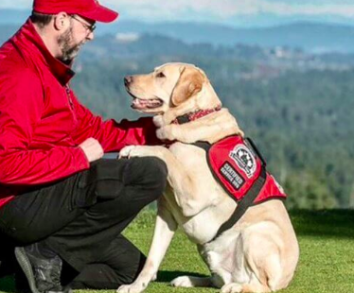
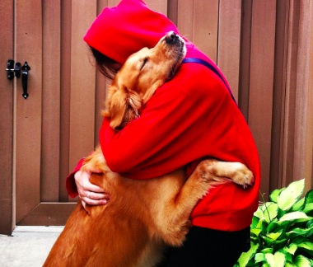
Dogs can help mentally

