Slide 1
I Believe Essay
By Eayn Shelley

Slide 2
I Believe In Friendly disagreements…
It is estimated that we make around 35,000 choices a day!

Slide 3
There is bound to be at least ONE person
That does something that might irritate you

Slide 4
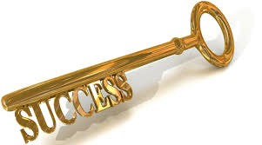
But It Is How You React and Respond
That is very important.
We should not judge someone based on a personal disagreement, because we don’t know their background, how they were raised, or anything else about them.

Slide 5
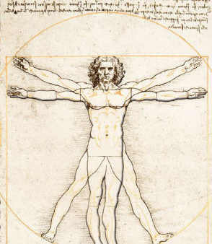
Humans all together as a species
Need to focus on bettering ourselves rather than magnifying someone else’s opinion you disagree with.

Slide 6
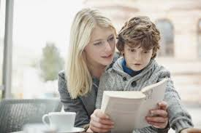
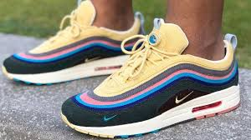
Ever Since I Can Remember
My mom has stressed the importance of empathy and sympathy.
She said with any debatable topic you HAVE to be able to put yourself in the other persons shoes.
empathy
&
sympathy

Slide 7
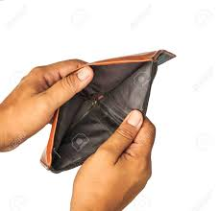
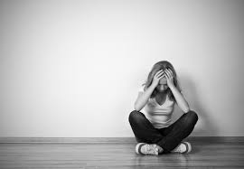
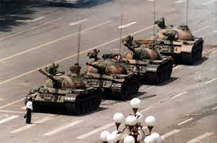
Think of their financial situation
Their Social situation
And how strongly they stand for something.

Slide 8
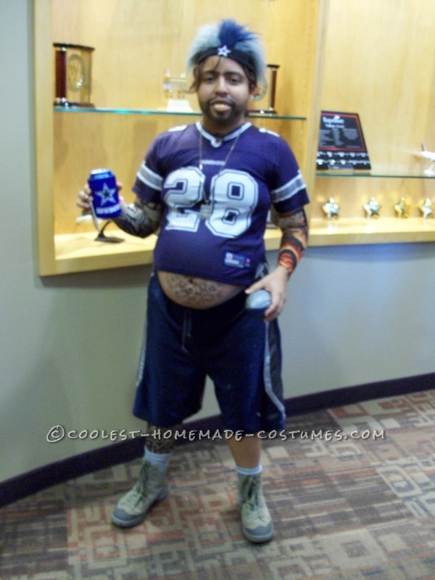
If there is one thing almost nobody likes
It is someone who cannot take a differing opinion
Being close minded in any dispute is going to further you from finding a solution

Slide 9
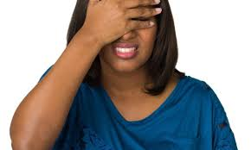
Imagine if a touchy subject came up
And someone has a personal experience with it
Somebody else is making jokes about it or being vile and offensive
That can make the person feel worthless.

Slide 10
I took APUSH My Junior Year of High School
And I feel like the class helped me with the communication skills, necessary for debating topics professionally.

Slide 11
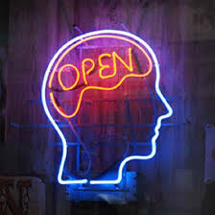
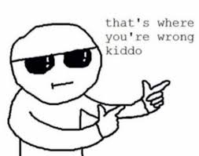
I would’ve said I was pretty open minded
When it came to controversial topics at the time
But there were many people in class that disagreed with me

Slide 12
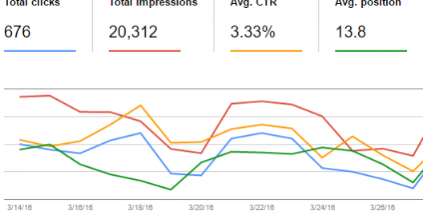
Instead of Being Rude
They showed me via statistics and facts
That I was just being an imbecile.
I completely changed my opinion and I humbled myself.

Slide 13
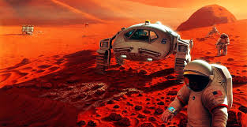
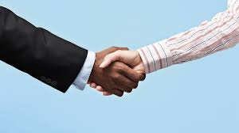
I Believe That..
If we want to grow stronger mentally and physically as a species and do things our ancestors only could’ve dreamed of….
then its gonna have to start with being able to have a friendly disagreement.

