Slide 1
I believe the world should be more accepting
By Caitlyn huff
Notes:
i believe that the would should be more accepting. The world has changed tremendously over the years, but in recent months the world has been like nothing we have ever experienced before. These last few months have been nothing but devastation and destruction

Slide 2
Notes:
Back in March, when COVID-19 had its significant outbreak and the world completely shut down to try and stop the spread of the virus. A few months after the world had shut down, it started to open back up again. Shortly following came the death of one man named George Floyd

Slide 3
Notes:
George Floyds death was caused by a local police officer who was prejudiced and racist .Mr. Floyd was accused of trying to use a counterfeit bill; this caused the police to be brought in.

Slide 4
Notes:
After they had put Mr. Floyd in handcuffs, the officer then continued to place him on the ground and put his knee on Mr. Floyd's neck, causing him not to be able to breathe. All it took was three minutes. Without oxygen to the brain for three minutes, the brain can not function. This would bring the world to what we know today.

Slide 5
Notes:
There have been so many different versions of the story, but the main one is Mr. Floyd was brutally killed by one main police officer who has since been charged with murder. Yes, I believe that the police officer should face the worst punishment, but the events that have followed have not been acceptable.

Slide 6
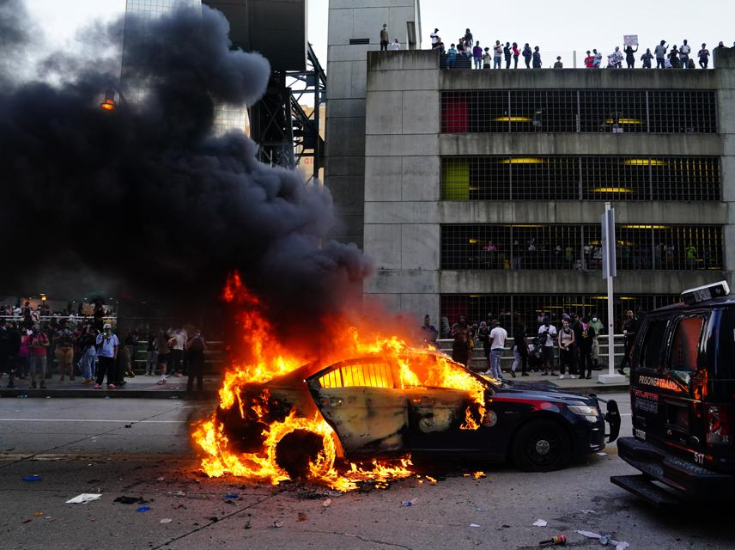
Notes:
Many people have taken office to this ONE person's view, but not considered others. There has been mass destruction in Minneapolis, Georgia, and many other states. Many people have destroyed innocent people's businesses and homes all in a fit of rage over what one person has done. I believe that there is a way to get your point across, but not this way.

Slide 7
Notes:
I believe that there are some good cops and some bad cops. Do I believe that all cops are bad? No. What I do believe is that the killing of other cops and people, in general, is wrong.

Slide 8
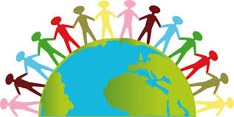
Notes:
I believe that the word should be more acceptable to other people's views and beliefs. People are being critized for believing things; not everyone has the same opinions on. In this world, people are taught to believe how you think something should be done or handled and do not let anyone tell you differently.

Slide 9
Notes:
Many people disagree on certain things, that is understandable, but the fact of causing this mass riots and destruction of these cities is entirely wrong. I believe that everyone should have an open mind, I'm not saying that everyone just believe in one thing. I am saying to respect other peoples opnion.

Slide 11
Notes:
I believe that this world should be more acceptable to other people's views and opnions.

