Slide 1
THE WAY OF THE WOLF
Academic Expo Presentation
By
HPES 1013-002, Intro to HPESS

Slide 2
PRESENTATION CONTENT
HPESS Majors Mission Statement
Project Objective
Exercise & Physical Activity Data
Benefits of Physical Activity
Physical Activity Requirements
Guidelines for Safe Physical Activity
Exercise / Physical Activity Plans
Conclusion
Resources

Slide 3
HPESS MAJOR’S MISSION STATEMENT
As HPESS majors, WE BELIEVE in encouraging individualized, age-appropriate physical activity to promote health and wellness for people of all demographics.

Slide 4
PROJECT OBJECTIVE
Red Wolves are highly territorial and guard their pack against intrusions.
HPES 1013 are members of the “A-State Pack”
Our objective is to protect members of our “Pack” from the intrusions of “Physical Inactivity”
HPES 1013 mobilized under the common theme of “Way of the Wolf”
HPES 1013 created instructional exercise materials for the A-State Pack in an effort promote physical activity

Slide 5
EXERCISE & PHYSICAL ACTIVITY DATA
Percent of adults aged 18 and over who met the Physical Activity Guidelines for aerobic physical activity: 53.3%
Percent of adults aged 18 and over who met the Physical Activity Guidelines for both aerobic and muscle-strengthening activity: 23.2%
Source: https://www.cdc.gov/nchs/fastats/exercise.htm

Slide 6
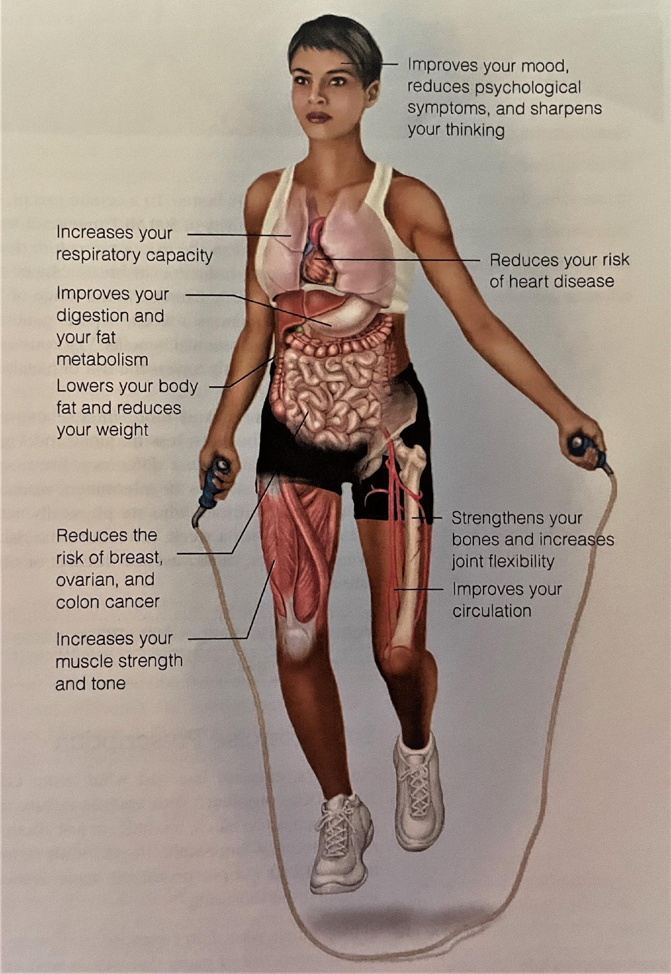
BENEFITS OF PHYSICAL ACTIVITY
Regular physical
activity enhances
your overall
physical and
mental
health and helps
prevent disease.
Source: U.S. Dept. of Health and Human Services, www.hhs.gov
www.hhs.gov

Slide 7
PHYSICAL ACTIVITY RECOMMENDATIONS
Source: www.acsm.org

Slide 8
GUIDELINES FOR SAFE PHYSICAL ACTIVITY
Choose types of physical activity that are appropriate for your current fitness level and health goals.
Increase physical activity gradually over time to meet key guidelines or health goals.
Inactive people should “start low and go slow” by starting with lower intensity activities and gradually increasing how often and how long activities are done.
Protect yourself by using appropriate gear and sports equipment, choosing safe environments, following rules and policies, and making sensible choices about when, where, and how to be active.
Consult a healthcare professional if you have chronic conditions or symptoms prior to initiating any physical activity regime.
Source: https://health.gov/sites/default/files/2019-10/PAG_ExecutiveSummary.pdf

Slide 9
EXERCISE / PHYSICAL ACTIVITY PLANS
Arms
Shoulders
Back
Abdominals
Legs
Cardio
Flexibility

Slide 10
ARMS
Goal/ Objective:
The goal of our arm workout plan to is to strengthen and tone your core as your
abdominal muscles engage when you perform the repetitions.
Benefits:
The benefits or arm exercises are endless. Simple exercises can enhance your workout, have a positive impact on heart health, and strengthen your bones.
Risks:

Slide 11
ARMS
Risks:
As for the risks, there are some arm exercises that may involve fast or repetitive twisting, or long-lasting or held movements which are best to be avoided because they can cause damage to bones and muscles. When deciding if any exercise is safe, you need to consider the technique and the load, as well as your personal circumstances, such as any previous injuries and your fitness level.

Slide 12
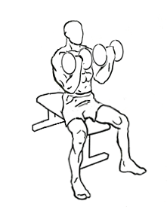
ARMS WARM-UP
30 Seconds of pull ups
30 Seconds of “rows” (Row your arms as though you are rowing a boat. During second round - add weight.)
30 Seconds of bicep curls
Repeat 3x

Slide 13
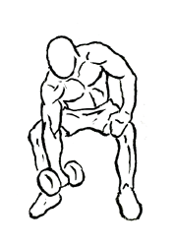
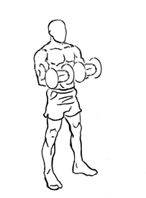
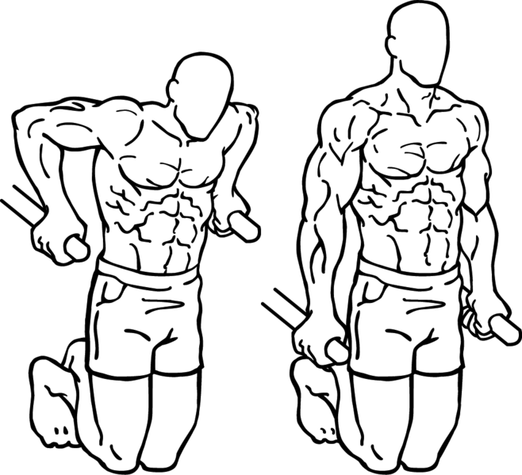
ARMS WORKOUT
Barbell Curls 3 sets of 10 reps (Barbell with your weight of choice held at your waist, and slowly raised to your chest.)
Concentration Curls 3 sets of 12 reps
Reverse Curls 3 sets of 12 reps
Dips 3 sets of 12 reps
Complete Workout Twice

Slide 14
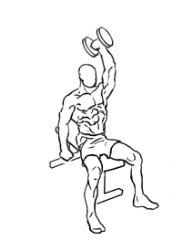
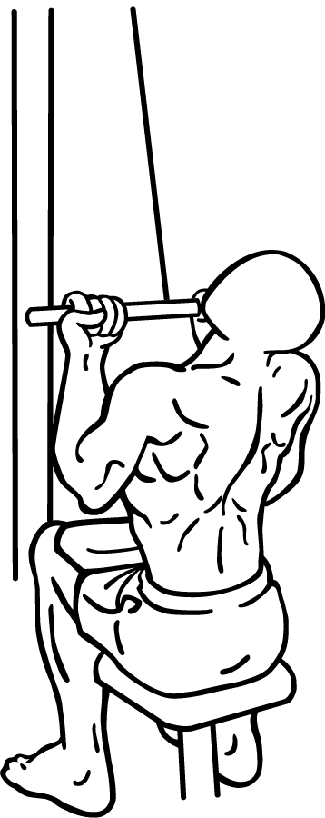
ARMS COOL DOWN
FIRST: Take a minute to stretch out your arms!!
30 Seconds of Dumbbell Extensions
30 Second Cable Pulls
30 Second Pull Ups
Repeat 2x
Encouragement: Never get discouraged if it feels like too much during the workout and you are getting too tired. Stop when you are tired and resume where you left off. It will eventually be a breeze!

Slide 15
SHOULDERS
Goals/Objectives:
This shoulders exercise is to not only strengthen your shoulders but
also upper back and chest.
Benefits:
The benefits or shoulder exercises are endless. Simple exercises can enhance your workout, have a positive impact on heart health, and strengthen your bones and shoulder joints.

Slide 16
SHOULDERS
Risks:
Just like any workout, there are certain risks.The risks are limited if you do the exercises correctly. Possible injuries would be pulled muscles or muscle cramps. These can be prevented by staying hydrated and stretching properly before and after the workout. Some shoulder exercises can be straining on the back and shoulder joints if you are not careful about overworking your body. Be sure to take breaks when necessary.

Slide 17
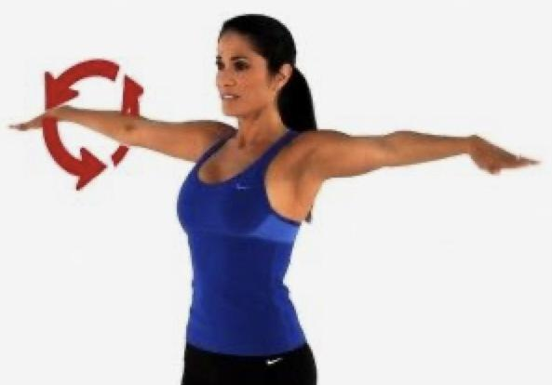
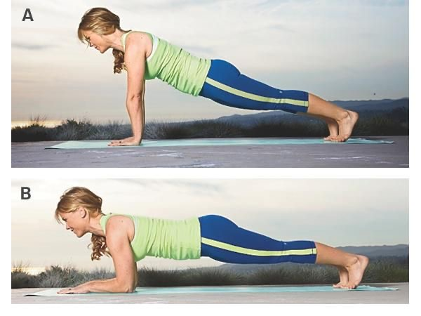
SHOULDER WARM UP
Shoulder Rotation 2 sets for 60 seconds (extend arms straight out, palms facing upward then rotate shoulders to turn palm face down)
Elbows to Arms Planks 2 sets for 60 seconds ( start in push-up position and transition into elbow plank position)
Crawling Plank 1 set for 60 seconds ( starting in push-up position walk arms closer to feet while keeping legs and arms straight)
stretch shoulders as needed for 3-5 minutes

Slide 18
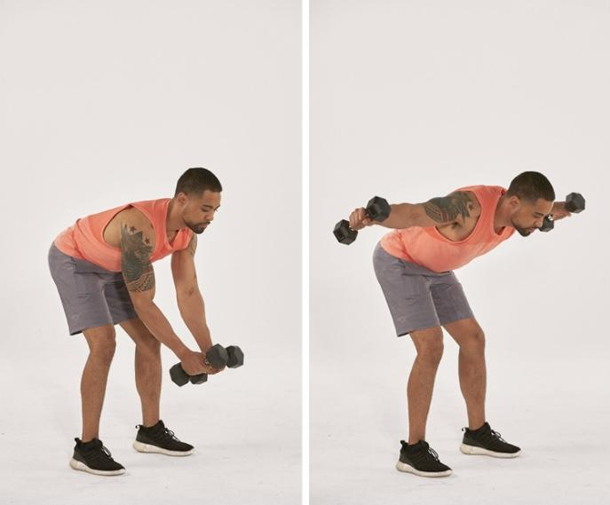
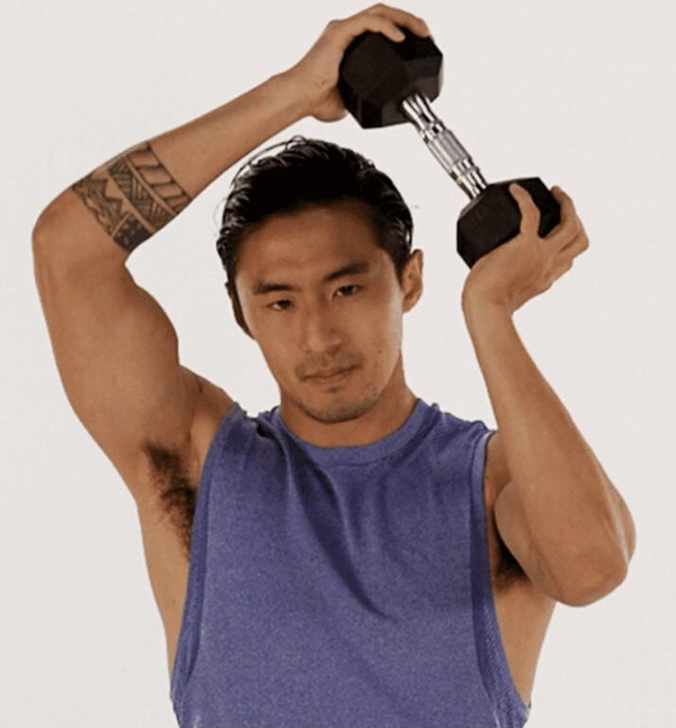
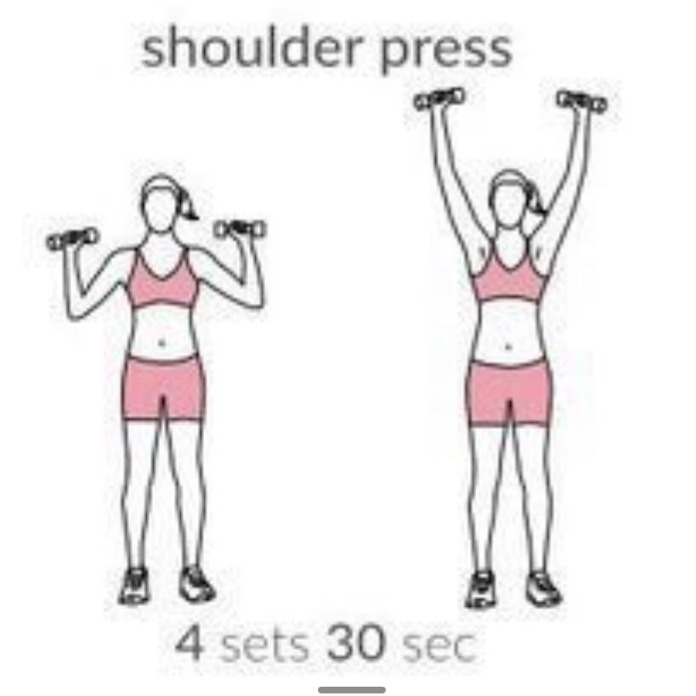
SHOULDER WORKOUT
Bend Over Lateral Raise with 5lb-15lb dumbbells 3 sets of 10 (bending forward 90 degrees at the hips and slightly bent knees raise your arms out to the sides and slowly back down)
Circle Chop with 10lb -20lb dumbbell 3 sets of 10 ( with dumbbell in hand using your shoulders rotate the dumbbell around your head)
Shoulder Press with 5lb-15lb dumbbells 3 sets of 10 ( standing straight up and arms out wide in an L shape slowly move your arms straight above your head in Y shape and slowly back down)
Push-ups 20 reps (elbows pointed back towards your legs lower you chest to the ground by bending arms slowly. Take breaks when needed or put knees down)

Slide 19
SHOULDER COOL DOWN/ STRETCH
Bring arm across body and pull it in with your other arm. Then switch to other arm
Put arm behind head making a triangle and pull hand with opposite arm.Then switch to other arm.
Cross arms by holding your own hand, then raise your arms over Then switch to other arm.
Rotate your arm forward in a giant circle. Then switch to other arm.
Rotate your arm backward in a giant circle. Then switch to other arm.
Shake out your arms.

Slide 20
BACK
Goal/Objective:
Strengthen muscles in the back
Gain lean mass and correct posture
Benefits:
Increase ability of mobility in the back and also helps to pull shoulders back making your posture stronger as you get older.
Potential Risk:
May come across a tear or strain if the exercise is not performed correctly and this may cause a good amount of discomfort making it harder to do daily activities.

Slide 21
BACK
Warm-up:
Foam roller back extension - 90 seconds
Touches toes and hold - 90 seconds
Cat/cow stretch - 60 seconds
Climb the ladder - 60 seconds
Spiderman stretch with rotation - 60 seconds each side
Standing medicine ball twists - 60 seconds

Slide 22
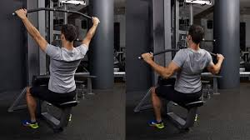
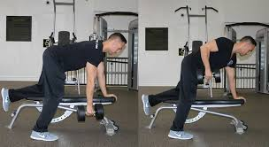
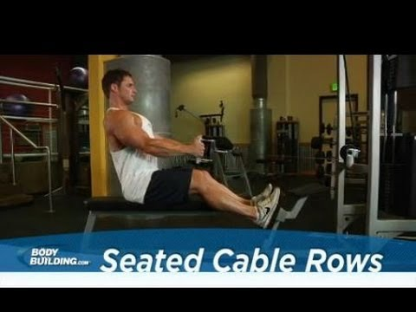
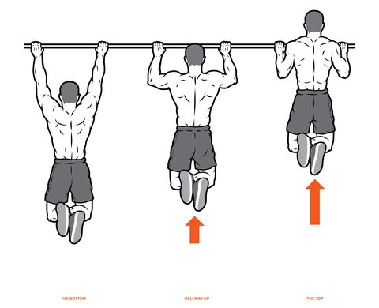
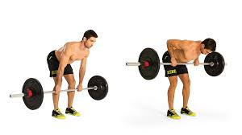
BACK
Workout:
Seated cable rows - 4 sets of 10
Pull ups - 4 sets AMRAP
Bent over barbell row - 3 sets of 8
Single arm dumbbell row - 4 sets of 10
Lat pulldowns with machine - 4 sets of 10

Slide 23
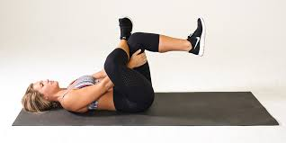
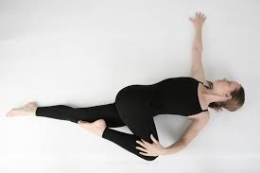
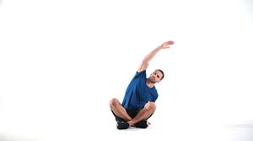
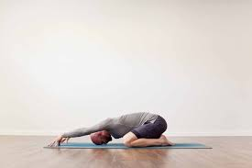
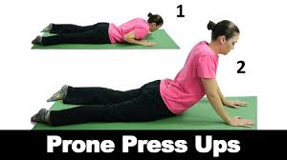
BACK
Cool down:
Figure 4 stretch - 30 seconds each side
Reclining twist - 10 seconds each side 3x
Child’s pose - 60 seconds
Seated side stretch - 60 seconds each side
Press up - 60 seconds

Slide 24
ABDOMINALS
Goal/Objective:
Strengthen core muscles
Gain confidence
Benefits:
Help build strength and endurance in the abdominal muscles which can help with improved posture, reduce back pain, improve balance and stability, and potentially assistance with breathing.
Potential Risk
Ab workouts can cause back pain if done incorrectly as well as you can strain a muscle.

Slide 25
ABDOMINALS
Warm-up:
90 second Jump Rope
60 second High Knees
30 second Jumping Jacks
30 second Mountain Climbers
60 second Criss-Cross Crunches
60 second Standing Side Crunch

Slide 26
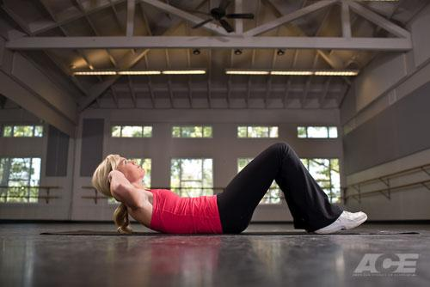
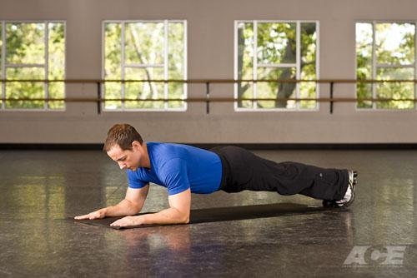
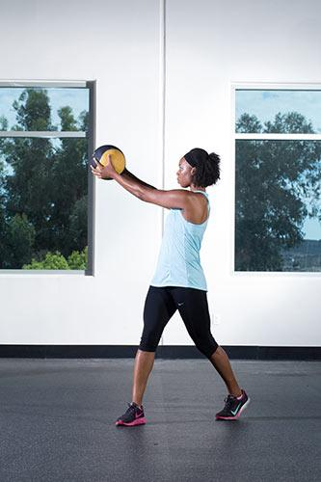
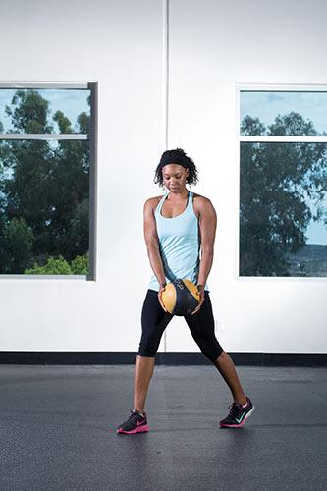
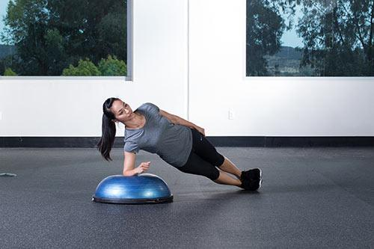
ABDOMINALS
Work out:
3 sets of 20 Crunches
60 second Front Plank
30 second right and left Side Plank
3 sets of 20 each side Standing Hay Baler
Crunches
Standing Hay Baler
Front Plank
Complete Workout Twice!
Side Plank

Slide 27
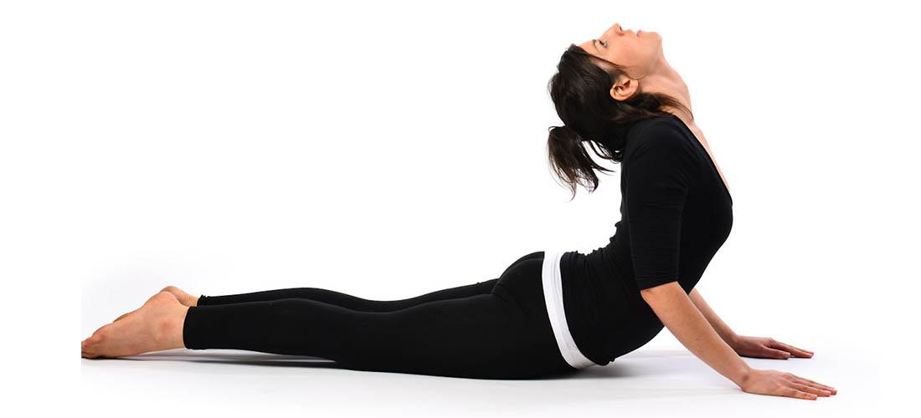
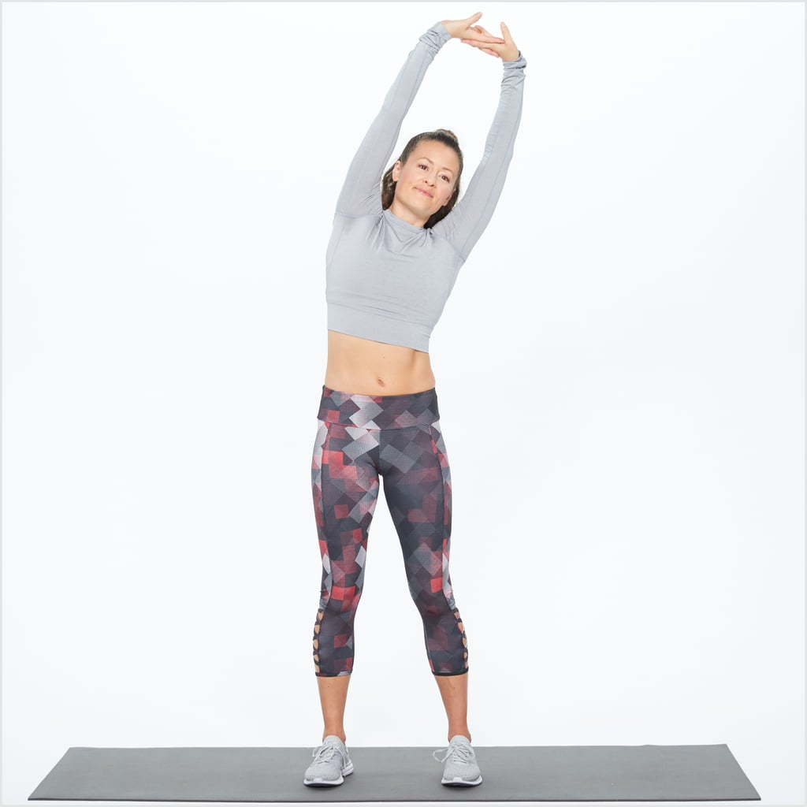
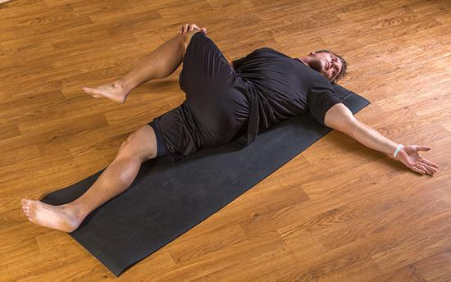
ABDOMINALS
Cool-down:
60 second Cobra Stretch
30 second each side Side Stretch
30 second each side Supine Spinal Twist Stretch
Encouragement/Motivation:
Bring friends or a workout partner to help keep you motivated and encourage you to keep going when it gets hard!

Slide 28
LEGS
Goal/Objective:
Aim to make your legs toned and most importantly strong. Stronger legs will significantly improve your performance of other workouts, including popular cardio training sessions such as running, walking and jogging.
Benefits:
Stimulates hormones
Balance Strength
Engages Core
Improves overall fitness
Potential Risks:
Possible injury if done incorrectly, especially of the knees

Slide 29
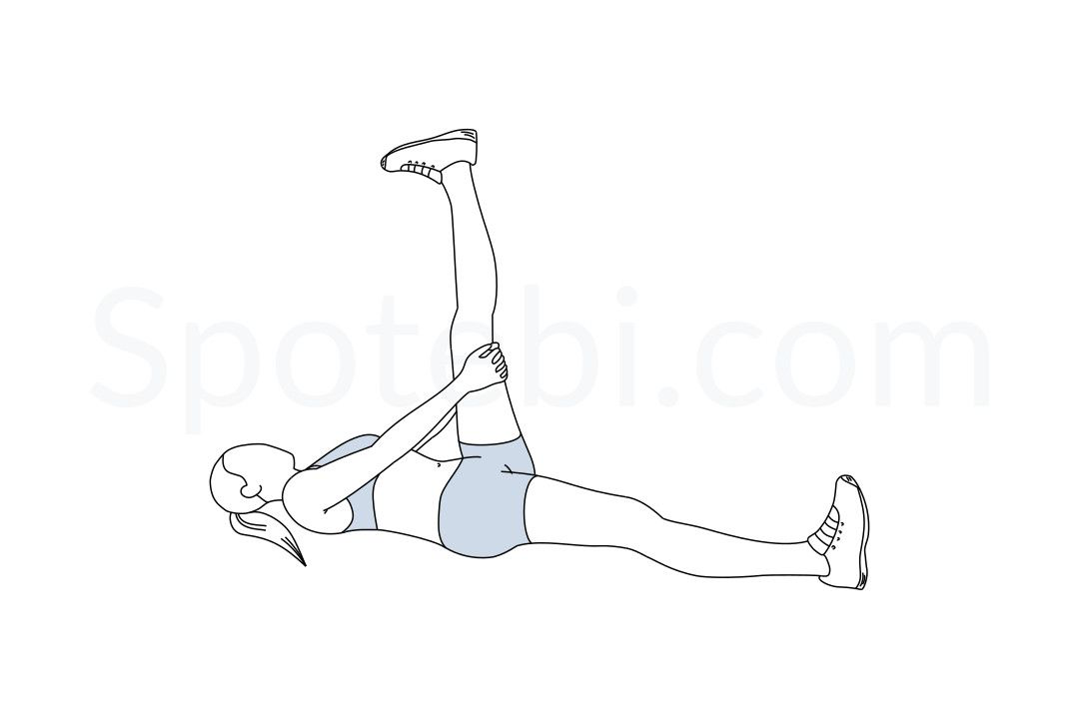
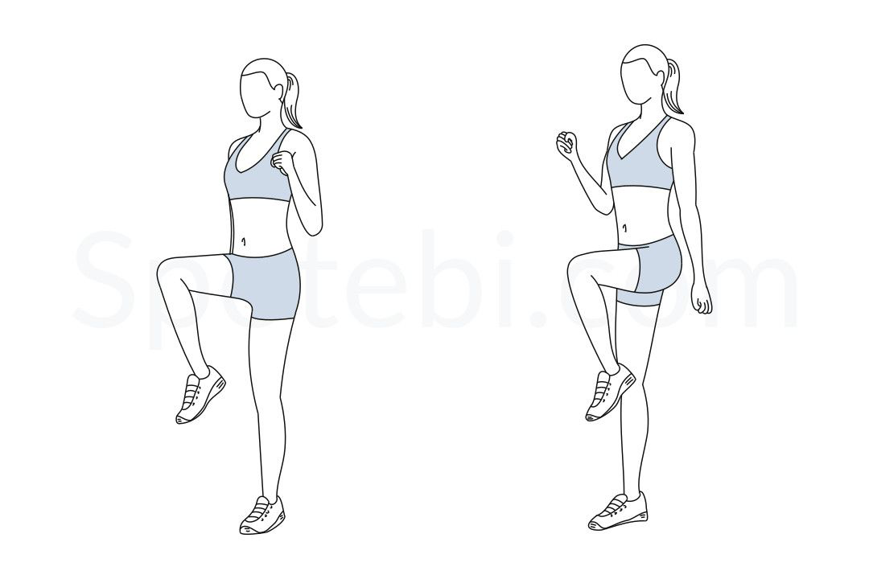
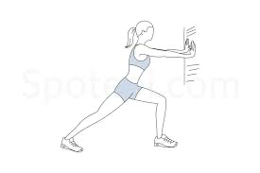
LEGS
Warm-up:
Hamstring stretch (30 seconds on each side)
High knees (30 seconds)
Wall Calf Stretch (30 seconds on each leg)

Slide 30
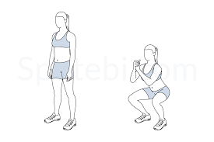
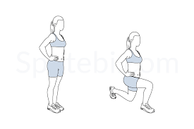
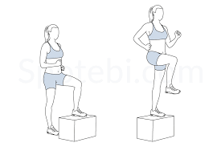
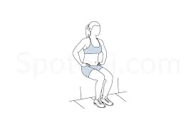
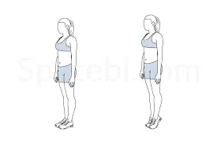
LEGS
Activities:
Complete circuit 3x: (weights are optional)
Body Squats (10)
Lunges (10 each leg)
Step-ups/Box Steps (10 each leg)
Wall Sits (30 seconds)
Calf Raises (20)

Slide 31
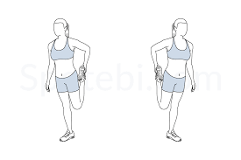
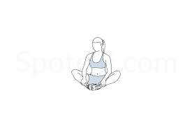
LEGS
Cool-Down:
Standing quad stretch (30 seconds)
Hamstring stretch (30 seconds)
“Butterfly” sit (30 seconds)

Slide 32
LEGS
Encouragement/Motivation:
You have the opportunity to workout and grow stronger!!!
You will feel content after completion
Bring a buddy to workout to help keep you motivated
Stay hydrated!

Slide 33
CARDIO
Goal :
Increase heart health and develop cardiovascular and aerobic fitness.
Benefits of Cardio :
brain and joint health
sleep and energy
better your mood
helps increase circulation which leads to clearer skin and healthier muscles.
Risk Factors :
remember, too much of a good thing can potentially be bad.
stressing and straining your heart
overloading the heart with blood causing potentially scarred heart chambers.
*always know your limits!* *everyone is different, so do what works best for you!*

Slide 34
CARDIO
Warm Up :
A warm-up generally involves doing your activity at a slower pace and reduced intensity to prepare your body for activity.
A brisk 5 minute walk / jog is a good way to get your heart rate going.
You could add 2 minutes of jump roping, lunges or cycling if you wanted.

Slide 35
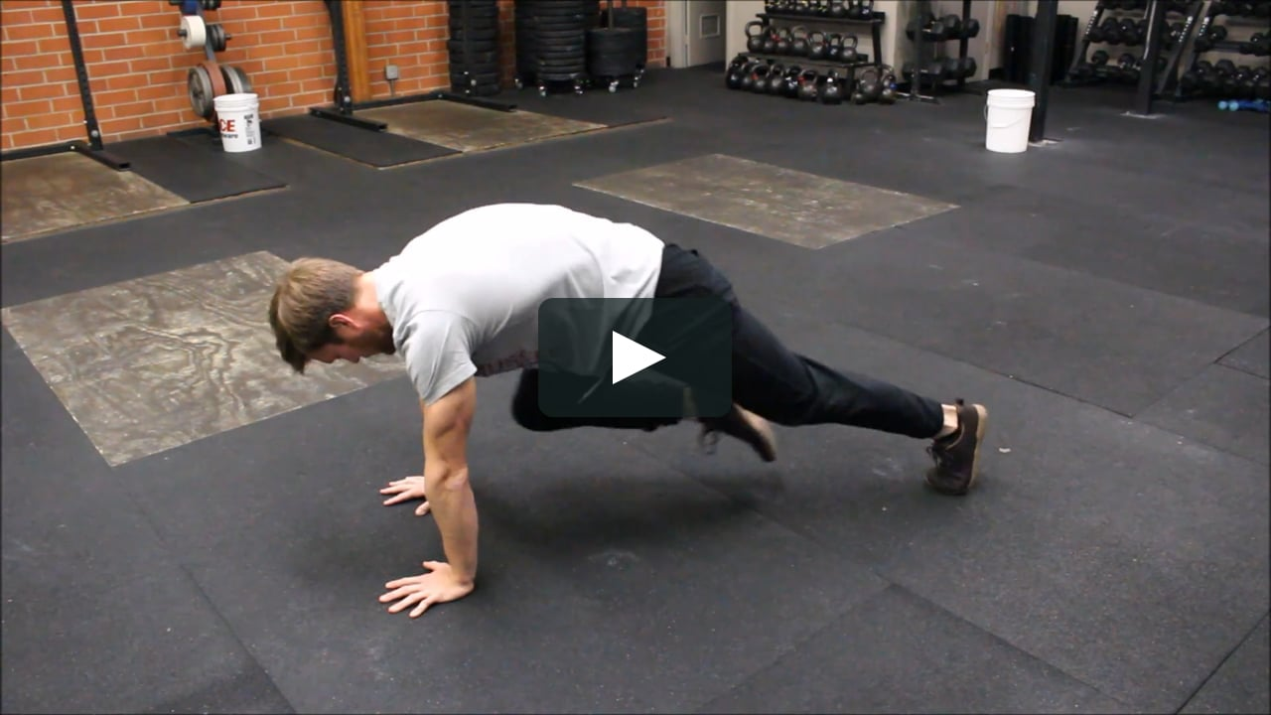
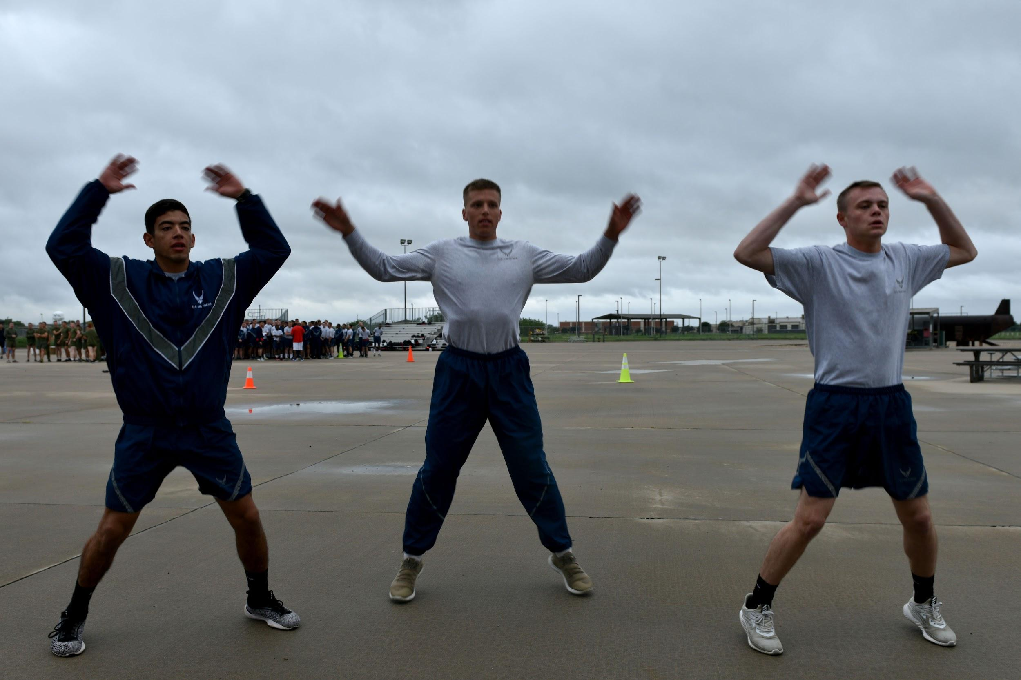
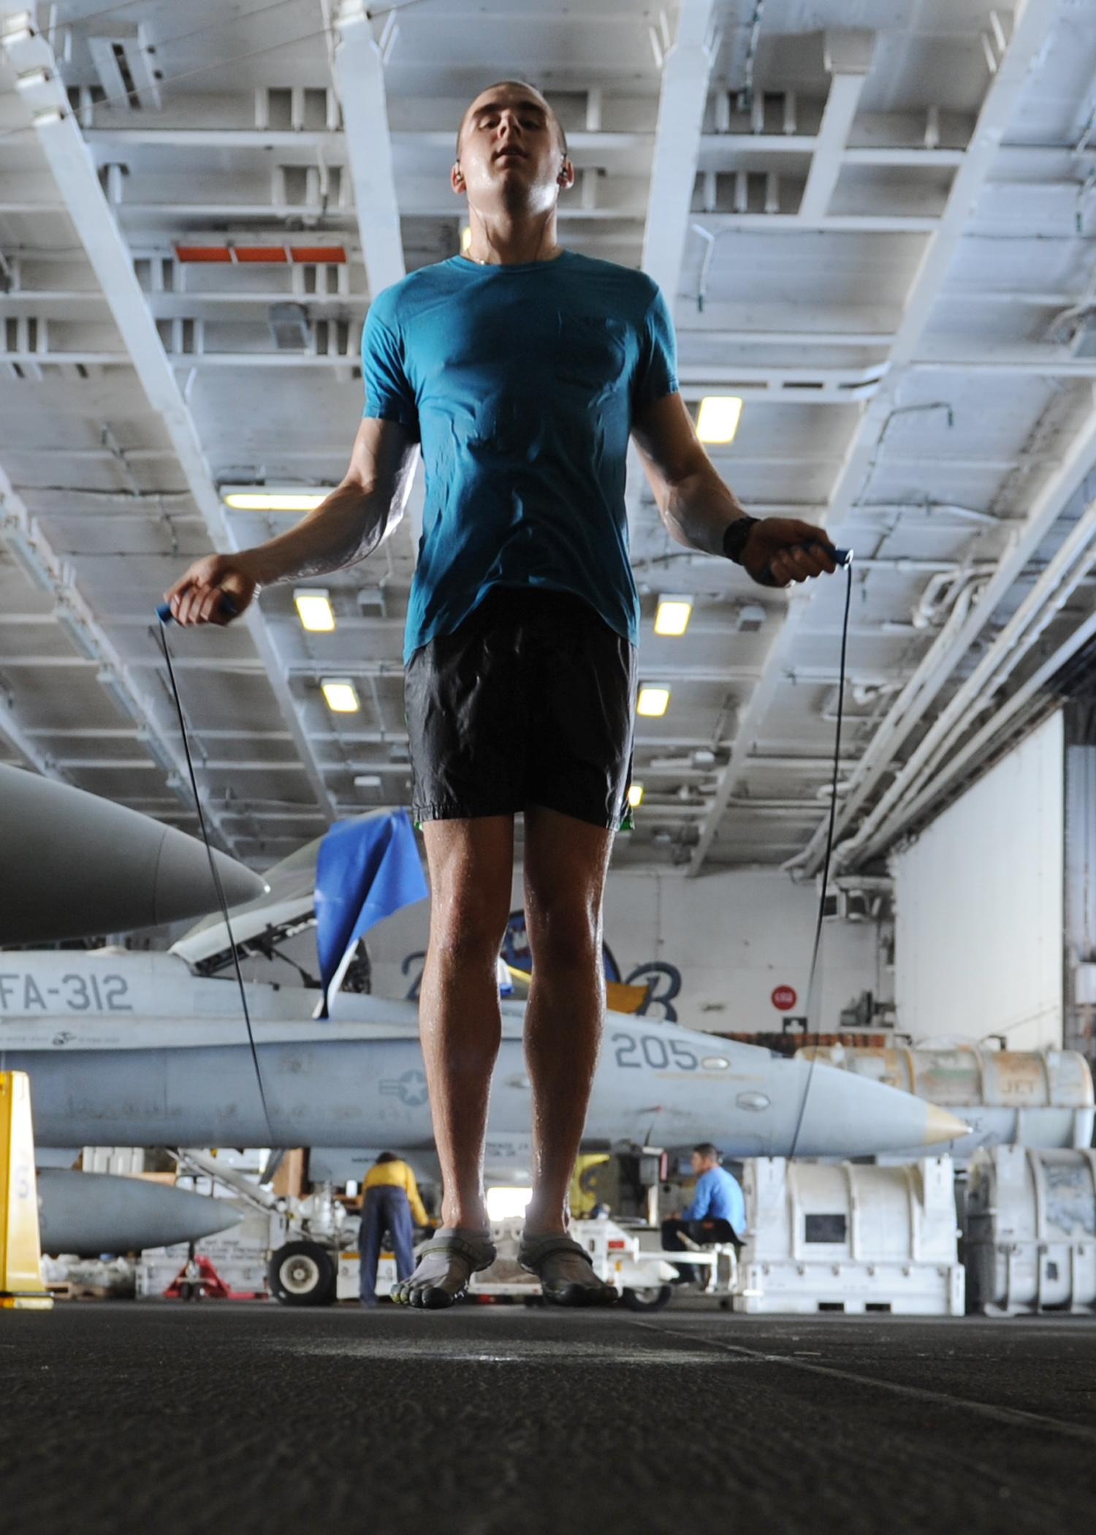
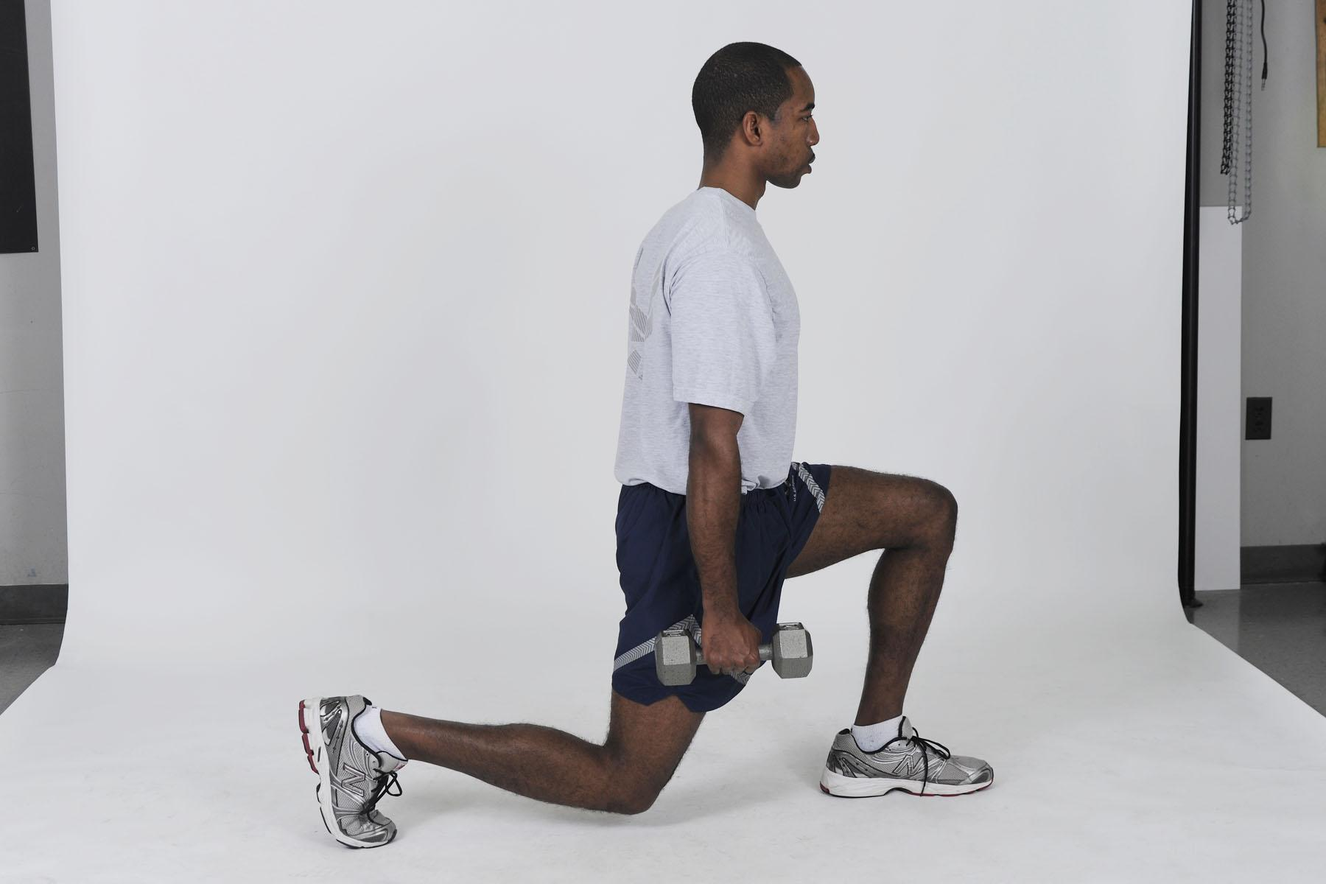
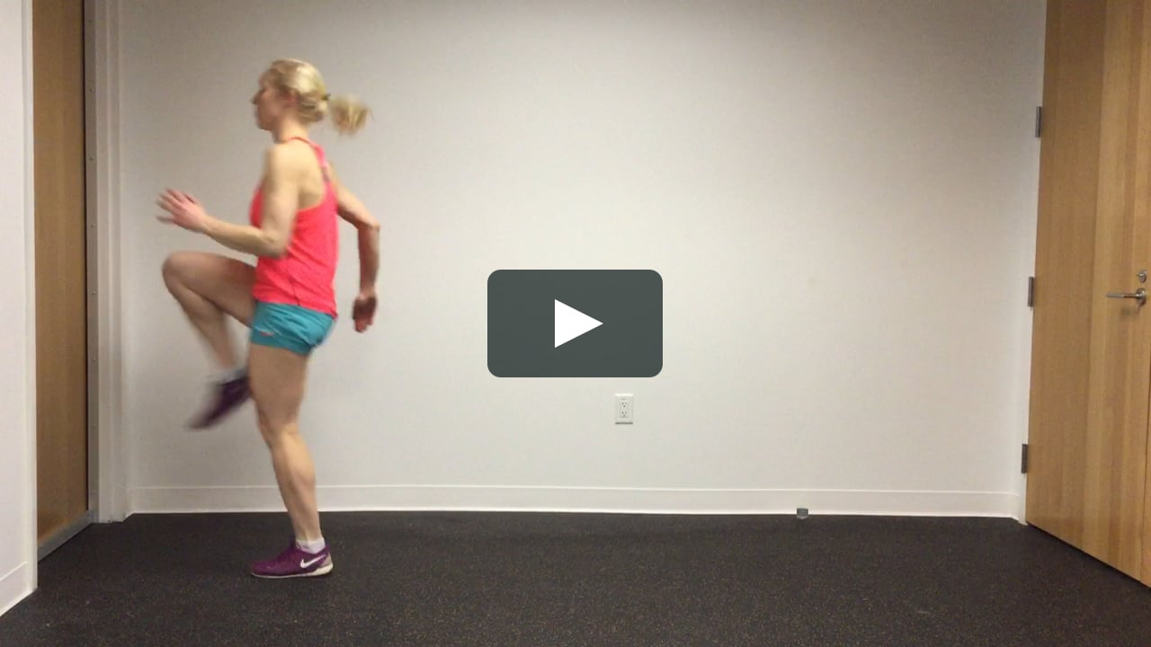
CARDIO
Workout :
1 minute - mountain climbers
1 minute - jumping jacks
1 minute - jump rope
1 minute - walking lunges
1 minute - high knees
* repeat!!! ( total time - 10 minutes )

Slide 36
CARDIO
ENCOURAGEMENT!!
Keep bettering yourself and it will pay off!!
believe in yourself!!!
do something today that your future self will thank you for!
every day is a chance to get stronger, eat better, live healthier and become the best version of yourself!

Slide 37
CARDIO
Workout :
treadmill :
walk for 1 ½ minutes
jog for 1 ½ minutes
run for 5 minutes
jog for 1 minute
walk for 1 minute
repeat!! (total time - 20 minutes) *
cool down - 5 minute brisk walk or jog.

Slide 38
FLEXIBILITY
Potential risks:
Muscles have a certain limit of how hard they can be pushed. While an increase in flexibility expands this limit, pushing one’s muscles too far too fast can result in injuries such as strains, and tears.
We highly encourage you to take these extra steps to reduce the risk of injury while stretching:
Do not stretch an unwarm muscle.
If a stretch hurts, ease up; you should only ever feel slight discomfort.
Do not bounce on a stretch; instead hold it steady in place.
Always continue to breathe normally while stretching.

Slide 39
FLEXIBILITY
Goal/ Objective:
to increase one’s flexibility in order to improve performance in all other areas of the workout
Benefits:
Increases freedom of movement, and both mental and physical relaxation, while improving posture
Releases muscle tension, which prevents soreness, and reduces the overall risk of injury

Slide 40
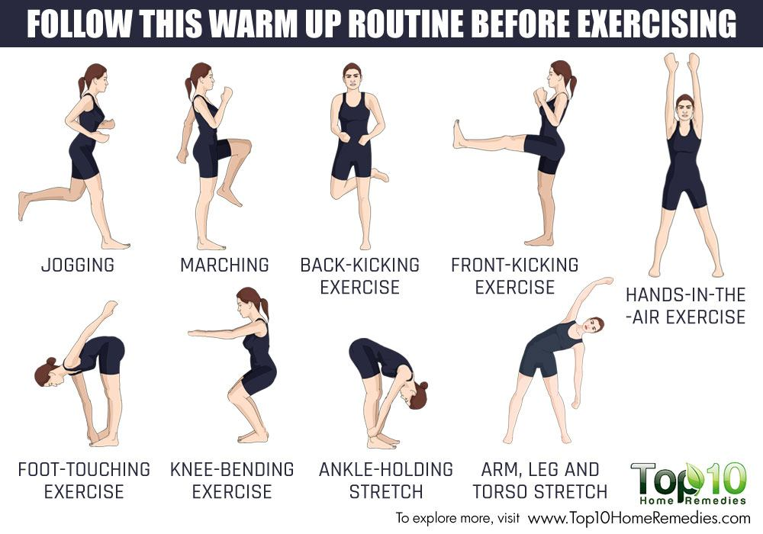
FLEXIBILITY
Warmup:
Stretching an unwarm muscle can result in injury; begin with a low-intensity warm up to prevent this. Chose ONE of the following as your warmup:
- Do a light 10 minute jog to warm up your muscles.
- Take a walk while swinging the arms in a wide circle.
- Do a few jumping jacks.

Slide 41
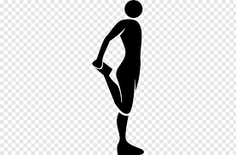
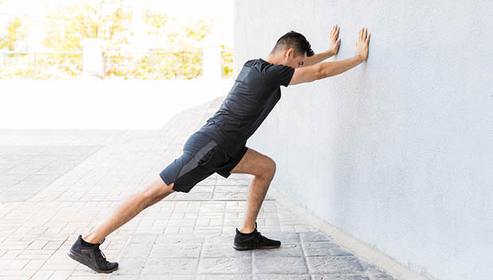
FLEXIBILITY
Workout: Flexibility is mainly stretching. -Do 3 times a week for 30 minutes.
do all of these for 10 - 30 seconds
-quadricep stretch: Take left leg and grab with right hand and gently pull heel up to buttocks and switch.
-calf stretch: Go to a wall and lean on use forearms to lean on wall bend one leg while the other remains straight. Move hips forward and keep lower half flat then switch legs.

Slide 42
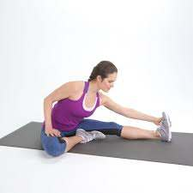
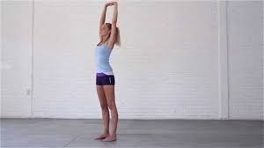
FLEXIBILITY
-hamstring stretch: Sit on the ground and lay left leg out straight. Bend right leg where sole of foot goes into left thigh. Lean forwards and reach towards your left foot. Kept left foot upright and switch sides.
-upperbody stretch- Interlock hands and use force and push arms as far up as you possibly can get them.
-Groin stretch: Put your elbows onto your inner thighs and hips and lunge forward at the hip
-Lower back stretch: “Pull your right leg toward your chest. Keep the back of your head on the floor. Try to keep your lower back flat. Repeat with your left leg.”

Slide 43
FLEXIBILITY
-more advanced stretches include:
-doing the splits can build flexibility

Slide 44
FLEXIBILITY
Cool Down
Always follow up a workout with light stretching to reduce soreness. Be sure to pay special attention to whichever muscular group you worked that day.
Encouragement/ Motivation
Do not be discouraged if your flexibility does not increase right away. Genetics play a huge role in how flexible one is, and the only way to increase it is stretching overtime.

Slide 45
FLEXIBILITY
-Encouragement/Motivation: doing these workouts takes off so much stress and tense off of your body. Find a friend to do these workouts with you and to hold you accountable or even take a yoga class! Yoga is a fun group setting that provides so many good flexible workouts

Slide 46
CONCLUSION
Utilize the provided techniques and exercises in a safe and appropriate manner. We hope that everyone takes the opportunity to engage in physical activity to promote and maintain a healthy lifestyle. Healthy Bodies and Healthy Minds, create a “Stronger, Healthier Pack.”
HPES 1013-002, Making Connections/Intro to HPESS

Slide 47
RESOURCES
https://www.healthline.com/health/exercise-fitness/never-skip-leg-day
https://www.livestrong.com/article/537454-leg-muscle-warm-up-exercises/
https://www.nerdfitness.com/blog/warm-up/
https://www.self.com/gallery/great-lower-body-stretches

Slide 48
RESOURCES
Abs: https://www.acefitness.org/education-and-resources/lifestyle/exercise-library/body-part/abs/
https://www.spotebi.com/workout-routines/10-minute-core-cardio-warm-up/
Flexibility: https://www.acefitness.org/education-and-resources/lifestyle/blog/6646/benefits-of-flexibility/
Warm Up, Cool Down and Be Flexible - OrthoInfo - AAOS

Slide 49
RESOURCES
Legs:
https://www.healthline.com/health/exercise-fitness/never-skip-leg-day
https://www.livestrong.com/article/537454-leg-muscle-warm-up-exercises/
https://www.nerdfitness.com/blog/warm-up/
https://www.self.com/gallery/great-lower-body-stretches

