Slide 1
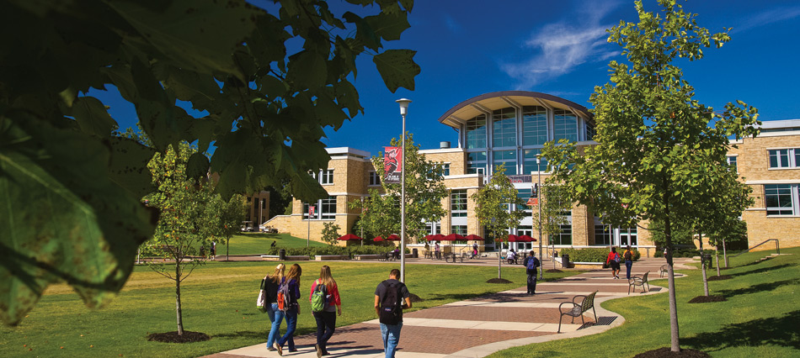
CayuseIRB
A Quick Start Guide for
IRB, IACUC, and IBC Researchers
Research and Technology Transfer Director of Research Compliance (870) 972-2694 | CayuseIRB@astate.edu
AState.edu
/ArkansasState
@ArkansasState

Slide 2
What is CayuseIRB?
Cayuse IRB is a user friendly, protocol management software using web forms designed to facilitate submissions to the IRB, IACUC, and IBC. This software records the protocol process from initial submission to closure to comply with record retention requirements established by governing agencies.
If you have used Cayuse 424 to submit grant applications, you may use the same sign-on to access to Cayuse IRB. If you have not used Cayuse 424 before, we must add you to the system before you may submit. This will include most students. To do so, please email a “Request to add new Cayuse IRB user” to CayuseIRB@astate.edu and provide the following information:
Name
Department
Department address
Email
Phone number
Fax number
Please allow a minimum of two business days to create new CayuseIRB users.
AState.edu
/ArkansasState
@ArkansasState

Slide 3
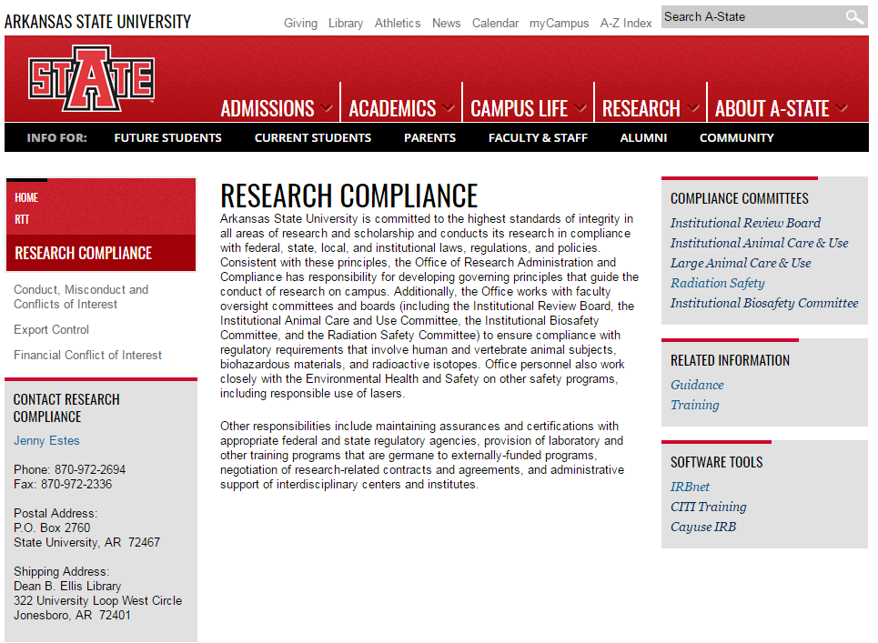
Logging in to Cayuse
You may log in to Cayuse directly at: https://astate.cayuse424.com
Or through the A-State research compliance website
AState.edu
/ArkansasState
@ArkansasState

Slide 4
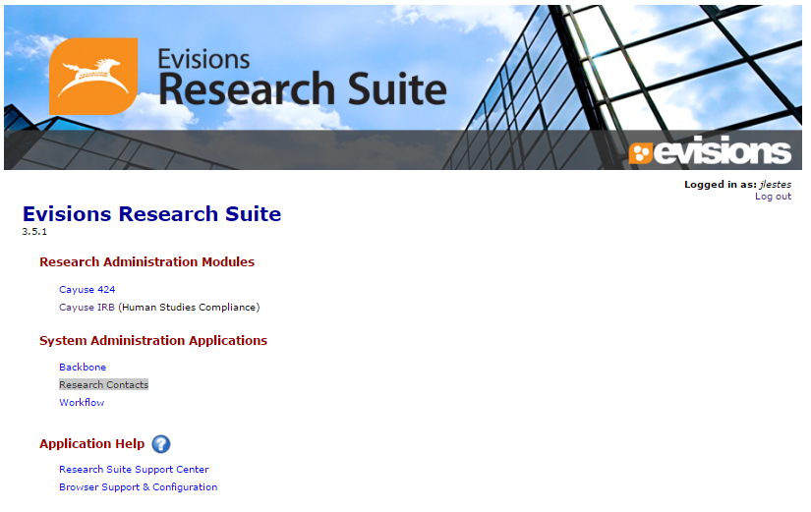
Select Cayuse IRB
The software is called “Cayuse IRB” but we will
use it for IRB, IACUC, and IBC submissions.

Slide 5
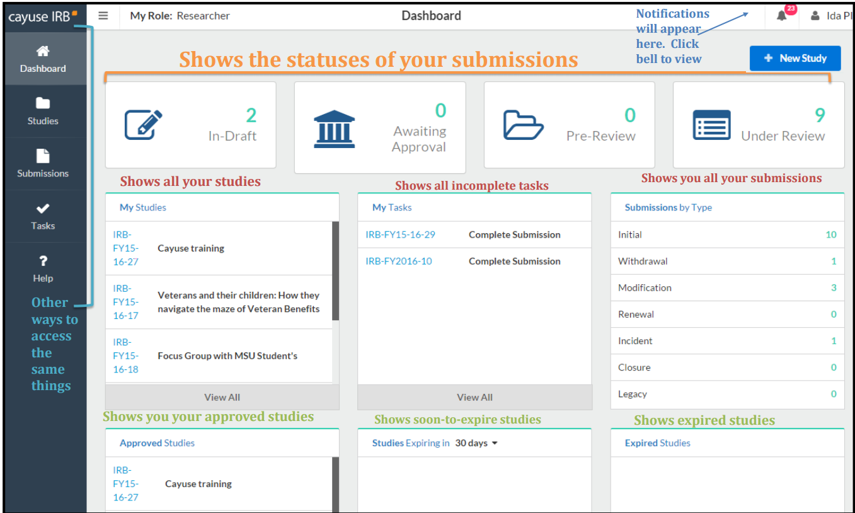
CayuseIRB Dashboard
Shows status of submissions and notifications, etc.

Slide 6
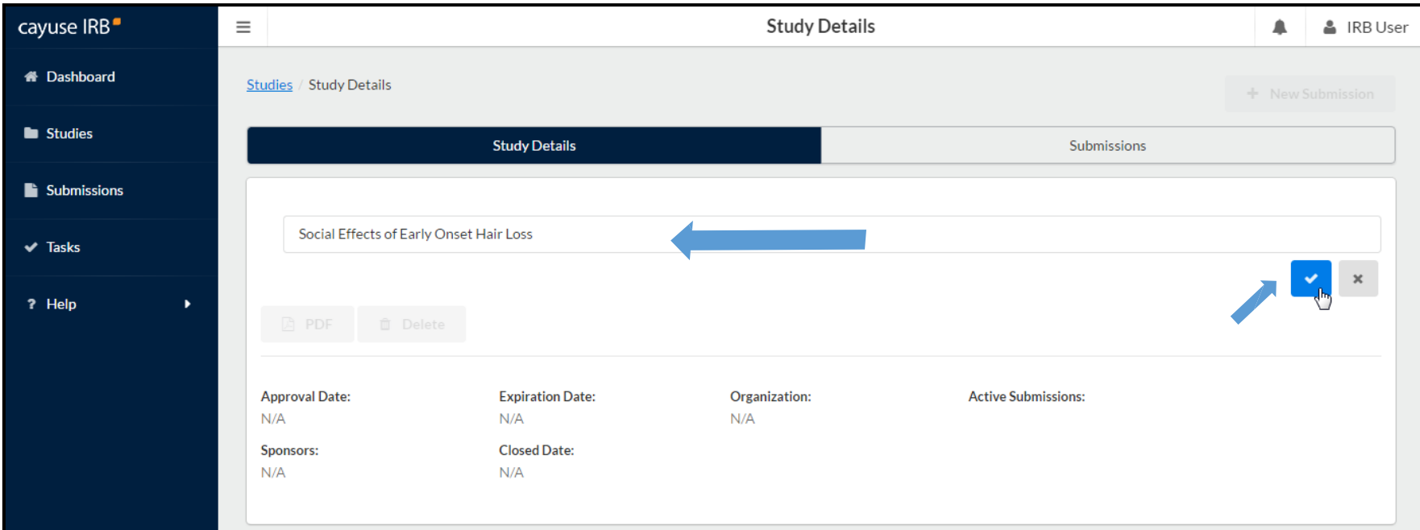
Create a new study
To create a new study, click the New Study button in the upper right corner of either the studies page or on your dashboard.
Enter a title for your study, then click Save.

Slide 7
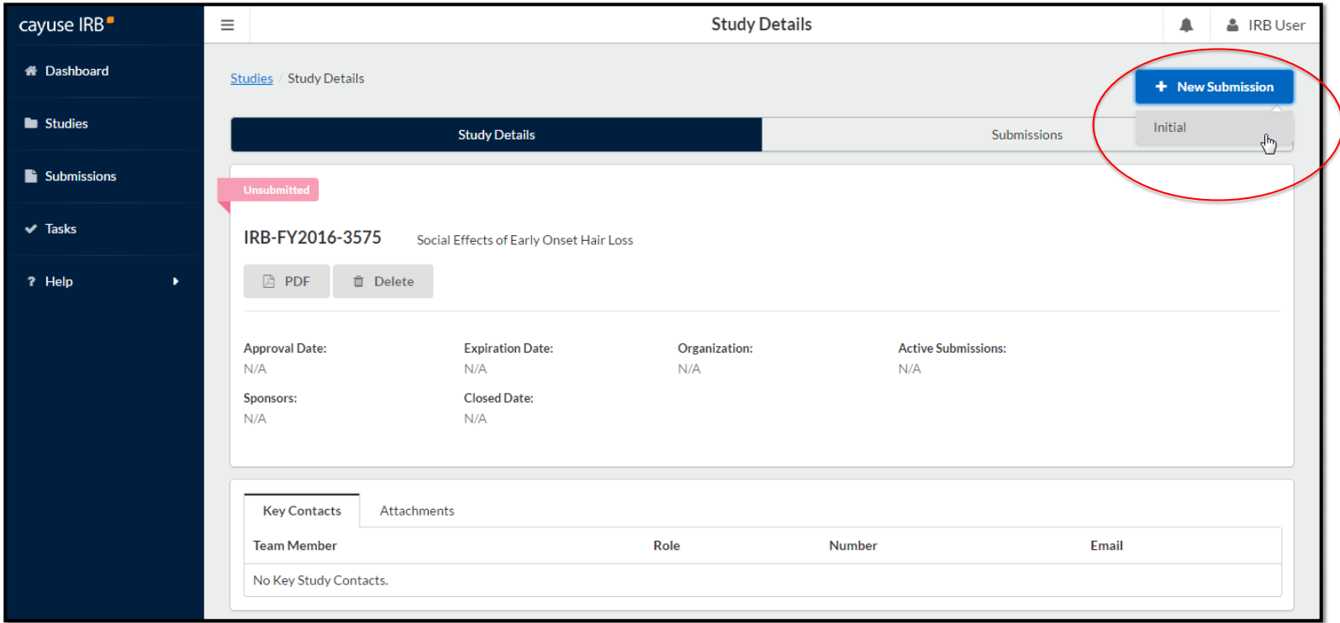
Add initial submission
Click New Submission in the upper right corner to add the Initial submission for your study.

Slide 8
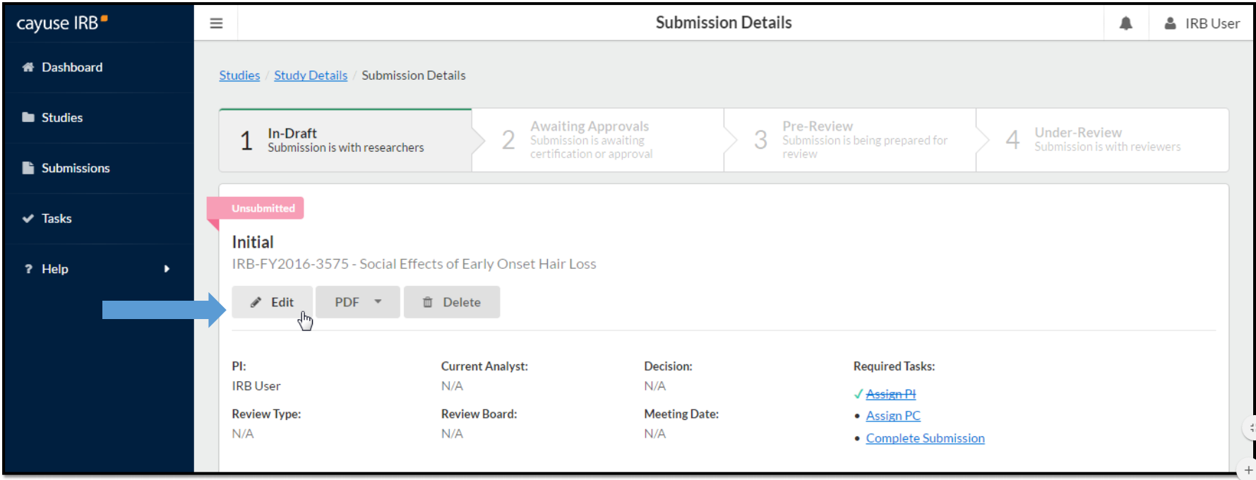
Add initial submission
The initial submission now appears in the study details.
(The person creating the study is listed as PI by default. This can be changed during editing, if needed.)
Click Edit to begin working on the initial submission.

Slide 9
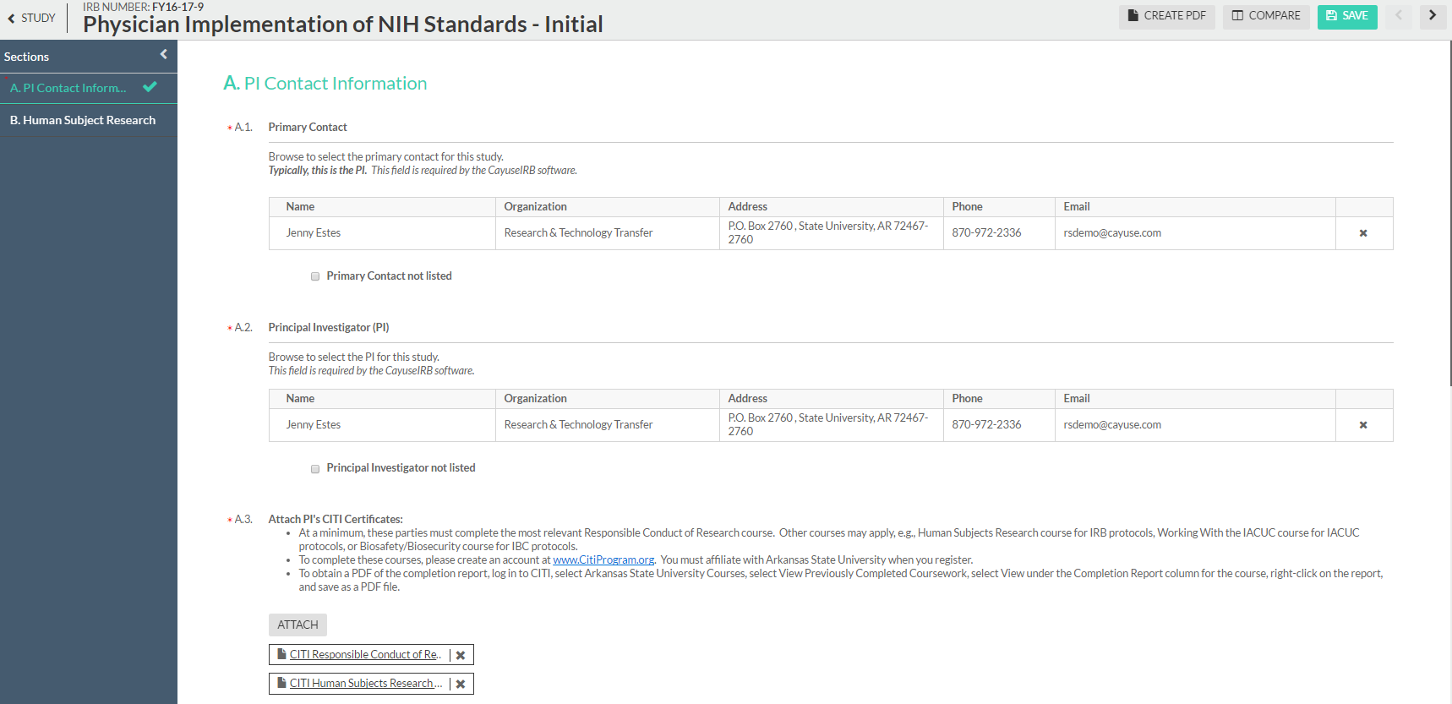
Complete the protocol
Answer the questions and attach documents, as prompted.
Use the arrows in the upper or lower right corners to move between pages.
Save often and proceed until your protocol is completed.
Items marked with a red asterisk are required fields.

Slide 10
Primary Contact
Cayuse requires a Primary Contact. This is usually the Principal Investigator.
The protocol cannot be submitted until all sections have a green checkmark
Cayuse requires a primary contact. This is usually the PI.
Protocols cannot be submitted until each section has a checkmark.
Unchecked sections are incomplete
Don’t forget to attach CITI completion reports!

Slide 11
Complete Submission and Certify
After all fields are answered, all documents are attached, and all sections are checked, click Save in the upper right corner, then click Complete Submission, then Confirm.
On the Submission Details page, click Certify.
(If the PI is a student, their Faculty Advisor must also certify.)

Slide 12
Notifications and Approval
You will be notified via Cayuse IRB Notifications as well as by email of protocols returned for correction, approval, and any updates. Once approved, the study will appear on your dashboard under Approved Studies.
Other Info:
All students must list their faculty advisors. Advisors must review and certify student submissions before it can proceed for review.
For login issues, please contact:
Submission Coordinator
(870) 972-2694
CayuseIRB@astate.edu
IRB Users Help – Creating Studies

