Slide 1



Financial Aid Training for Counselor and Mentors
presented by:
Arkansas State University Office of Financial Aid & Scholarships
Fall 2019
AState.edu
/ArkansasState
@ArkansasState

Slide 2
Agenda – High School Counselors Workshop
October 13, 2020
9:00 – 9:15 Welcome Terry Finney
9:15 – 10:45 Overview of Financial Aid Programs – Terry Finney
Applying for Federal Financial Aid – Christina Kostick
Dependency Status – Christina Kostick
Professional Judgement – Christina Kostick
After the FAFSA – Christina Kostick
10:45 – 11:00 Searching for Scholarships – Dena Bolar Graves
11:00 – 11:15 ASTATE Scholarship Update – Dena Bolar Graves
11:15 – 11:45 ASTATE Admissions Update – Pamela Bowie
11:45 – 12:00 ADHE Update – Ellena Cox

Slide 3
Overview of
Financial Aid Programs
AState.edu
/ArkansasState
@ArkansasState

Slide 4
Financial Aid
Money from a source other than the family to assist with the cost of attending college
AState.edu
/ArkansasState
@ArkansasState

Slide 5
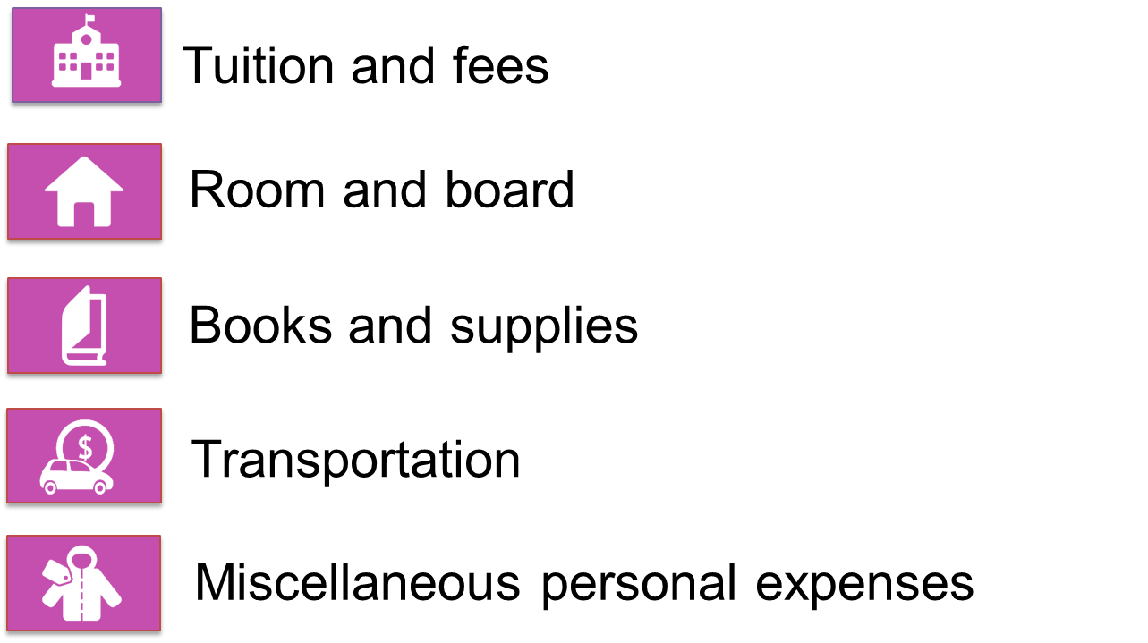
Cost of Attendance (COA)
Direct and Indirect Costs
AState.edu
/ArkansasState
@ArkansasState

Slide 6
Expected Family Contribution
(EFC)
An index used to calculate eligibility for aid
Stays the same regardless of college
Two components
  Parent contribution
  Student contribution
Calculated using FAFSA data and a formula specified by law
AState.edu
/ArkansasState
@ArkansasState

Slide 7
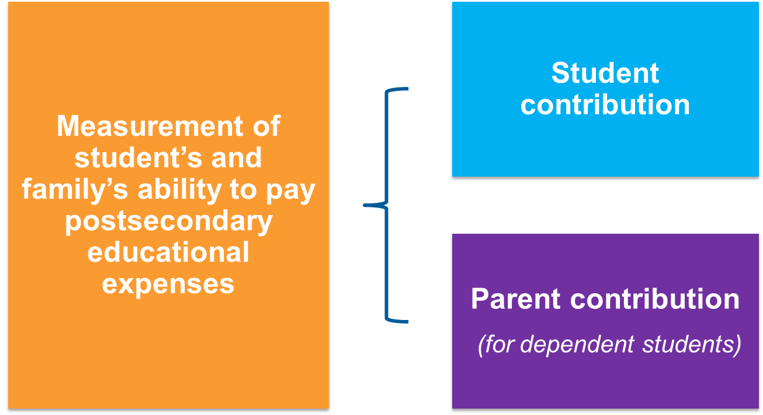
Expected Family Contribution
(EFC)
AState.edu
/ArkansasState
@ArkansasState

Slide 8
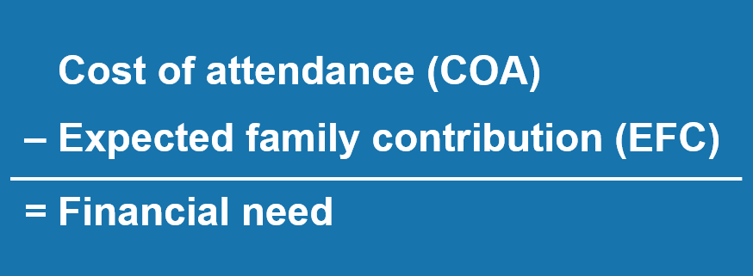
Financial Need
AState.edu
/ArkansasState
@ArkansasState

Slide 9
Categories of Aid
Need-based aid
Merit-based aid
AState.edu
/ArkansasState
@ArkansasState

Slide 10
Types of Aid
Scholarships
Grants
Work-Study Employment
Loans
AState.edu
/ArkansasState
@ArkansasState

Slide 11
Sources of Aid
Federal Government
Employers
States
Private Sources
College and Universities
AState.edu
/ArkansasState
@ArkansasState

Slide 12
Federal Programs
AState.edu
/ArkansasState
@ArkansasState

Slide 13
Federal Pell Grant
Federal Supplemental Educational Opportunity Grant (FSEOG)
Teacher Education Assistance for College and Higher Education (TEACH) Grant
Federal Work-Study (FWS)
Federal Direct Student Loans (Direct Loans)
Iraq Afghanistan Service Grant (IASG)
Federal PLUS Loans
AState.edu
/ArkansasState
@ArkansasState

Slide 14
Grants
Federal Pell Grant
  Provides need-based grants to low-income undergraduate students.
Federal Supplemental Educational Opportunity Grant (FSEOG)
  Provides need-based grants to low-income undergraduate students (campus-based aid).
Teacher Education Assistance for College and Higher Education (TEACH) Grant
  Provides assistance to students who intend to teach in a public or private elementary or secondary school that serves students from low-income families.
Iraq and Afghanistan Service Grant
  Provides possible assistance to students whose parent or guardian died as a result of military service in Iraq or Afghanistan after September 11, 2001
AState.edu
/ArkansasState
@ArkansasState

Slide 15
Federal Pell Grant
Grant amounts depend on the student’s:
  Expected Family Contribution (EFC)
  Enrollment status (full or part-time)
  Attendance status (full academic year or less)
  Pell Grant maximum award per academic year: $6,345 (2020-2021)
  * Maximum award may be subject to change pending legislative budgetary adjustments
AState.edu
/ArkansasState
@ArkansasState

Slide 16
FSEOG
FSEOG recipients must be:
  Pell Grant eligible
  Current award amounts vary from:
    $100-$4,000 per year.
  * Not all colleges participate in the FSEOG program and availability is based on funding at the college.
AState.edu
/ArkansasState
@ArkansasState

Slide 17
TEACH Grant
The TEACH Grant is:
  Not based on financial need.
  Available to both undergraduate and graduate students.
TEACH Grant recipients must be:
  Enrolled in an institution that participates in the TEACH Grant program.
  Enrolled in coursework geared towards a career in the field of teaching.
  Able to demonstrate certain academic achievements.
  Provides the maximum award:
    Up to $4,000 per year (2020-2021)
AState.edu
/ArkansasState
@ArkansasState

Slide 18
TEACH Grant
TEACH Grant recipients must sign an “Agreement to Serve” which states that the student will:
  Teach at least four years in a public or private elementary or secondary school.
  Teach full-time in a high-need field
  Teach in a school that serves students from low-income families.
  If the teaching obligation is not completed, the TEACH Grant must be repaid as a Direct Unsubsidized Loan.
AState.edu
/ArkansasState
@ArkansasState

Slide 19
TEACH Grant
  Due to sequestration, award amounts for any TEACH Grant must be reduced.
    For any 2019–20 TEACH Grant first disbursed on or after Oct. 1, 2019, and before Oct. 1, 2020, the maximum award of $4,000 is reduced by 5.9% ($236), resulting in a maximum award of $3,764
    For any 2020–21 TEACH Grant first disbursed on or after Oct. 1, 2020, and before Oct. 1, 2021, the maximum award of $4,000 is reduced by 5.7% ($228), resulting in a maximum award of $3,772.
  For more information visit:
  https://studentaid.ed.gov/sa/types/grants-scholarships/teach#sequestration
AState.edu
/ArkansasState
@ArkansasState

Slide 20
Iraq/Afghanistan Service Grant
The award is equal to the amount of maximum Federal Pell Grant for the award year, but cannot exceed the cost of attendance for that award year.
Grant recipients must be:
  Less than 24 years old.
  Enrolled in college at least part-time at the time of the parent or guardian’s death.
AState.edu
/ArkansasState
@ArkansasState

Slide 21
Iraq/Afghanistan Service Grant
  Due to sequestration, award amounts for any Iraq/Afghanistan Grant must be reduced.
    For any 2019–20 Iraq/Afghanistan Grant first disbursed on or after Oct. 1, 2019, and before Oct. 1, 2020, the maximum award of $6,345 is reduced by 5.9% ($365.50), resulting in a maximum award of $5,829.50
    For any 2020–21 Iraq/Afghanistan Grant first disbursed on or after Oct. 1, 2020, and before Oct. 1, 2021, the maximum award of $6,345 is reduced by 5.7% ($361.66), resulting in a maximum award of $5,983.34
  For more information visit:
  https://studentaid.ed.gov/sa/types/grants-scholarships/iraq-afghanistan-service#sequestration
AState.edu
/ArkansasState
@ArkansasState

Slide 22
Campus-Based Programs
Federal Supplemental Educational Opportunity Grant (FSEOG)
Federal Work-Study (FWS)
  Provides part-time employment for undergraduate and graduate students with financial need, allowing them to earn money to help pay educational expenses.
AState.edu
/ArkansasState
@ArkansasState

Slide 23
Federal Work-Study (FWS)
Students are paid at least federal minimum wage.
Eligible employers (on and off campus opportunities)
  Schools
  Federal, state, or local public agencies
  Private non-profit organization
  Community service activities
  * Not all colleges participate in the FWS program and availability is based on funding at the college.
AState.edu
/ArkansasState
@ArkansasState

Slide 24
Federal Direct Loans
Direct Subsidized Loan
Direct Unsubsidized Loan
Direct PLUS Loan for Parents
Direct PLUS Loan for Graduate/Professional Students
AState.edu
/ArkansasState
@ArkansasState

Slide 25
Federal Direct Loans
Subsidized Loans
Government PAYS the borrowers accrued interest while you are attending college and other eligible periods
Based on Financial Need
Fixed Rate
Undergraduate students
Amount: $3,500-$5,500
Unsubsidized Loans
The borrower is responsible for the interest for the life of the loan
NOT based on Financial Need
Fixed Rate
Undergraduate and graduate students qualify
Amount: $5,500-$20,500
AState.edu
/ArkansasState
@ArkansasState

Slide 26
Federal Direct PLUS Loans
Parent PLUS
For parents of dependent students
Borrower must not have a negative credit history.
If approved, parent may borrow up to, but not exceeding the college’s Cost of Attendance (COA)
Fixed Rate
Borrower is responsible for all the interest
Graduate PLUS
For graduate/professional students
Borrower must not have a negative credit history.
Fixed Rate
If approved, student may borrow up to, but not exceeding the college’s Cost of Attendance (COA)
AState.edu
/ArkansasState
@ArkansasState

Slide 27
Federal Direct Loans
(First Disbursed after October 1 and before October 1, 2020)
Loan Type | Interest Rates | Loan Fees | Repayment
Direct Subsidized (Undergraduate) | 2.75% | 1.057% | Begins 6 months after student has left school
Direct Unsubsidized (Undergraduate) | 2.75% | 1.057% | Begins 6 months after student has left school
Direct Unsubsidized (Graduate) | 4.30% | 1.057% | Begins 6 months after student has left school
Direct PLUS for Parents | 5.30% | 4.228% | May be deferred until 6 months student drop ½ time or 60 days after loan is fully disbursed
Direct PLUS for Graduate/Professional Students | 5.30% | 4.228% | Begins 6 months after student has left school
AState.edu
/ArkansasState
@ArkansasState

Slide 28
Other Sources of Aid
Institutional or private tuition plans
Other family resources
Home equity loans
Private/alternative loans
Tuition savings plans (529 plans)
Employer-sponsored tuition plans
AState.edu
/ArkansasState
@ArkansasState

Slide 29

AState.edu
/ArkansasState
@ArkansasState

Slide 30
Applying for Federal Student Aid:
Free Application for Federal Student Aid (FAFSA)
AState.edu
/ArkansasState
@ArkansasState

Slide 31
FSA ID
FSA ID consists of username and password used for electronically signing financial aid applications.
FSA ID needed to log into fafsa.gov, the National Student Loan Data System(NSLDS) at nslds.ed.gov, StudentLoans.gov, StudentAid.gov and Agreement to Serve(ATS) at teach-ats.ed.gov
Create FSA ID at https://studentaid.ed.gov/npas/index.htm
Students and eligible parents should establish an FSA ID for ease of submission and signatures for the FAFSA.
  Both the student and the parent need a separate username name, password and email address
Recommend setting up FSA ID at the end of junior year/summer prior to senior year
Users should retain all information used to set up FSA ID
AState.edu
/ArkansasState
@ArkansasState

Slide 32
FAFSA Completion Resources
FAFSA Website
www.fafsa.gov
Financial Aid Toolkit:
http://financialaidtoolkit.ed.gov/tk/
2019-2020 FAFSA Resources:
https://financialaidtoolkit.ed.gov/tk/learn/types.jsp
Do You Need Money for College?
https://studentaid.ed.gov/sa/sites/default/files/2019-20-do-you-need-money.pdf?_ga=2.155358899.981371147.1568735237-454422182.1554831332
Creating and Using Your FSA ID:
https://studentaid.ed.gov/sa/fafsa/filling-out/fsaid
AState.edu
/ArkansasState
@ArkansasState

Slide 33
FAFSA Completion Tool
Data available by state or territory
Report alphabetical by high school
Shows number of completed and submitted Free Applications for Federal Student Aid (FAFSAs) for current and previous application cycles
https://studentaid.ed.gov/sa/about/data-center/student/application-volume/fafsa-completion-high-school
AState.edu
/ArkansasState
@ArkansasState

Slide 34
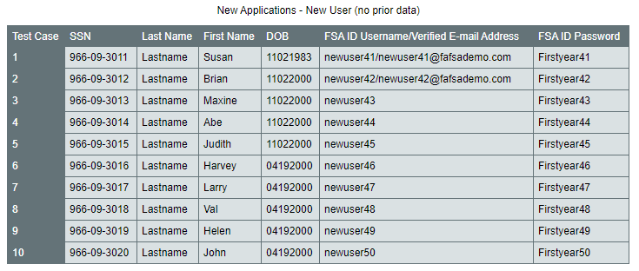
FAFSA Demo Site fafsademo.test.ed.gov
A demonstration site is available so you can increase your own understanding of the FAFSA and show it to students before they apply.
  Provides a way for financial aid administrators to show students and parents, as well as financial aid office staff, how to use FAFSA on the Web and FAA Access to CPS Online. It offers most of the features of the production versions of the FAFSA on the Web and FAA Access to CPS Online Web sites, except that no data is processed.
Note: This site is purely a learning tool.
AState.edu
/ArkansasState
@ArkansasState

Slide 35
FAFSA
Produced by the U.S. Department of Education
Collects family’s personal and financial information used to calculate student’s EFC
Available in English and Spanish
Available in two formats:
  On-line
  PDF (Download from www.fafsa.gov)
AState.edu
/ArkansasState
@ArkansasState

Slide 36

myStudentAid Mobile App
Student may use the myStudentAid app to complete the 2020-2021 FAFSA.
AState.edu
/ArkansasState
@ArkansasState

Slide 37
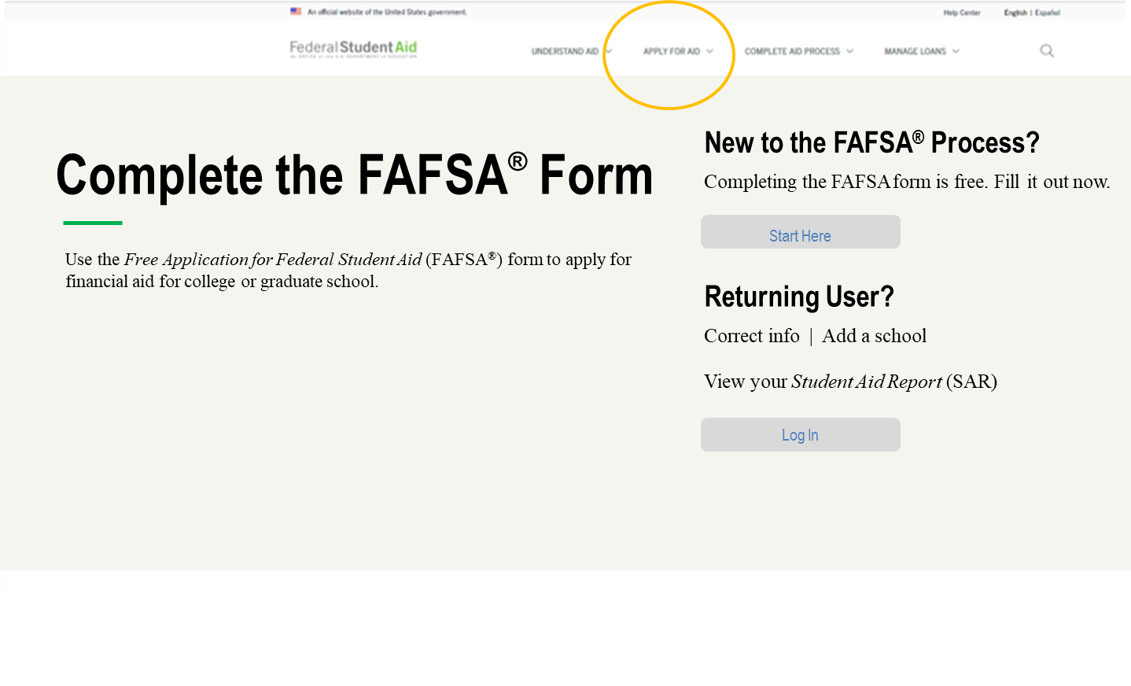
FAFSA on the Web
Application available
October 1st each year.
fafsa.gov
AState.edu
/ArkansasState
@ArkansasState

Slide 38
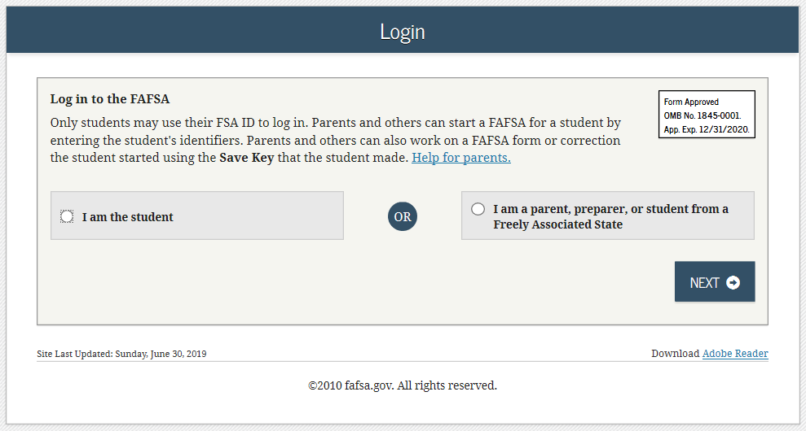
FAFSA on the Web
AState.edu
/ArkansasState
@ArkansasState

Slide 39
IRS Data Retrieval Tool
Data available in English and Spanish
IRS data tool will be available on October 1 and may be utilized to transfer 2018 tax information
FOTW includes logic/questions to determine if applicant is eligible to use the IRS Data Retrieval Tool
  “Unmarried and both parents living together” not eligible to use IRS Data Retrieval
  Same gender married couples using “Married filing jointly” status can use IRS Data Retrieval
Applicant’s response will take him or her to the IRS system or provide a message that the applicant should use own financial figures to complete FOTW
AState.edu
/ArkansasState
@ArkansasState

Slide 40
IRS Data Retrieval Tool
Certain tax filers cannot use the
IRS Data Retrieval Tool
Did not indicate on FAFSA a tax return was completed
Marriage date is January 2020, or later
First three digits of the SSN are 666
Filed a non-U.S. tax return
Married and filed as head of household, or filed separate returns
Neither married parent entered a valid SSN
Non-married parent or both married parents entered all zeroes for the SSN
AState.edu
/ArkansasState
@ArkansasState

Slide 41
Frequent FAFSA Errors
Incorrect parent and/or student Social Security Numbers
Divorced/remarried/unmarried but living together parental information-which belongs on the form
  Income earned by parents/stepparents missing
Untaxed income
U.S. income taxes paid
Verifying FSA ID info
Household size
  Number of household members in college
Real estate and investment net worth
FAFSA missing parent and/or student signature
AState.edu
/ArkansasState
@ArkansasState

Slide 42
AState.edu
/ArkansasState
@ArkansasState

Slide 43
After the FAFSA
AState.edu
/ArkansasState
@ArkansasState

Slide 44
FAFSA Processing Results
Central Processing System notifies student of FAFSA processing results via:
  E-mail containing a direct link to student’s electronic Student Aid Report (SAR) if student’s e-mail was provided
  Student with FSA ID can view SAR on line at www.fafsa.gov
  Typical processing time is 24-48 hours from time of filing FAFSA
AState.edu
/ArkansasState
@ArkansasState

Slide 45
Student Aid Report (SAR) Formats
Paper SAR
Paper SAR Acknowledgment
E-mail Notification of SAR Processing
Sample 2019-20 SAR found on ifap.ed.gov:
https://ifap.ed.gov/sarmaterials/attachments/1920SARAcknowledgementEnglish.pdf
AState.edu
/ArkansasState
@ArkansasState

Slide 46
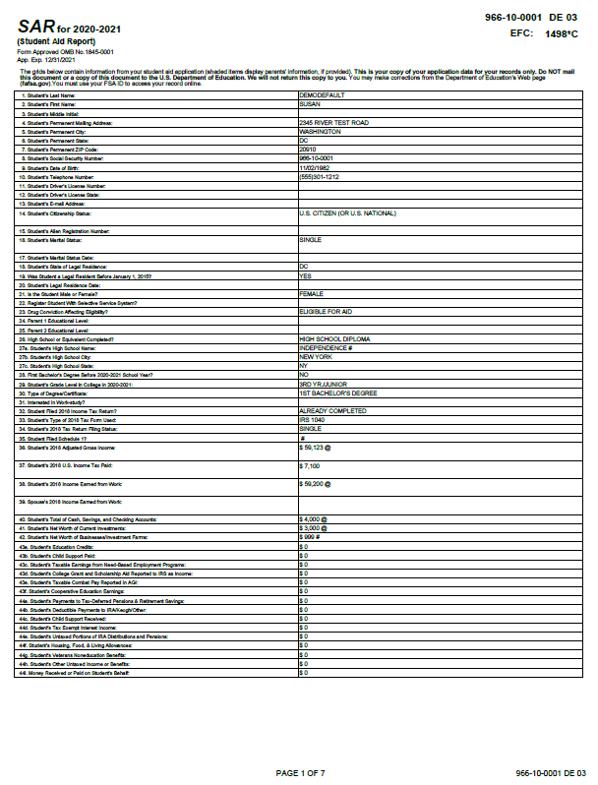
Student Aid Report (SAR) Formats
If valid email address is provided on FAFSA
Provides access to electronic SAR at www.student aid.gov
AState.edu
/ArkansasState
@ArkansasState

Slide 47
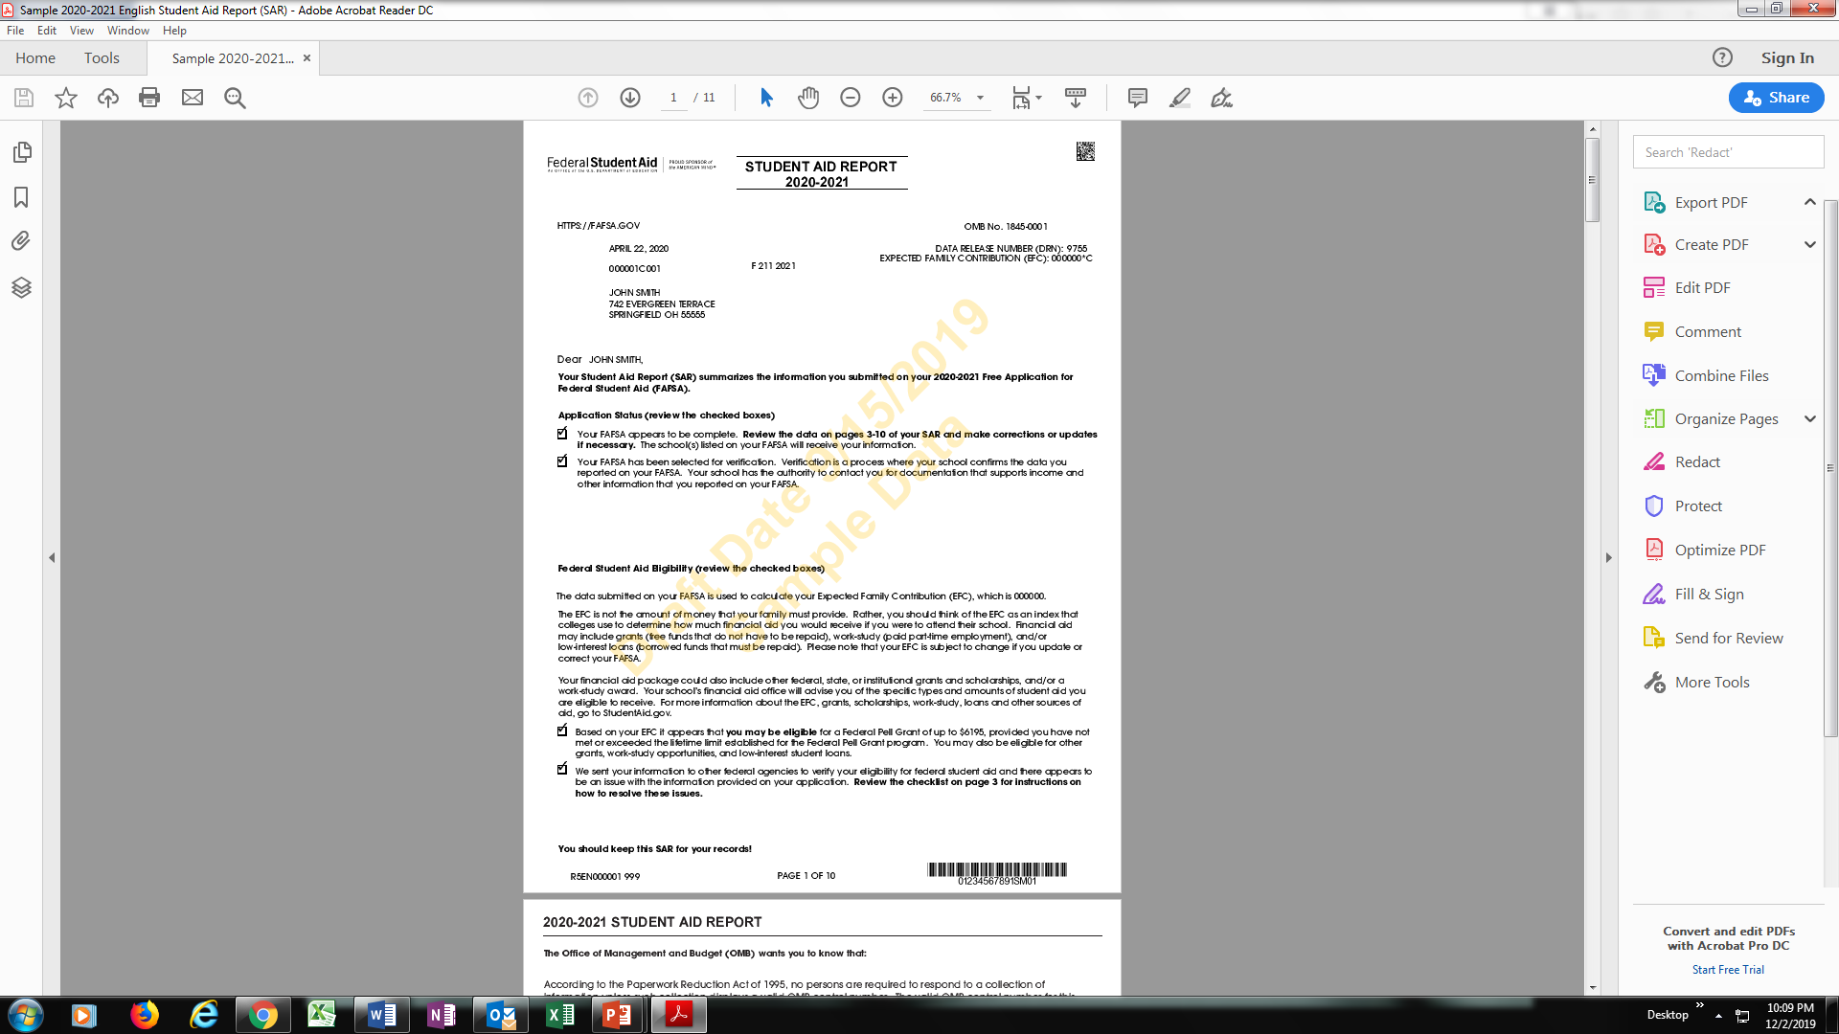
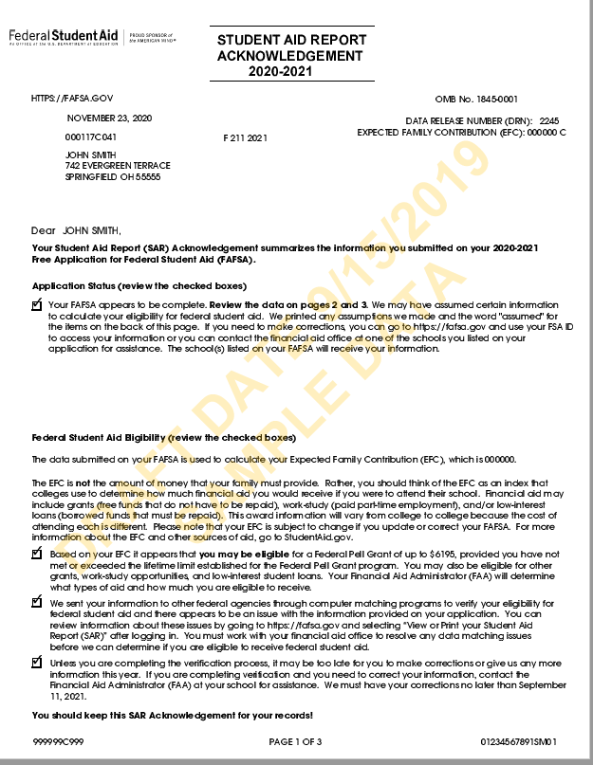
Student Aid Report (SAR) Formats
SAR sent if paper FAFSA filed without providing an email address
SAR Acknowledgement sent if FOTW filed without providing an email address
AState.edu
/ArkansasState
@ArkansasState

Slide 48
Corrections
Students should only correct information that was reported incorrectly when he or she completed the FAFSA
Corrections to FAFSA data may be made by:
  Using FAFSA on the Web (fafsa.gov), if the student has an FSA ID
  Updating and mailing the paper SAR
  Submitting the documentation to the school’s financial aid office (RECOMMENDED)
AState.edu
/ArkansasState
@ArkansasState

Slide 49
Verification
Process by which the U.S. Department of Education (ED) through the financial aid office confirms information provided by students and families on the FAFSA is accurate
Students can be selected for verification by the Department of Education or the college
Items to be verified will vary
Financial Aid cannot be processed until verification is completed.
AState.edu
/ArkansasState
@ArkansasState

Slide 50
AState.edu
/ArkansasState
@ArkansasState

Slide 51
Student Dependency Status
AState.edu
/ArkansasState
@ArkansasState

Slide 52
What Makes a Student Independent?
Born before 01/01/1997 (for 2020-2021 year)
Married
Graduate or professional student
Active duty military for purposes other than training.
Veteran
Has children who receive more than 50% support from the student.
AState.edu
/ArkansasState
@ArkansasState

Slide 53
What Makes a Student Independent?
Has dependents (other than children or spouse) who receive more than 50% support from the student.
Is an orphan, has been in foster care/dependent/ward of the court.
Is an emancipated minor.
Is or has been in legal guardianship.
Is homeless or self-supporting and at risk of being homeless
  As determined by agencies specified in FAFSA instructions.
AState.edu
/ArkansasState
@ArkansasState

Slide 54
Who Qualifies as a Parent for a Dependent Student?
AState.edu
/ArkansasState
@ArkansasState

Slide 55
Who is a Parent?
Biological parents
Adoptive parents
Step-parents, if they are married to the student’s biological or adoptive parent and the student is included in their household size.
AState.edu
/ArkansasState
@ArkansasState

Slide 56
Who is Not a Parent?
Foster parents
Legal guardians who have not adopted the student
Any relatives (including grandparents) who have not adopted the student
Step-parents who have not adopted the student and who would be the only person providing parental information.
AState.edu
/ArkansasState
@ArkansasState

Slide 57
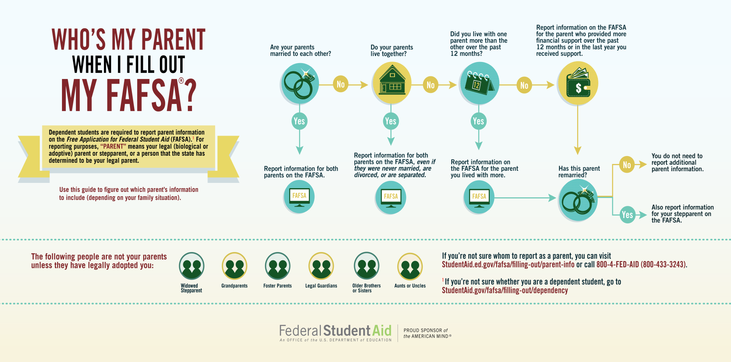
Parental Determination
AState.edu
/ArkansasState
@ArkansasState

Slide 58
Professional Judgment
AState.edu
/ArkansasState
@ArkansasState

Slide 59
Professional Judgment
Families cannot report special circumstances on the FAFSA
Professional judgment must be completed after the student submits the FAFSA and completes verification (if required)
Professional judgment is exercised by the Financial Aid Administrator
Link for more information: https://fafsa.ed.gov/fotw1920/help/fahelp26j.htm
AState.edu
/ArkansasState
@ArkansasState

Slide 60
Professional Judgment Basics
“the authority of the financial aid administrator, on the basis of adequate documentation, to make adjustments on a case-by-case basis to the cost of attendance or the values of the data items required to calculate the expected student or parent contribution (or both) to allow for treatment of an individual eligible applicant with special circumstances.”
AState.edu
/ArkansasState
@ArkansasState

Slide 61
Professional Judgment
Process varies from college to college
Documentation must be provided
Situations which warrant professional judgment may include:
  Dependency Overrides
  Divorce, death or parent
  Loss of income by student or parent
  Unusual medical expense
AState.edu
/ArkansasState
@ArkansasState

Slide 62

Professional Judgment
Unusual uncovered medical/dental expenses
Loss of employment
Death of parent
One-time taxable income
Loss of untaxed income
Death of spouse
Divorce
AState.edu
/ArkansasState
@ArkansasState

Slide 63
Professional Judgment
Dependency Override
Situation in which Financial Aid Administrators have the authority to change the student’s status from dependent to independent
  Student is unable to answer “Yes” to any of the dependency status questions due to a special circumstance.
Student must provide documentation of situation.
AState.edu
/ArkansasState
@ArkansasState

Slide 64
Professional Judgment
Dependency Override
Special circumstances:
  Abuse at home
  Abandonment by parents
NOT Special Circumstance:
  Parent’s do not claim student on taxes
  Student does not live with parents and supports self
  Parent’s do not want to help pay for college
  Parent’s refuse to provide information for FAFSA
AState.edu
/ArkansasState
@ArkansasState

Slide 65
Professional Judgment
Dependency Override
Documentation includes:
  Letter from student describing the circumstances
  Letter from friend or family member close to the situation that can describe the student’s circumstance
  Letter from a third party:
    Teacher
    Social Worker
    Member of Clergy
    Court Documents
    Law Enforcement
    Physician/Counselor
AState.edu
/ArkansasState
@ArkansasState

Slide 66
Completing the FAFSA without Parent Information
AState.edu
/ArkansasState
@ArkansasState

Slide 67
No Access to Parental Information
FAFSA will ask if student will be providing parental data
If no, student may indicate that he/she meets special circumstances criteria
Student may submit FASFA without parental information
  FAFSA will have a reject code which will prevent student from being awarded
    Student will need to contact the Financial Aid Office to complete the application with a possible Dependency Override
AState.edu
/ArkansasState
@ArkansasState

Slide 68
Parents Refusal to Provide Information
Student indicates situation on the FAFSA, selecting the option to apply for an unsubsidized loan only
Student may submit FASFA without parental information
  FAFSA will have a reject code which will prevent student from being awarded
    No EFC will be calculated and the student will not be eligible to receive the Pell Grant any other need-based aid
    Student will need to contact the Financial Aid Office to complete the application
AState.edu
/ArkansasState
@ArkansasState

Slide 69
AState.edu
/ArkansasState
@ArkansasState

Slide 70
Reviewing and Comparing Award Letters
Out-of-pocket expenses after financial aid
Mixture of grants and self-help aid
Future award packages
AState.edu
/ArkansasState
@ArkansasState

Slide 71
Establishing a Relationship with the Financial Aid Office
Importance
Questions to Ask
Benefits
AState.edu
/ArkansasState
@ArkansasState

Slide 72
AState.edu
/ArkansasState
@ArkansasState

Slide 73
Searching for Scholarships
AState.edu
/ArkansasState
@ArkansasState

Slide 74
Scholarship Search Tips
Never pay for scholarship searches
  Always use free scholarship search engines
Pay close attention to application deadlines
Be sure that you understand the guidelines on how to apply
AState.edu
/ArkansasState
@ArkansasState

Slide 75

Scholarship Sources
AState.edu
/ArkansasState
@ArkansasState

Slide 76
Online Sources
www.scholarships.com
www.fastweb.com
www.unigo.com/scholarships
https://bigfuture.collegeboard.org/pay-for-college/grants-scholarships
https://fundmyfuture.info/scholarships
https://studentaid.ed.gov/sa/types/grants-scholarships/finding-scholarships
http://www.careerinfonet.org/scholarshipsearch/ScholarshipCategory.asp?searchtype=category&nodeid=22
AState.edu
/ArkansasState
@ArkansasState

Slide 77
Additional Financial Aid Resources
Don’t Get Scammed on Your Way to College
http://studentaid.gov/sites/default/files/dont-get-scammed.pdf
Federal Trade Commission
http://www.ftc.gov/scholarshipscams
Formal Feedback/File a Complaint
https://feedback.studentaid.ed.gov
AState.edu
/ArkansasState
@ArkansasState

Slide 78
Arkansas State University Scholarship Programs
AState.edu
/ArkansasState
@ArkansasState

Slide 79
A-State Scholarship Programs
A-State will make Institutional Scholarship offers to 2021 High School graduates based on ACT/SAT and GPA. ACT/SAT super scores will be accepted for scholarship consideration (excluding A-State Scholar)
AState.edu
/ArkansasState
@ArkansasState

Slide 80
A-State Scholarship Eligibility
Must be a U.S. Citizen
Must be a 2021 high school graduate
Must submit all official high school and concurrent college transcripts
Must submit all official ACT, SAT test scores
Must submit all immunization records
AState.edu
/ArkansasState
@ArkansasState

Slide 81
A-State Scholarship Process
Students must be admitted to receive full consideration for A-State Institutional Scholarships.
No separate application is required, except for the A-State Scholar
  The A-State Scholar requires additional documentation
  Deadline is December 1, 2020
  Visit www.astate.edu/AStateScholar for more details
AState.edu
/ArkansasState
@ArkansasState

Slide 82
A-State Scholarship Awarding
Scholarship offers will be made monthly beginning October 15, 2020 through July 1, 2021.
Scholarship amounts can be upgraded based on receipt of new ACT/GPA through July 1, 2021 (excluding Astate Scholar)
To accept scholarships and the Terms and Conditions, monitor the A-State myCampus portal http://myCampus.astate.edu
AState.edu
/ArkansasState
@ArkansasState

Slide 83

AState.edu
/ArkansasState
@ArkansasState

Slide 84

A-State Privately Funded Scholarships
Online application for Privately Funded Scholarships available October 1, 2020 through February 1, 2021.
  Scholarships are offered by the various colleges on campus.
  www.astate.edu/scholarships
    Students may upload personal essays, student resumes, and letters of recommendation.
AState.edu
/ArkansasState
@ArkansasState

Slide 85


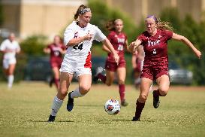

A-State Performance Scholarships
Students will need to contact the appropriate department for scholarship information.
AState.edu
/ArkansasState
@ArkansasState

Slide 86
AState.edu
/ArkansasState
@ArkansasState

Slide 87
A-State Admissions Update
Pamela Bowie
Senior Director of Admissions
AState.edu
/ArkansasState
@ArkansasState

Slide 88
Today’s Agenda
2021 Admission Application
2021 Admission Standards
Electronic document submission
ArkACRAO Virtual College Fair
Virtual Pack Preview October 30
AState.edu
/ArkansasState
@ArkansasState

Slide 89

2021 Admissions Application
Fee Waivers
  Currently enrolled high school concurrent students @ A-State partner schools
  $0 EFC on FAFSA
  Qualify for free/reduced lunch
  Received an ACT/SAT fee waiver
  Participant in a federally-funded TRIO program
  https://admissions.astate.edu/register/appfeewaiver
AState.edu
/ArkansasState
@ArkansasState

Slide 90
2021 Admissions Application
Social Security Numbers
Not required on the application
Required for access to the my.Astate portal
  Housing application
  Class registration
  Account balance
  Alternative IDs: Tax ID number, DACA number
  Students should not make up SSNs
AState.edu
/ArkansasState
@ArkansasState

Slide 91
2021 Admissions Application
Undocumented Students
  Undocumented students are not prohibited from attending A-State
  Not all undocumented students are DACA students
  Contact the registrar to discuss in-state tuition eligibility under Arkansas Act 844
AState.edu
/ArkansasState
@ArkansasState

Slide 92
2021 Admission Standards
“Flexible” is the key word
  21 ACT/1060 SAT superscore and 2.75 GPA = unconditional admission
  19 ACT/990 SAT superscore and 2.3 GPA = conditional admission (Transition Studies)
  3.0 cumulative GPA with
    No test score = test-optional admit (test score still required for enrollment)
    15 ACT/830 SAT – 18 ACT/970 SAT = test optional admit (encouraged to continue testing for placement purposes)
AState.edu
/ArkansasState
@ArkansasState

Slide 93
Electronic Document Submission
Email is not considered official
  Slate.org
  DropBox
    Email admissions@astate.edu for links
  CommonApp/Naviance
  TRIAND
  Mail:
    Office of Undergraduate Admissions
    P O Box 1800
    State University, AR 72467
AState.edu
/ArkansasState
@ArkansasState

Slide 94
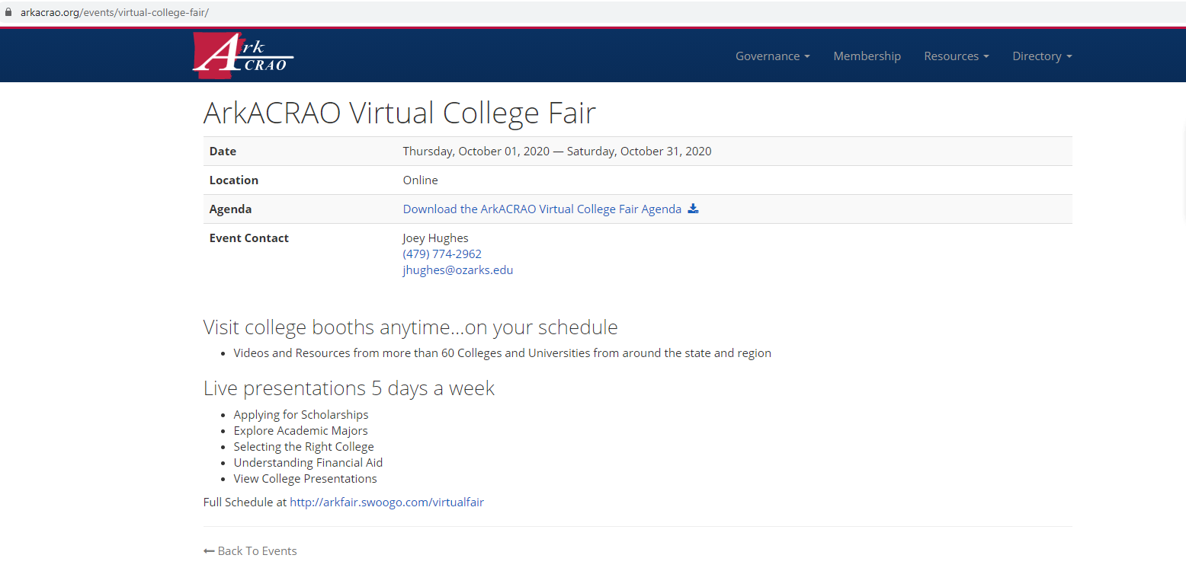
ArkACRAO Virtual College Fair
ArkACRAO.org
AState.edu
/ArkansasState
@ArkansasState

Slide 95
Virtual Pack Preview Day
visit.AState.edu
Friday, October 30, 2020
  Live welcome @ 9:30 am
  Info sessions @ 10 am and 1 pm
    Freshmen admission
    Honors
    Financial aid and scholarships
    Housing
  College sessions @ 10:45 am and 1:45 pm
  A-State @ A Glance 11:30 - 1 pm
    Student organizations
    Campus resources
    Dining services
    Culture and inclusion
    How to pick a major
    Study Abroad
AState.edu
/ArkansasState
@ArkansasState

Slide 96
Contact us!
870-972-2782
admissions@astate.edu
pbowie@astate.edu
@astateadmissions on social
Apply for admission: http://www.astate.edu/info/apply/
AState.edu
/ArkansasState
@ArkansasState

Slide 97
Arkansas Department of Higher Education (ADHE) Programs
AState.edu
/ArkansasState
@ArkansasState

Slide 98

ADHE Financial Aid Programs
Arkansas Challenge/Lottery Scholarship
Arkansas Concurrent Challenge
Arkansas Future Grant (ARFuture)
Arkansas Workforce Challenge Scholarship
Governor’s Distinguished Scholarship
Law Enforcement Officer’s Dependent Scholarship (LEO)
Military Dependent Scholarship (MDS)
National Guard Tuition Assistance
AState.edu
/ArkansasState
@ArkansasState
This Photo by Unknown Author is licensed under CC BY-SA

Slide 99
YOUniversal Application scholarships.adhe.edu
Available October 1st
Search and apply for all ADHE administered scholarship and grants at one time
Receive email status notifications
Student may manage their account 24/7:
  May update personal information and college of attendance
  Review transcript and test score information
AState.edu
/ArkansasState
@ArkansasState

Slide 100

YOUniversal Counselor’s Website
AState.edu
/ArkansasState
@ArkansasState

Slide 101

Traditional Challenge/Lottery
Academic Eligibility Criteria:
  Graduate from an Arkansas public high school, private school or home school
  Earn a 19 super-score on the ACT
  Deadline is July 1st
AState.edu
/ArkansasState
@ArkansasState

Slide 102
Traditional Challenge/Lottery
Basic Eligibility Criteria:
  Accepted for admission at an approved institution of higher education as a full-time student in a program of study that leads to a bachelor’s degree, associate degree, qualified certificate or a nursing school diploma
  Applicant must complete the YOUniversal Scholarship Application and the FAFSA.
AState.edu
/ArkansasState
@ArkansasState

Slide 103
Challenge/Lottery Scholarship Award Amounts
2 year Institutions
$1000 Freshman
$3000 Sophomore
4 year Institutions
$1000 Freshman
$4000 Sophomore
$4000 Junior
$5000 Senior
Students that have completed 27 or more college-level hours are eligible to request a waiver for first year award amount
  Must be submitted by June 1st Previous recipients will continue to receive the amounts stipulated in their original award
If student has remaining eligibility, they can use the scholarship towards a graduate-level or professional degree
Maximum award for 4 year institution is 120 hours; 2 year institution is 5 semesters
AState.edu
/ArkansasState
@ArkansasState

Slide 104
Traditional Challenge/Lottery
Enrollment
At least 12 hours the first Fall semester following high school
At least 15 hours each semester thereafter
Measured as of the end of the 11th class day
  Any hours added after the 11th class day do not count for eligibility
Only hours enrolled at a single school count
Renewal
Maintain a 2.5 cumulative GPA
Successfully complete at least 27 hours their first academic year
Successfully complete at least 30 hours each academic year thereafter
May use summer terms to meet hour and GPA requirements
Complete all required remedial courses within the first 30 semester hours after receiving the scholarship
AState.edu
/ArkansasState
@ArkansasState

Slide 105
Concurrent Challenge (ACT 456)
Academic Eligibility Criteria:
  Only high school Junior or Senior qualify
  Up to two concurrent credit courses per semester
Award Amount
  $125 per course
AState.edu
/ArkansasState
@ArkansasState

Slide 106
Arkansas Future Grant
Academic Eligibility Criteria:
  Graduate from an Arkansas public high school, private school, or home school
  Be enrolled part-time or full-time at an approved institution, in a program of study that leads to an associate degree or a certificate
  Must complete FAFSA
  Deadline to Apply for Fall: July 1st
  Deadline to Apply for Spring: January 10th
AState.edu
/ArkansasState
@ArkansasState

Slide 107
Arkansas Future Grant
Enrollment & Award
Will allow part-time enrollment
Awards Based off of two-year institution program costs for qualifying Associate and Certificate programs at public institutions
Grant will be awarded on a first come, first serve basis
Last to pay Grant
List of the programs available at AState:
https://static.ark.org/eeuploads/adhe-financial/ArFuture_Degrees_-Final2020-2021.pdf
Renewal
Maintain Satisfactory Academic Progress
Monthly mentoring per semester
Complete 10 hours of community service per semester
Once a student graduates, the recipient must work in Arkansas for 3 years
AState.edu
/ArkansasState
@ArkansasState

Slide 108
Distinguished Governor’s Scholarship
32 ACT score and;
3.5 academic GPA; or
National Merit or National Achievement Finalist
Up to 375 awards
FAFSA not required
Deadline is March 1st
AState.edu
/ArkansasState
@ArkansasState

Slide 109
Distinguished Governor’s Scholarship
If there is a county in Arkansas that does not have a Distinguished Scholar, the highest ranking applicant from that county will be awarded a Governor’s Scholarship at $5000 per year
AState.edu
/ArkansasState
@ArkansasState

Slide 110
Distinguished Governor’s Scholarship
Enrollment
At least 12 hours the first Fall semester following high school
At least 15 hours each semester thereafter
Measured as of the end of the 11th class day
  Any hours added after the 11th class day do not count for eligibility
Only hours enrolled at a single school count
Renewal
Maintain a 3.25 cumulative GPA
Successfully complete at least 27 hours their first academic year
Successfully complete at least 30 hours each academic year thereafter
May use summer terms to meet hour and GPA requirements
If student has remaining eligibility, they can use the scholarship towards a graduate-level or professional degree
AState.edu
/ArkansasState
@ArkansasState

Slide 111
Law Enforcement Officer’s Dependents Scholarship
Undergraduate dependent/spouse of Arkansas Law Enforcement Officer
  Killed or totally disabled in the line-of-duty
  Dependent must be under 23 years of age
Waiver of tuition, fees, and room
Deadline is July 1st
Renewal - minimum GPA: 2.0
AState.edu
/ArkansasState
@ArkansasState

Slide 112
Military Dependents Scholarship
Undergraduate dependent/spouse of service member who:
  Is Missing in Action (MIA);
  Was Killed in Action(KIA);
  Was a Prisoner of War (POW); or
  Permanently and totally disabled
State supported college, university or technical institute
Must apply for Chapter 35 benefits from the Veterans Affairs (VA) Office
Waiver of tuition, fees, and room and board in excess of VA benefits
Deadline is July 1st
Renewal - complete a minimum of 24 hours per academic year along with a minimum GPA of 2.0
AState.edu
/ArkansasState
@ArkansasState

Slide 113
Arkansas National Guard Tuition Waiver Program
Active member of the Arkansas Army/Air National Guard
State supported college, university or technical institute
Tuition and fees waiver
Last to pay Grant
Must contact their unit
For more information students may contact the Education Office at the Guard 501-212-4021
AState.edu
/ArkansasState
@ArkansasState

Slide 114
Scholarship Hold Request
Must be requested through the YOUniversal portal and documentation must be submitted explaining the reason for the hold
Maximum hold is 24 months (4 semesters) for the following:
  Medical condition of the student or immediate family member;
  Personal or immediate family emergency;
  Military service/training;
  Service in a national or international humanitarian project;
  Internship & Co-Op
  Financial hardship
AState.edu
/ArkansasState
@ArkansasState

Slide 115
ADHE Contact Information
ADHE Financial Aid Contact Information: finaid@adhe.edu
501-371-2000
AState.edu
/ArkansasState
@ArkansasState

Slide 116

AState.edu
/ArkansasState
@ArkansasState

