Slide 1
GME Governance and Financing: What can the IOM Committee Recommendations Accomplish?
Debra F. Weinstein, M.D.
Vice President, GME
Partners HealthCare System
dweinstein@partners.org

Slide 2
Context for the Deliberations: Perceived Problems
Mismatch between physician workforce and population needs
Insufficient physician diversity
GME graduates lack some competencies needed for current practice
Insufficient fiscal transparency, accountability for public funding
“Overpayment” of IME
Questions re: justification for public funding

Slide 3
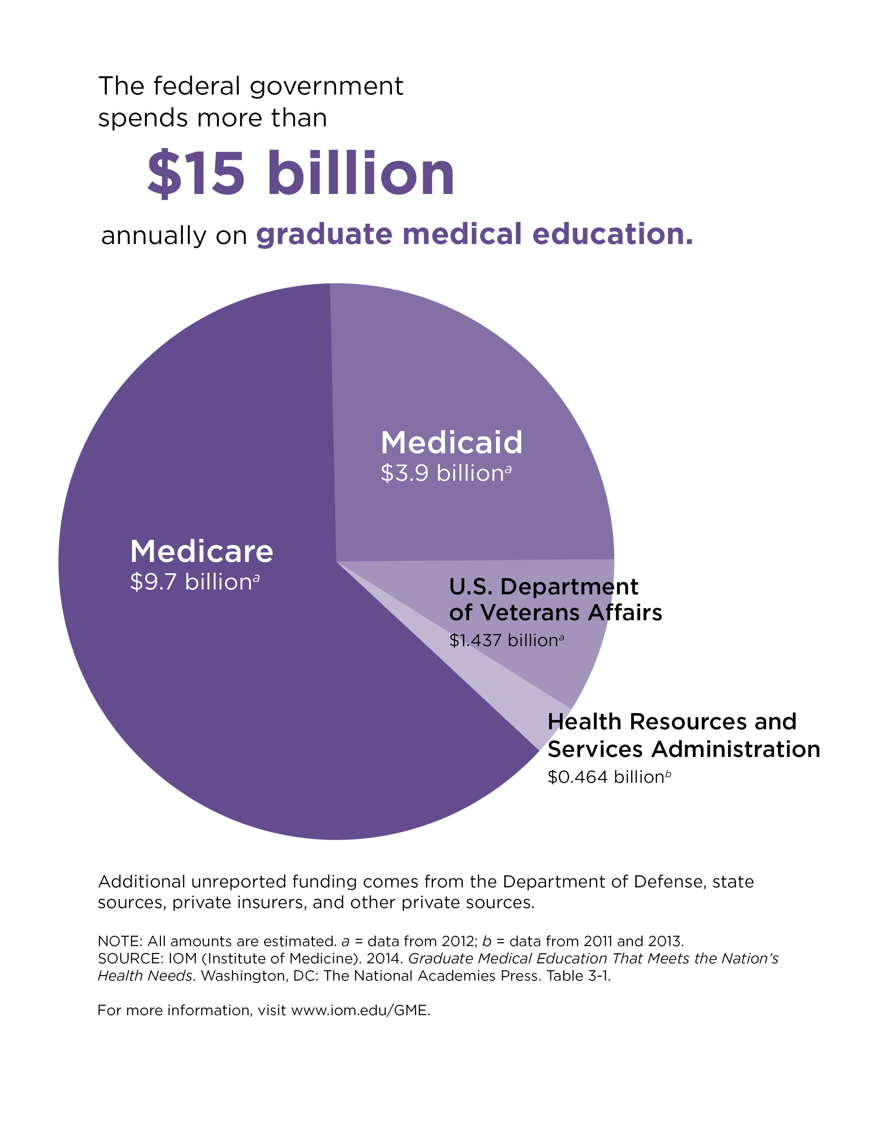
Primary Focus: $10B from Medicare
$15B in federal funding

Slide 4
Committee Observations Underlying the Recommendations
Forecasting need for physicians is historically unreliable
Medicare GME payment formulas are inflexible, inequitable, illogical, inscrutable and outdated
Net financial impact of sponsoring residency programs is poorly understood
↑Federal funding for GME (in the current system) wouldn’t address specialty or geographic needs
↑GME trainees isn’t dependent on ↑federal funding
  17.5% ↑ 2003-12 despite cap on Medicare-funded slots

Slide 5
Problems with Current Distribution Methodology
Linked to Medicare volume
  Children’s Hospitals and other non-PPS orgs excluded
  Disincentive for ambulatory training
DME linked to historic costs
  Significant variation in PRA’s
  Poor understanding of net financial impact
Cap on funded slots
  Locks in current funding distribution
Payments contingent only on accreditation
  Lacks incentive to improve outcomes or vehicle to influence production (e.g. specialty mix)
Payment to sites (rather than sponsors)
  Undermines accountability

Slide 6
The Gist of the Recommendations
➔Maintain stable, secure public funding for GME (at least for the next decade)
➔Move from cost-based to outcome-based funding
➔Improve the GME payment distribution methodology
➔Phase in changes to minimize problems from funding shifts
➔Incentivize, facilitate and support innovation
➔Leave Medicaid at states’ discretion, but require same transparency and accountability as for Medicare
➔Create a GME Policy Council in the Office of HHS Secretary and a GME Center within CMMS

Slide 7
Create one Medicare GME fund (i.e. merge IME and DME) with two subsidiary funds
Operational Fund
Transformation Fund
  develop and evaluate innovations in education
  pilot alternative GME payment methods
  determine and validate performance measures needed for an outcomes-based payment system
  award new Medicare-funded GME training positions in priority disciplines and geographic areas

Slide 8
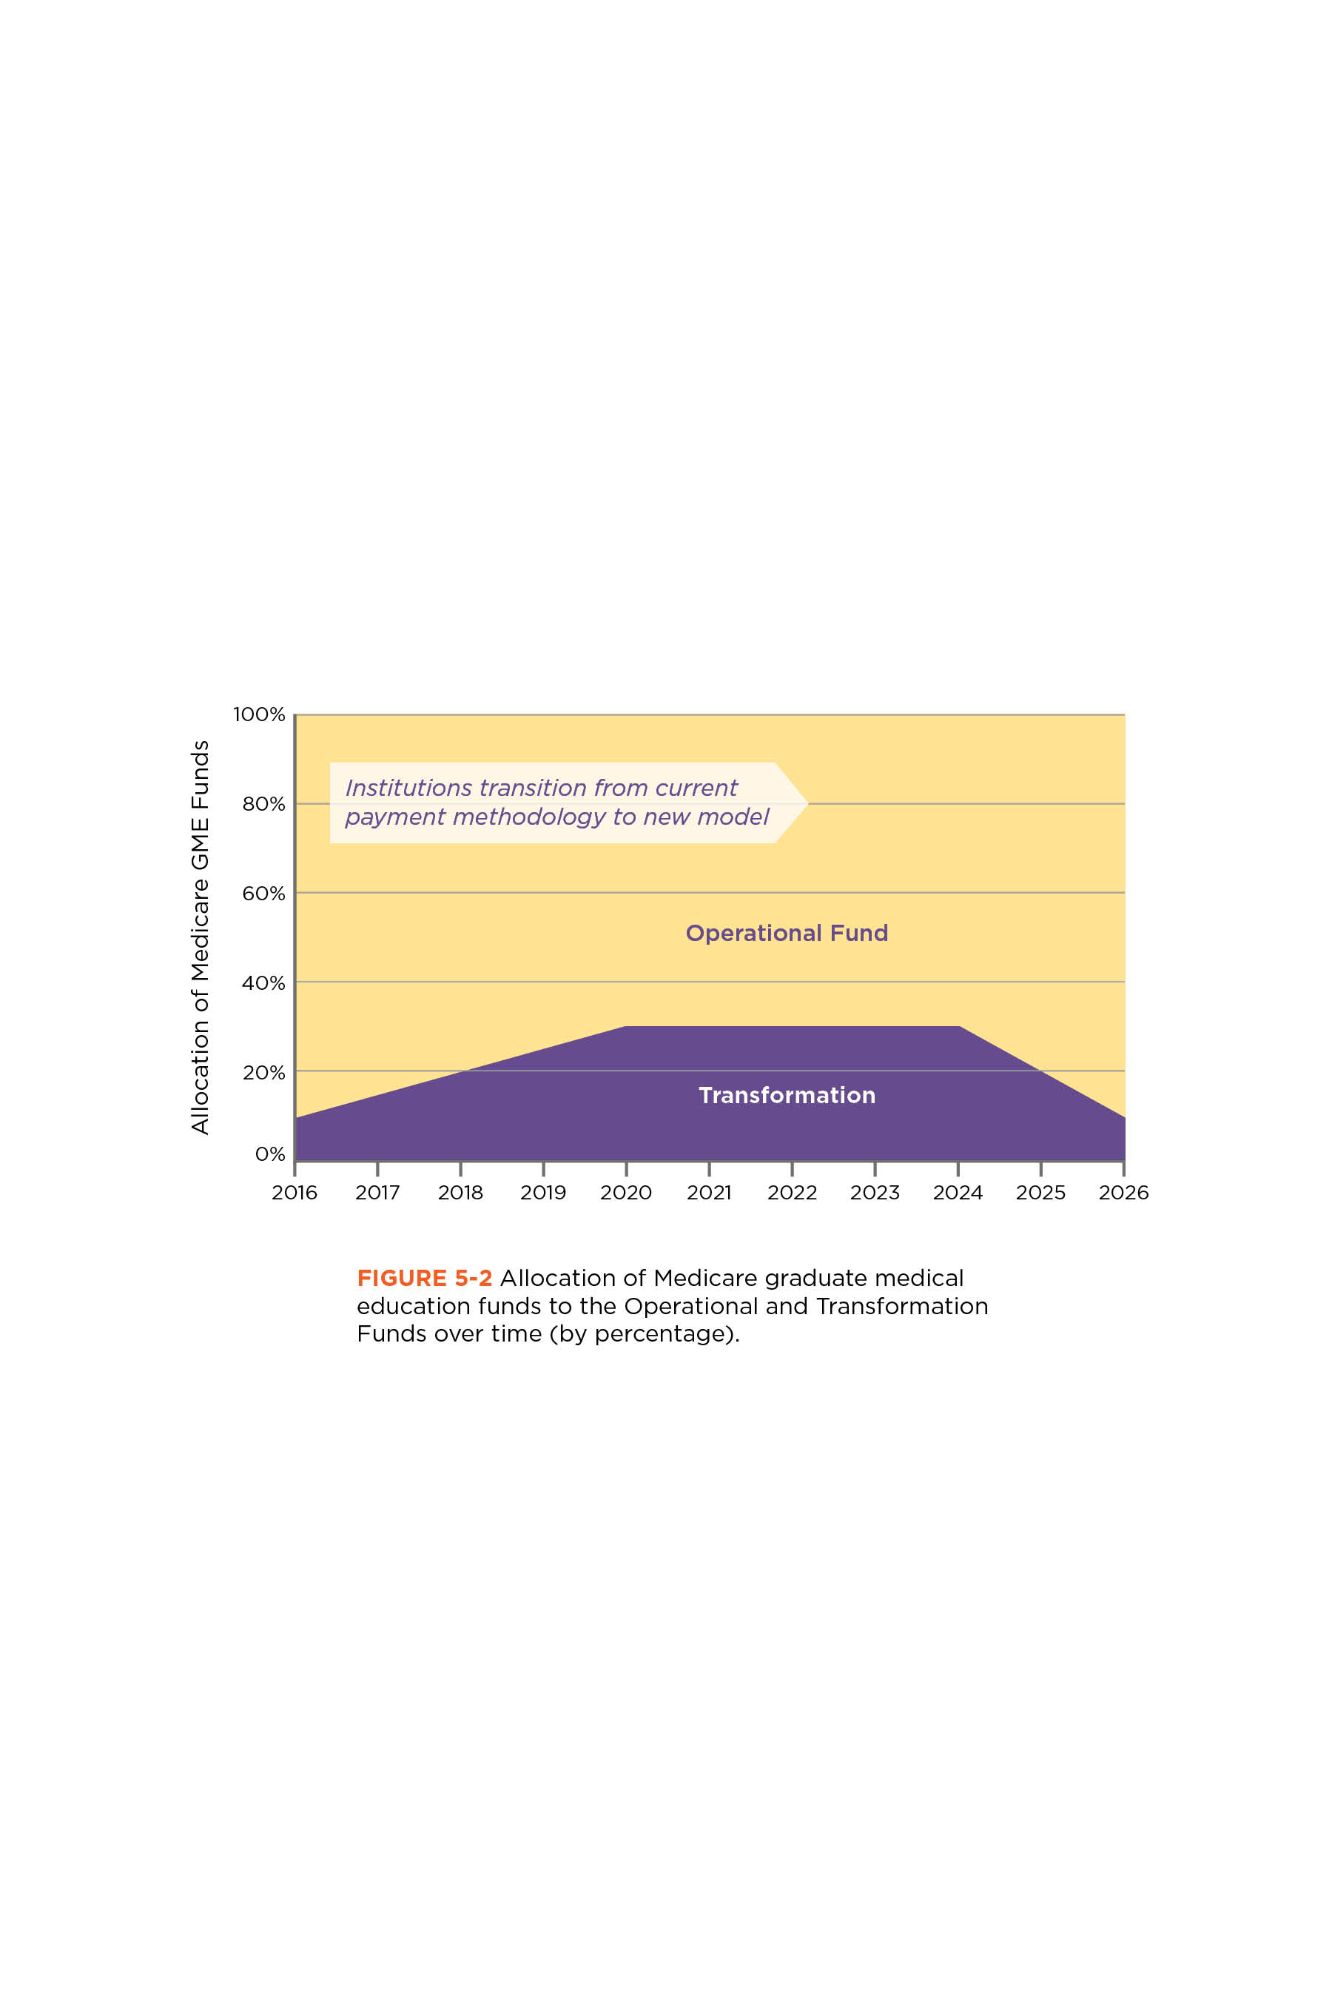
Overview of Proposed Funding Allocation

Slide 9
Modernize Medicare GME Payment Methodology
Operational funds distributed via a single payment (current IME and DME streams are combined)
National per-resident amount (PRA), with a geographic adjustment
  PRA = total value of the GME Operational Fund ÷ current # Medicare-funded training slots
Operational funds provided directly to sponsoring organizations
(Phase II:) Implement performance-based payments

Slide 10
Impact of Phase I Financing Recommendations
Funding for Children’s Hospitals & Teaching Health Centers
Institutional revenue (from Operational Fund) will ↑ or ↓
National PRA will ↓ during temp expansion of Transformation Fund
Funds →GME sponsor requires negotiations between affiliates
Coordinated collection and analysis of data relating to GME outcomes
Funding, structure, ?regulatory relief support research
Concerns about “empirically justified” IME become moot

Slide 11
Vision for Phase II
Operational Fund distributes performance-based payments
Transformation Fund supports ongoing R&D
System is flexible and nimble
  Outcomes data continually evaluated
  Payment incentives change to address evolving workforce needs
  Funding shifts (gradually) across sponsors and specialties to maximize outcomes
10-year re-evaluation: data documents high value outcomes

