Slide 1
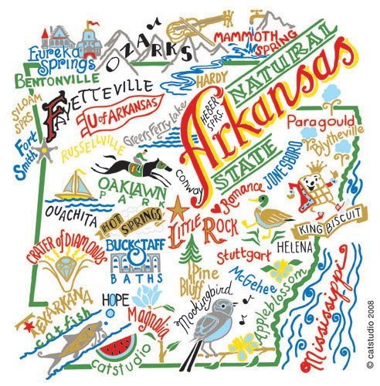
A Healthier Arkansas
Presented by: Tripp Umbach
10/16/14

Slide 2
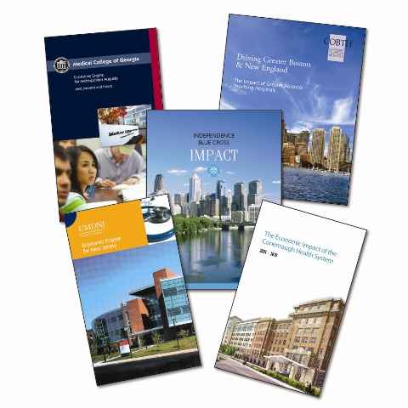
Introduction: Tripp Umbach
Over the past ten years, Tripp Umbach has been instrumental in 20 new or expanding medical education projects throughout the United States.
Since 1990, Tripp Umbach has consulted with 75 academic medical centers, more than 500 hospitals, and 250 universities across all 50 states.
Since 1995, Tripp Umbach has measured the economic impact of every U.S. medical school and teaching hospital.

Slide 3
In the mid-nineteenth century, it was easy to become a doctor in America…
Entrance requirements to medical schools were nonexistent other than the ability to pay the fees.
Laboratory work was sparse, and even in the clinical subjects, no opportunity to work with patients was provided.
University or hospital affiliations, in the few cases in which they existed, were nominal.

Slide 4
Physician Surplus Forecast Two Decades Ago; Officials Now Predict a Shortage
The Council of GME predicted that the U.S. would face a surplus of 80,000 physicians by the year 2000.
The AAMC predicted a physician shortage across the country of 62,900 physicians by 2015, growing to 130,600 by 2025.
The IOM has spoken about the numerous avenues by which a patient can receive care and how this complicates the physician shortage discussion.
Focused and innovative UME/GME planning to meet regional and statewide needs = grow your own / create pipeline.
1991
2010
2014
Future

Slide 5
Needs Assessment

Slide 6
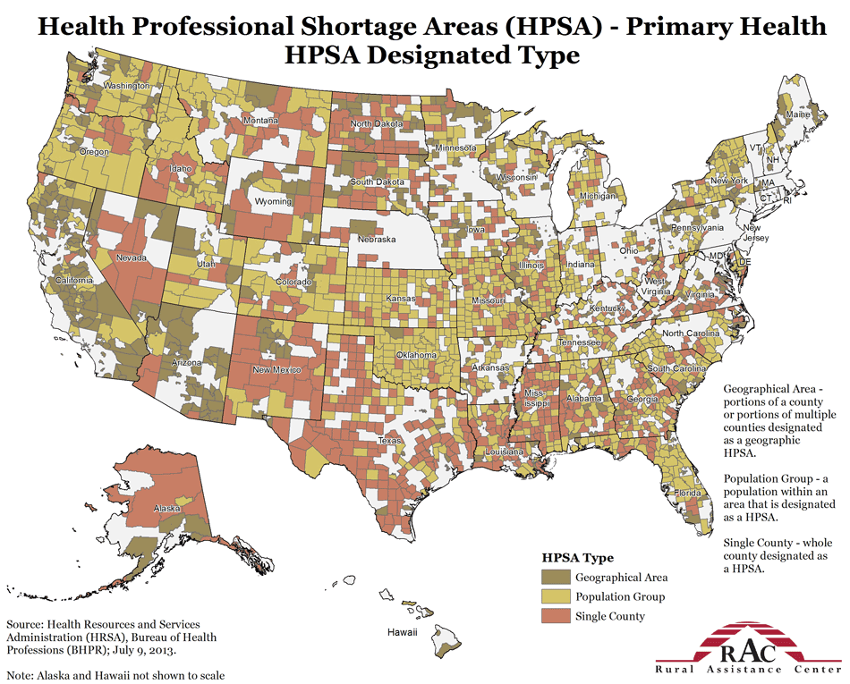
Arkansas Physician Shortages
48% of the counties in Arkansas are deemed to have health professional shortages.
In Arkansas, an estimated 551,000 people (19% of the state’s population) currently live in one of the 87 areas designated as a primary care HPSA.
An additional 61 practitioners would be needed in these communities to remove the HPSA designation, while an additional 128 primary care practitioners would be needed to achieve HRSA’s target practitioner-to-population ratio of 1:2,000.
Jonesboro, Ark.

Slide 7
Arkansas Health Rankings
State | Rank (1-10) | State | Rank (41-50)
Massachusetts | 1 | Arizona | 41
Maine | 2 | Arkansas | 42
Vermont | 3 | Oklahoma | 43
Hawaii | 4 | Georgia | 44
Maryland | 5 | Alabama | 45
Rhode Island | 6 | Nevada | 46
New York | 7 | Texas | 47
New Hampshire | 8 | Idaho | 48
Connecticut | 9 | Utah | 49
Minnesota | 10 | Mississippi | 50
Arkansas is ranked 42nd in terms of the lowest rate of primary care physicians per 100,000 population.
The Kaiser Family Foundation reports that the population of adults in Arkansas, compared to the national average in 2010, has lower life expectancy (76.1 versus 78.6) and higher rates of obesity (67.2% versus 63.8%), diabetes (9.6% versus 8.7%), smoking (22.9% versus 17.2%), and deaths per 100,000 due to heart disease (226.2 versus 186.5).

Slide 8
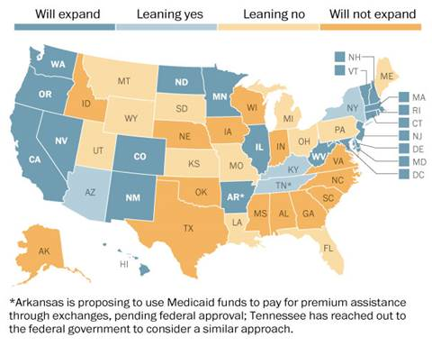
Future of Health care
The State Department of Human Services says more than 55,000 low-income Arkansans have said they want to sign up for coverage under a recently approved plan to use federal Medicaid funds to purchase private insurance.
Approximately 251,000 Arkansans may become eligible for Medicaid and approximately 323,000 Arkansans will qualify for subsidies to pay health insurance premiums in 2014.

Slide 9
Growth in D.O.s
Nationally the number of D.O.s has skyrocketed in the past 30 years from roughly 15,000 nationwide in 1980 to nearly 80,000 today.

Slide 10
Feasibility Study Overview (2013)
In September 2013, Arkansas State University retained Tripp Umbach to:
Assess the feasibility of opening an osteopathic medical school at the Jonesboro campus of Arkansas State University
Recommend the “ideal” osteopathic medical education program that can be supported both short-term and longer term by both the university and the Jonesboro community.
Feasibility Statement:
“Through the facilitation of a comprehensive feasibility study process that included such measures as interviews, work sessions, data analysis, financial analysis, and interest of hospitals and physicians in the region; Tripp Umbach has determined that the development of a new osteopathic medical school in Jonesboro, Ark. is feasible.”

Slide 11
Local Impact
The medical school will be a major driver of the regional economy, creating jobs and generating millions in annual net impact to the region.
$69.9 Million in Economic Impact during the 2-year start-up period; Growing to $87.7 Million Annually at full capacity
$2.1 Million in taxes to communities in Northeast Arkansas
317 jobs will be supported at start-up and 420 jobs at full capacity

Slide 12
Overview of Medical Education

Slide 13
The Continuum: A Long-Term Investment
GME/Residency Training
K – 12
College (4 years)
Medical School (4 years)
2 years basic science
2 years clinical clerkships
Graduate Medical Education
3 – 7 years advanced training in a specialty
Medical School
Phase 1
Phase 2
Phase 3
Phase 4
Undergraduate/
College
K-12 Education

Slide 14
How We Have Typically Viewed Economics of GME....

Slide 15
Economic Value to a Community
GME
Each Physician Who Stays in a Community Generates $1.3M in Economic Impact on the Region
Each Physician’s Practice within the Community on Average Creates an Additional 6-7 Jobs
Each Physician’s Practice on Average Generates $300,000 in Regional Tax Revenue
Each Resident Who Stays and Becomes a Primary Care Physician within an Underserved Area Generates on Average a $3.6M Economic Impact on the Region

Slide 16
GME Economics 101
Ranges from $50k Per Resident to as High as $180k Per Resident
% of Medicare in Patient Load
Ratio of Hospital Beds to Residents
Income from CMS:
The Balanced Budget Amendment of 1996, in which Congress froze federal funding for established medical residency programs.

Slide 17
Benefits to Hospitals Due to GME
Recruitment Cost Savings Resulting From Graduating Residents
Additional Hospital Operating Revenue (Profit) Generation Due to Graduated Residents Practicing at Hospital
Additional Hospital Operating Revenue (Profit) Generation Due to Specialty Physicians at Hospital because it has GME
Revenue from Quality Outcomes

Slide 18
Benefits to Hospitals Due to GME
Savings from Lower Utilization in Emergency Department
Image Enhancement in Key Program and Service Areas as a “Teaching Hospital”
Expansion of Potentially Profitable Programs Due to Residency Accreditation Requirements to Hire Additional Sub-Specialty Physicians
Workforce that is Closely Tied with the Culture of Both Your Hospital and Your Community

Slide 19
UME + GME = Doctors

Slide 20
Making a Difference in the Community
The future benefits resulting from expanding both UME and GME include:
Expanding access for underserved populations
Increasing the quality of healthcare
Increasing economic development through the attraction of highly qualified faculty and students
Attracting new industries who are drawn to regions with superior healthcare (i.e., Independent research organizations, Pharma, etc.)

Slide 21
Success
Based on national averages, students who complete both their UME and GME in Arkansas have a better than 80% chance of remaining in the state. Students that only complete UME in Arkansas have a 58% chance of remaining in the state.
This is why the integrated, collaborative process is so important.
The true success lies in developing pipelines, recruiting residents, and retaining graduates to an educationally enriched region.

Slide 22
Thank You
Questions anyone?

