Slide 1


Implications of
The IOM GME Report
Fitzhugh Mullan, MD
Murdock Head Professor of Medicine and Health Policy
George Washington University
Arkansas GME Summit
October 16, 2014

Slide 2
1st Year MD and DO Enrollment In
2003 Compared With Projected 2017 Enrollment Figures
  2003 2017 # and % Increase
  MD 16,541 21,434 4,893 29.6%
  DO 3,308 6,675 3,367 101.8% _______________________________________________
  Combined 19,849 28,109 8,260 41.2%
Sources: AAMC Results of the 2012 Medical School Enrollment Survey, May 2013;
AAMC Enrollment Data 2008 https://www.aamc.org/download/60740/data/enrollmentdata2008.pdf
AACOM – Trends in Osteopathic Medical School Applicants, Enrollment and Graduates
Notes:
MD 2007 Figure - https://www.aamc.org/download/60740/data/enrollmentdata2008.pdf
MD & DO 2017 Figure - AAMC Results of the 2012 Medical School Enrollment Survey, May 2013;
DO 2007 Figure - Trends in Osteopathic Medical School Applicants, Enrollment and Graduates - http://www.aacom.org/data/studentenrollment/Pages/default.aspx

Slide 4
1st Year MD and DO Enrollment In
2003 Compared With Projected 2017 Enrollment Figures
  2003 2017 # and % Increase
  MD 16,541 21,434 4,893 29.6%
  DO 3,308 6,675 3,367 101.8% _______________________________________________
  Combined 19,849 28,109 8,260 41.2%
Sources: AAMC Results of the 2012 Medical School Enrollment Survey, May 2013;
AAMC Enrollment Data 2008 https://www.aamc.org/download/60740/data/enrollmentdata2008.pdf
AACOM – Trends in Osteopathic Medical School Applicants, Enrollment and Graduates
Notes:
MD 2007 Figure - https://www.aamc.org/download/60740/data/enrollmentdata2008.pdf
MD & DO 2017 Figure - AAMC Results of the 2012 Medical School Enrollment Survey, May 2013;
DO 2007 Figure - Trends in Osteopathic Medical School Applicants, Enrollment and Graduates - http://www.aacom.org/data/studentenrollment/Pages/default.aspx

Slide 5
MD and DO Medical School Graduation Projections from 2008 - 2021
Academic Graduation Year | MD Graduates | DO Graduates | Total Graduates
2008-2009 | 16,467 | 3,588 | 20,055
2009-2010 | 16,836 | 3,631 | 20,467
2010-2011 | 17,362 | 4,159 | 21,521
2011-2012 | 17,343 | 4,458 | 21,801
2012-2013 | 18,156 | 4,726 | 22,882
2013-2014* | 18,665 | 5,428 | 24,093
2014-2015* | 19,230 | 5,788 | 25,018
2015-2016* | 19,517 | 5,986 | 25,503
2016-2017* | 20,055 | 6,449 | 26,504
2017-2018** | 20,654 | 6271 | 26,925
2018-2019** | 21,053 | 6,222 | 27,275
2019-2020** | 21,255 | 6,179 | 27,434
2020-2021** | 21,434 | 6,675 | 28,109
Sources: AAMC and ACCOM
*Notes extrapolated data
**Notes projected data
Notes:
2008-2012 MD & DO Graduation Data – Actual Graduation data from:
MD 2008: AAMC Data Book
MD 2009-2013 - https://www.aamc.org/download/321532/data/2013factstable27-2.pdf
DO 2008-2012 - http://www.aacom.org/data/graduates/Pages/default.aspx
DO 2013 - http://www.aacom.org/data/studentenrollment/Documents/prelim%20enroll%20report%202013%20fast%20facts%20103013.pdf
Projected Data:
*MD & DO 2013-2017 Based on current enrollment data
MD 2013-2017 - 2013 Applicant and Enrollment Data Charts - AAMC
https://www.aamc.org/download/358638/data/2013applicantandenrollmentdatacharts.pdf
DO 2013-2017 First-Year Enrollment by Gender 1968-2013 - http://www.aacom.org/data/studentenrollment/Pages/default.aspx
**MD & DO 2017-2021 – Based on Enrollment data from https://members.aamc.org/eweb/upload/12-237%20EnrollmSurvey2013.pdf
Does not account for attrition

Slide 6
New Entrants into GME: Entrants into GME Without Prior GME 2010-2013
Entrants
Year
Sources: NCHWA analysis of data from AAMC and AACOM, April 2012; Number for 2011 is provisional; Number for 2013 is from NRMP and AOA
Notes:
MD PGY-1 Positions - http://www.nrmp.org/match-data/nrmp-historical-reports/
DO PGY1- Positions - https://natmatch.com/aoairp/aboutstats.html

Slide 7

Projected US MD and DO Medical School Graduates (with 3% Attrition Rate) and 1st Year Entrants into GME (2009-2021)
Year
2014-2021 data are based on a 1% annual increase in entrants into GME
Notes:
3% Attrition Rate
GME Projections 2014 – 2020 based on a 1% annual growth
MD PGY-1 Positions - http://www.nrmp.org/match-data/nrmp-historical-reports/
DO PGY1- Positions - https://natmatch.com/aoairp/aboutstats.html
2009-2012 MD & DO Graduation Data – Actual Graduation data from:
MD 2009: AAMC Data Book
MD 2009-2013 - https://www.aamc.org/download/321532/data/2013factstable27-2.pdf
DO 2009-2012 - http://www.aacom.org/data/graduates/Pages/default.aspx
DO 2013 - http://www.aacom.org/data/studentenrollment/Documents/prelim%20enroll%20report%202013%20fast%20facts%20103013.pdf
Projected Data:
*MD & DO 2013-2017 Based on current enrollment data
MD 2013-2017 - 2013 Applicant and Enrollment Data Charts - AAMC
https://www.aamc.org/download/358638/data/2013applicantandenrollmentdatacharts.pdf
DO 2013-2017 First-Year Enrollment by Gender 1968-2013 - http://www.aacom.org/data/studentenrollment/Pages/default.aspx
**MD & DO 2017-2021 – Based on Enrollment data from https://members.aamc.org/eweb/upload/12-237%20EnrollmSurvey2013.pdf
All data based on enrollment data – does not account for attrition
2010-2013 MD, DO and Combined graduates – based on real graduation data
2013-2017 MD, DO and Combined graduated – based on real enrollment data – no account for attrition
MD Graduation Projections 2016-2021 – AAMC 2013 Enrollment

Slide 8
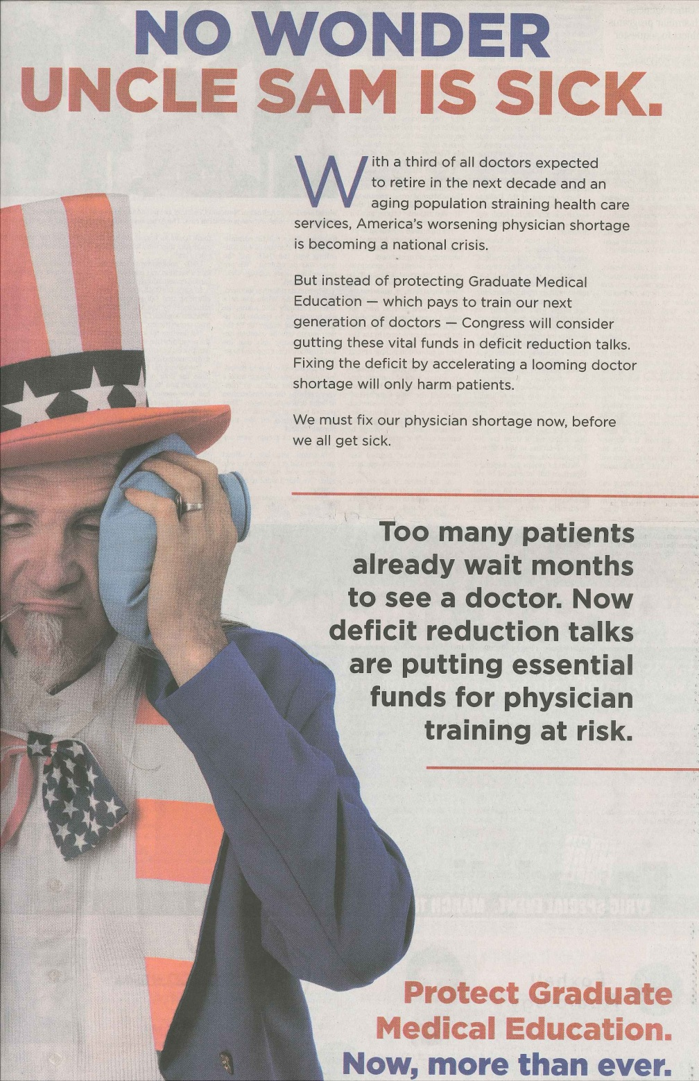
Source: The Washington Post, March 11, 2013

Slide 9
Source: American Medical Association (www.savegme.org).

Slide 10
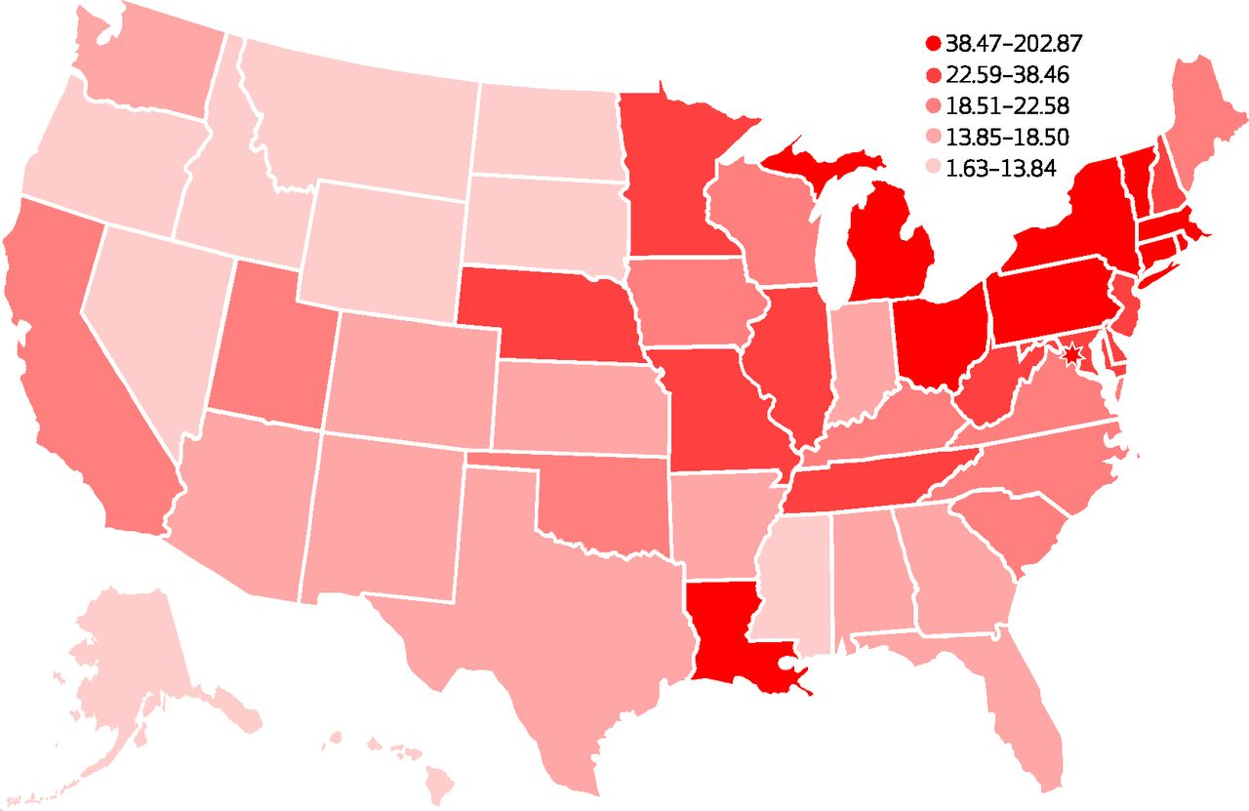
State Medicare Graduate Medical Education Cap Per 100,000 Population, 2010.
Mullan F et al. Health Aff 2013;32:1914-1921
Notes:
State Medicare Graduate Medical Education Cap Per 100,000 Population, 2010

Slide 11
State Level Medicare Graduate Medical Education Cap and Payments, Arrayed by Cap per 100,000 Population (Selected States)
State | Population | Resident cap | Resident Cap per 100,000 population | Resident number | Medicare GME payments | Medicare GME payment per population | Medicare GME average payment per resident
NY | 19,378,102 | 14,945.91 | 77.13 | 15,549 | $2,008,212,352 | $103.63 | $139,126
CT | 3,574,097 | 1,774.65 | 49.65 | 1,844 | $266,880,096 | $74.67 | $155,135
US | 312,471,327 | 91,559.05 | 29.31 | 101,024 | $10,094,758,522 | $32.31 | $112,642
KS | 2,853,118 | 527.73 | 18.50 | 548 | $52,258,136 | $18.32 | $100,834
AR | 2,915,918 | 455.66 | 15.63 | 515 | $35,584,024 | $12.20 | $79,144
MS | 2,967,297 | 333.84 | 11.25 | 437 | $22,162,972 | $7.47 | $67,527

