Slide 1
The Single GME
Accreditation System
October 16, 2014

Slide 2
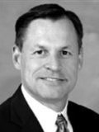
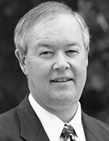
Speakers
John Potts, MD
Senior Vice President, ACGME
Adrienne White-Faines, MPA
Executive Director and CEO, AOA
Boyd Buser, DO
AOA Board of Trustees

Slide 3
The medical professions are at a crossroads. We must evolve and adapt.
Notes:
Dr. Potts
Environmental factors that prompted discussion and led to partnership.
The medical professions at a crossroads.
Increased demand for quality, accountability and pay for performance
Renewed focus on preventive medicine, care management, and technology
Medicine is changing
Affordable Care Act impacting institutions, payers and physicians
More physicians choosing to be employed vs. private practice
Approach to training, including GME, must evolve to align with expectations of patients, policymakers, future physicians and other key stakeholders.
Believe single GME system is the best way forward to show our commitment to quality, accountability, and teamwork in training next generations of physicians.
Shared vision on a new approach to health care delivery focused on enhancing consistency of process and strengthening public trust.
Empowers young professionals with the power of choice.
Shares osteopathic medicine’s unique principles and practices with patients and MD colleagues throughout their training.

Slide 4
Why a Single Accreditation System?
Consistent evaluation and accountability
Enhanced opportunities for trainees
Eliminate unnecessary duplication
Efficiencies and cost-savings in accreditation
One accreditation system transparent to:
Federal government
Licensing boards
Credentials committees
Public
Notes:
Dr. Potts

Slide 5
AOA-Approved Programs
May apply for ACGME accreditation July 1, 2015
To achieve Initial Accreditation, programs must demonstrate substantial compliance with Program Requirements
For programs that have:
AOA approval
Matriculated residents/fellows
Two systematic exceptions to ACGME PRs
AOA-certified faculty members will be “acceptable to the review committee”
A program may have an osteopathic co-program director
Notes:
Dr. Potts

Slide 6
Pre-Accreditation Status
Created for and to be applied only during the transition to ACGME accreditation of currently AOA-approved programs
Extended to include institutions
Is not synonymous with Initial Accreditation
Granted upon receipt of completed application
Does not require IRC / RRC review
Status will be publicly acknowledged
Individuals who complete programs that have previously achieved “Pre-Accreditation Status” will be subject to eligibility standards in effect June 30, 2013
This does not mean that such graduates are eligible for all ACGME subspecialty programs
Notes:
Dr. Potts

Slide 7
Pre-Accreditation Status
Importance to ACGME:
Programs will be in data system
ADS annual update
Case logs
Resident survey
Faculty survey
Milestones
Remains in effect until:
Program achieves Initial Accreditation; or
Program withdraws application; or
June 30, 2020
Notes:
Dr. Potts

Slide 8
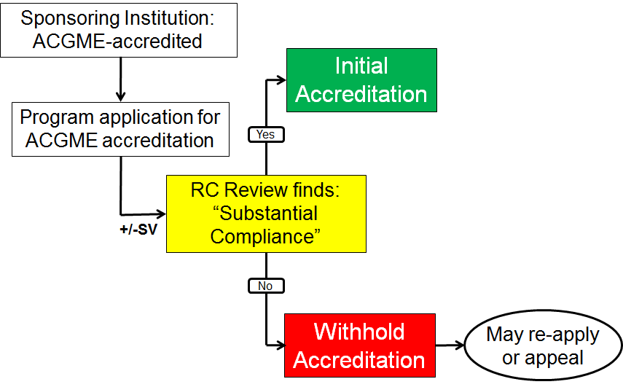
Application Process
Actions on Usual Applications
Notes:
Dr. Potts

Slide 9
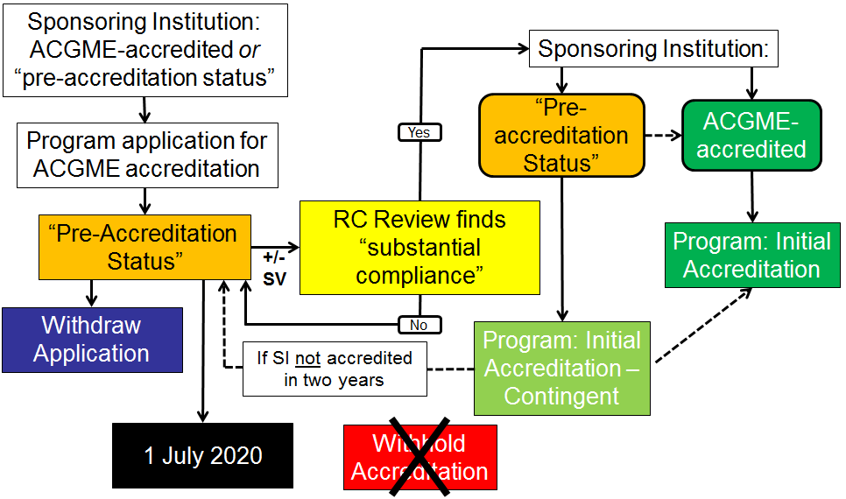
Application Process
Actions on AOA Applications
Notes:
Dr. Potts

Slide 10
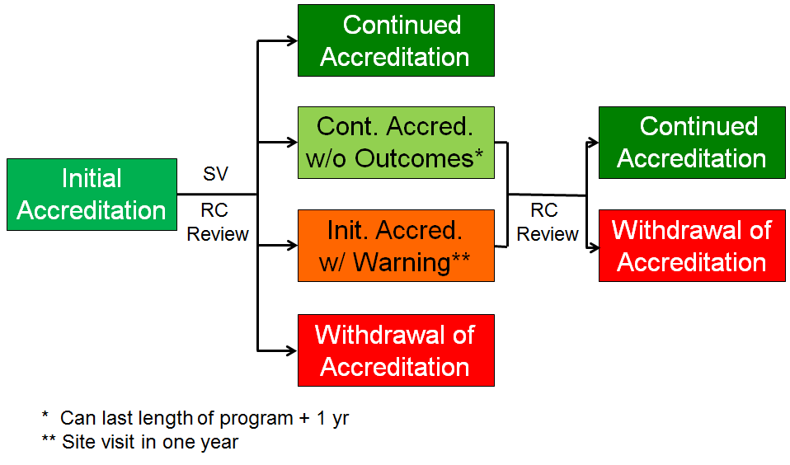
Application Process
After Initial Accreditation
Notes:
Dr. Potts

Slide 11
Application Process
We want AOA programs to succeed
Things we are doing to assist in transition:
Pre-Accreditation Status
No “Withhold” on applications
Multiple applications; one application fee
Waiving PRs for ABMS certification of faculty
Allowing co-program directors
Educating AOA programs about ACGME
Notes:
Dr. Potts

Slide 12
Single Accreditation System Timeline
Education & Application Processes
2014-2015 Oct Nov Dec Jan Feb Mar Apr
Educate Program Directors
on application process, preparation and timeframe
Educational forums
Institutions may apply for
“pre-application” status
Begin
April 2015
Individual programs able to apply for “pre-accreditation” status
Begin July 2015
Notes:
Dr. Potts

Slide 13
The Osteopathic Perspective
Goals of Single GME
Act in the best interest of patients
Respond to dynamic growth, interest in OM
Preserve unique dimensions of osteopathic medicine
Secure broad access to postdoctoral training for current and future physicians
Affirm appropriate role and voice of DOs in governance
Benefits & Opportunities
Consistent approach to training that encourages all physicians to deliver quality care in a holistic, patient-centered fashion
Aligns competency standards
Aligns with policy makers’ expectations
Stronger, unified voice on GME access and funding issues
Greatly increases visibility of osteopathic medicine
Overall, seek to enhance efficiency, relevance and innovation in post-graduate GME in the U.S.
Notes:
Adrienne

Slide 14
Single System Infrastructure
Single Accreditation System
ACGME Board of Directors
Recognition Committee for OM Residency Designation
RRCs with Osteopathic Medicine GME
RRC for NMM/OMM
RRC Monitoring Committee
Joint Task Force Overseeing Transition
Senior VP to Oversee Osteopathic Accreditation
AOA/AACOM Integrated into Governance and Operations of New ACGME
Notes:
Adrienne

Slide 15
Elements of Agreement
AOA and AACOM join governance of ACGME as member organizations
Beginning July 1, 2015, accredited AOA programs begin 5-year transition to ACGME accreditation
Osteopathic standards are added to ACGME standards to define osteopathic programs
DOs and MDs eligible for all residencies
Notes:
Dr. Buser

Slide 16
Maintaining Distinctive Elements of Osteopathic Educational Continuum
Changed
GME Accreditation
Unchanged
CME
Board Certification
Predoctoral Education
COMLEX
The agreement streamlines the accreditation of GME programs but does not alter the distinctive elements of the other components of the osteopathic medical profession’s educational continuum.
Notes:
Dr. Buser
Board Certification, CME, Predoctoral Education, COMLEX – All will continue to operate according to current procedures.
In short, the agreement streamlines the accreditation of GME programs but preserves and protects the structures within each medical profession.

Slide 17
Considerations for Hospitals
Financial implications
Hospitals with dually accredited and parallel accredited programs should realize cost savings as they no longer have to maintain two separate GME accreditation systems
Institutional sponsorship
Choice of self-sponsor, third-party sponsor or OPTI sponsor
Benefits of maintaining osteopathically-focused programs
Goal is to grow and strengthen programs to meet demand
AOA + ACGME
ACGME
Notes:
Dr. Buser

Slide 18
Why Maintain Osteopathic Programs?
DOs’ holistic approach to care aligns with national health care objectives
DOs tend to train and practice in community-based settings, and understand the unique health care needs of their communities
DOs mostly practice in the primary care specialties of family medicine, internal medicine, pediatrics and OB/GYN
DOs who provide specialty care in communities tend to be more involved in patients’ continuum of care
DOs help to fill a critical need for physicians in rural, urban and other medically underserved communities
Notes:
Dr. Buser

Slide 19
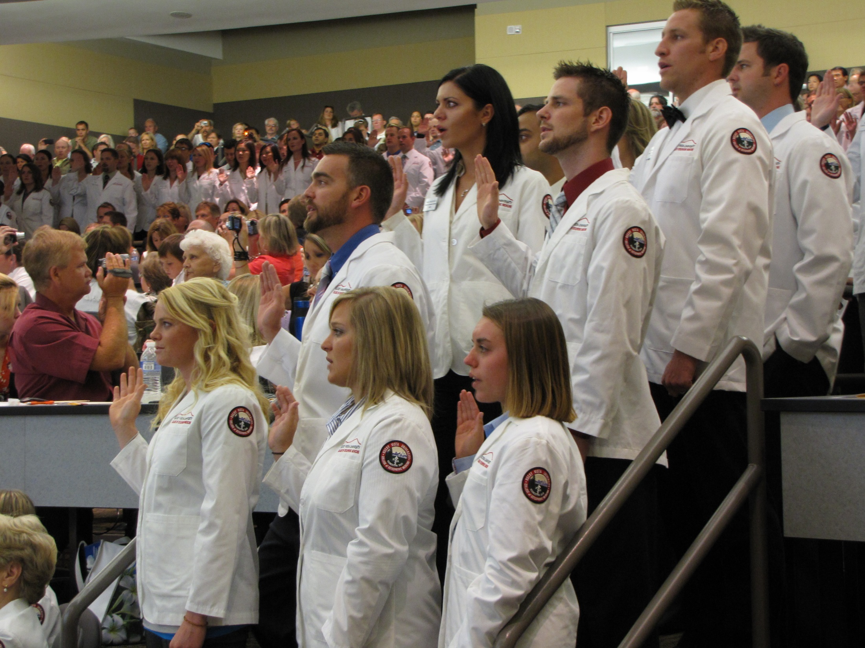
A new day in
graduate medical education
SINGLE GME ACCREDITATION
Discussion and Q&A
Notes:
Dr. Buser

Slide 20
Resources and Questions
SingleGME@osteopathic.org info@acgme.org
www.osteopathic.org/SingleGME
www.acgme.org

