Slide 1



Data Informed Decisions
Summer 2020 Workshop: Content Series #7
presented by: Dr. Summer DeProw
July 15, 2020
AState.edu
/ArkansasState
@ArkansasState

Slide 2



Workshop Procedures
Welcome and thank you for participating in our Summer Workshop Series!
You will be muted upon entry to the workshop, so please introduce yourself via the Chat feature by clicking “Chat.”
The window to the right will appear where you can add your introduction:
If you have questions during the session, please add them to the Chat box and at the conclusion of our time we will include them in the Q and A.
AState.edu
/ArkansasState
@ArkansasState

Slide 3
Workshop Agenda
Attendees will be able to:
  Connect the dots between learning outcomes, curriculum maps, direct measures data, and indirect measures data
  Collect Data from applicable measures
    Use Blackboard, EAC, Excel, Scantron, Qualtrics and other methods to collect data
  Organize Data
    By rubric row, exam item, survey answer, etc.
  Identify what the data results mean for the measure, course, program
    How/When/Where to engage program/course faculty in assessment analysis and interpretation
AState.edu
/ArkansasState
@ArkansasState

Slide 4
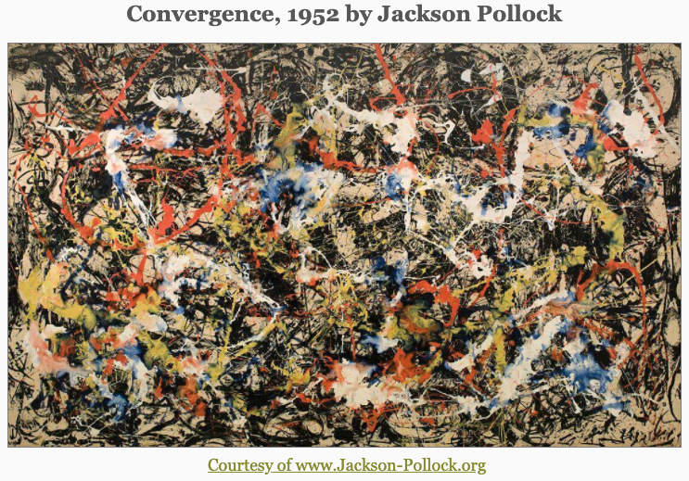
Organize data to develop a coherent learning story…
AState.edu
/ArkansasState
@ArkansasState

Slide 5
How did we get here?
Learning Outcomes
Curriculum Mapping
Direct and Indirect Measures
Data Findings
AState.edu
/ArkansasState
@ArkansasState

Slide 6
Before you start, check the checkpoints
  Does the data speak to the faculty?
  How many students included in the data?
  How many cycles/years of data included?
  Does the process have efficacy?
  Find the curriculum map?
AState.edu
/ArkansasState
@ArkansasState

Slide 7
Data Capture
Can be done by:
  Blackboard Reporting
  EAC Visual Data
    Across Course Shells of one professor
    Across Sections of a single course
    Across Time for a course
  Scantron Reports
    Through the Testing Center
  Qualtrics
    Predominately used with surveys, but can be used for Direct Assessment (i.e. exams or qualitative analysis of ”long answer” responses)
AState.edu
/ArkansasState
@ArkansasState

Slide 8
Inter-Rater Reliability
Definition
Wide-range of applications across a variety of situations so there is no single definition (Gwet, 2014)
Basic concept is to determine the intentional agreement between raters and remove the happenstance agreement due to rater guessing
Usually reported between 0 to 1, but some measures can offer negative scores between -1 and 0.
Why is IRR important?
“Nearly universal” agreement that reliability is an important property in educational measurement (Bresciani, et al., 2009)
We are scoring student work that cannot be scored objectively but requires a rating of degree
The goal is to minimize the variations between raters to formalize the criteria for scoring student work
Gives an opportunity for training
Less formally, it should spark robust conversation between professors about what students should know and be able to do and/or the data professors need to make student-learning action plans
AState.edu
/ArkansasState
@ArkansasState

Slide 9
Data Reporting with Rubrics
AState.edu
/ArkansasState
@ArkansasState

Slide 10
Data Reporting with Rubrics
AState.edu
/ArkansasState
@ArkansasState

Slide 11
Data Reporting with Rubrics
AState.edu
/ArkansasState
@ArkansasState

Slide 12
Before you start, check the checkpoints
  Does the data speak to the faculty?
  How many students included in the data?
  How many cycles/years of data included?
  Does the process have efficacy?
  Find the curriculum map?
AState.edu
/ArkansasState
@ArkansasState

Slide 13
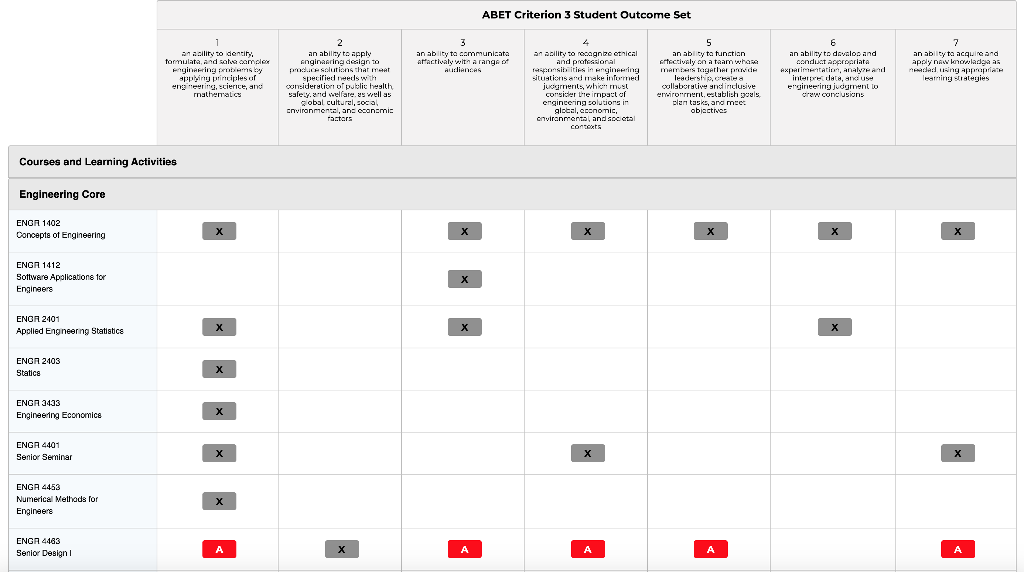

Slide 14
Data Reporting with Exams
Purchased/Licensure Exams
  ETS Major Field Exams
  CAT—Critical Thinking Analysis Test
  California Critical Thinking Skills Test
  ACAT
  Specific graduate admissions exam—MCAT, PCAT
  Pre-Licensure exam—HESI
  Any licensure exam—PRAXIS, NCLEX, etc.
Advantages
  Tested exam questions
  All statistics calculated for you—Aggregate and disaggregate
  Sub-scores can be directly connected to outcomes
  Comparative data
Disadvantages
  Includes questions that are not part of curriculum
  Students don’t invest themselves
  Most are knowledge-based exams, not application of knowledge
AState.edu
/ArkansasState
@ArkansasState

Slide 15
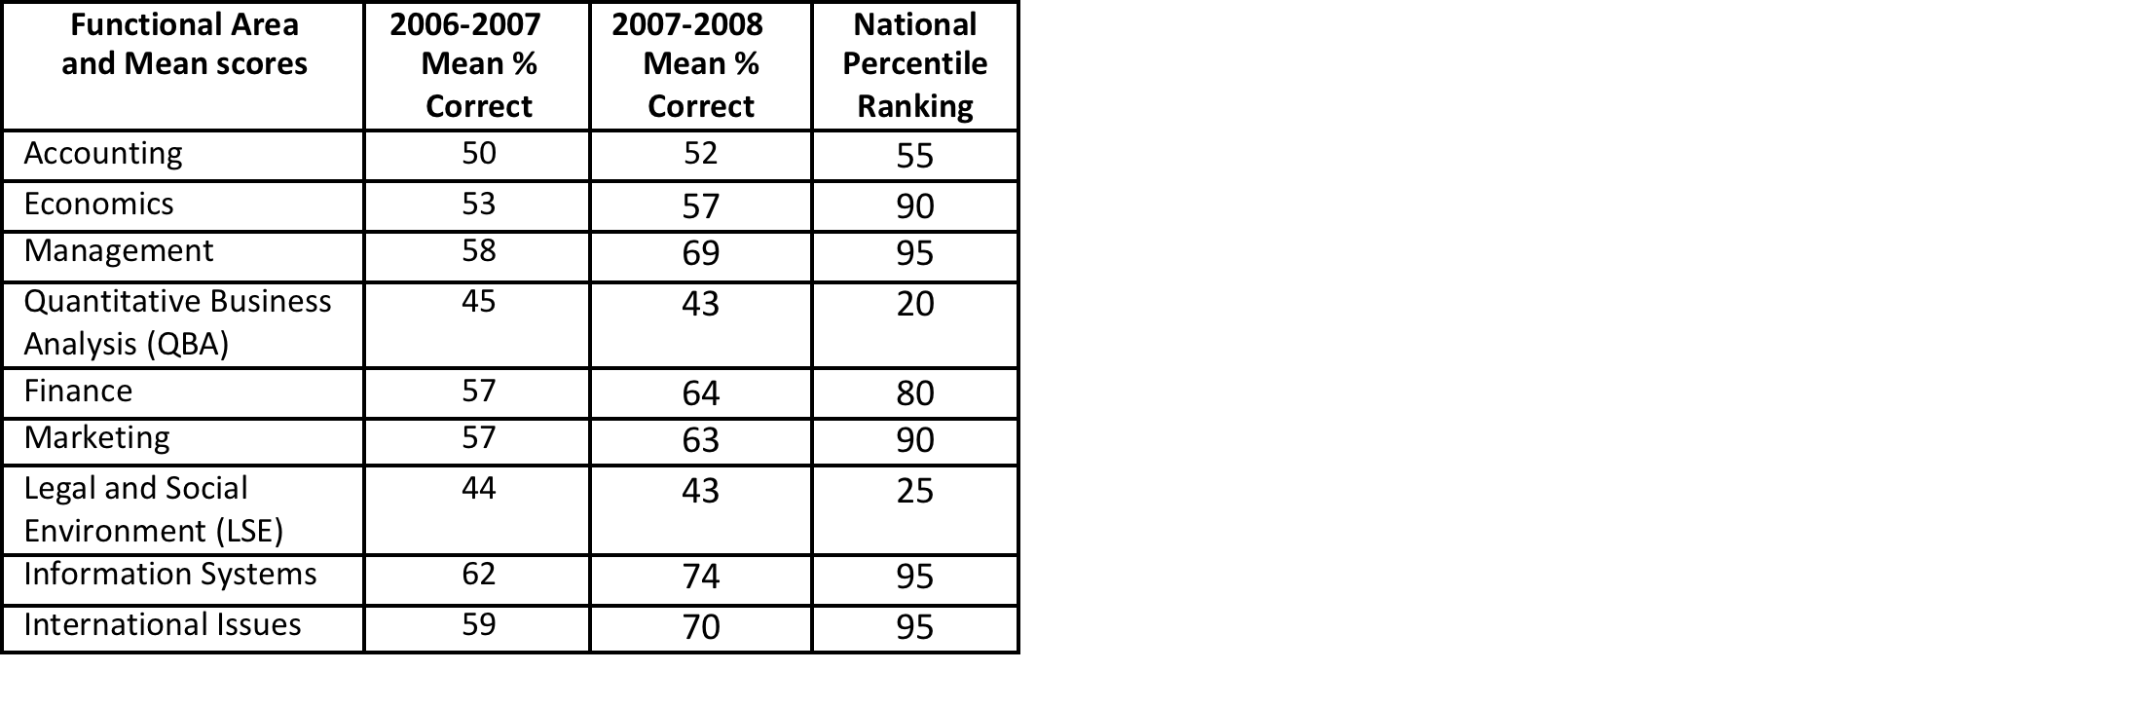
Data Reporting with Exams
AState.edu
/ArkansasState
@ArkansasState

Slide 16
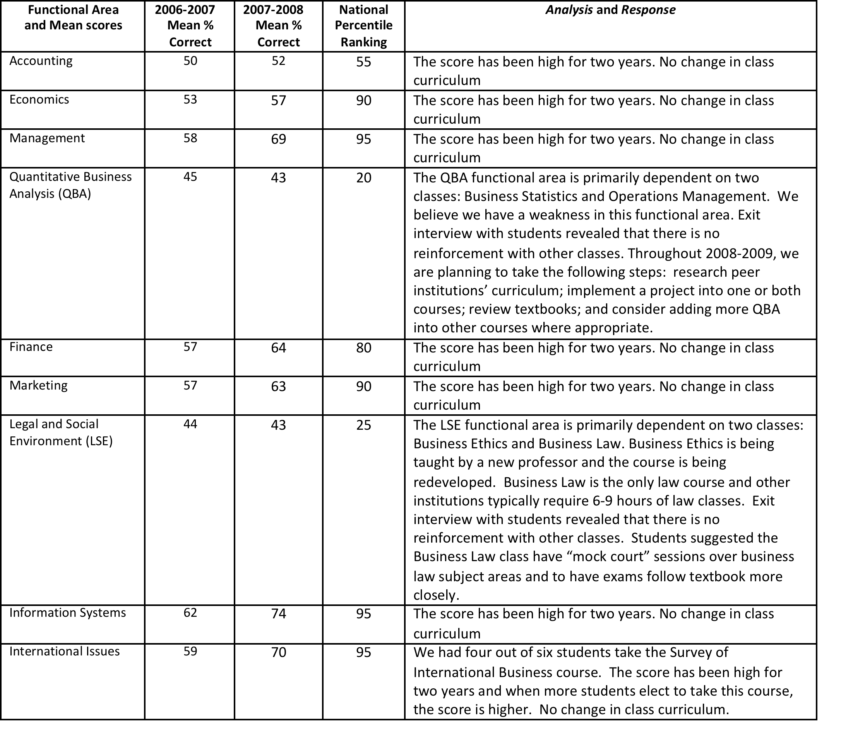
Data Reporting with Exams
AState.edu
/ArkansasState
@ArkansasState

Slide 17
Data Reporting with Exams
Homegrown Exams
  Advantages
    Professors can align exam to outcomes
    Professors have confidence in results
    Can include application questions from scenario-based (case study, video, music) questions
  Disadvantages
    Create the exam
    Connecting the exam questions to multiple outcomes can be laborious
    Calculate statistics yourself
    No external comparative data
  Tools
    Blackboard
    EAC
    Scantron
AState.edu
/ArkansasState
@ArkansasState

Slide 18
Aggregate Data
Entire group over a period of time
  Example, Senior Plant and Soil Science students comprehensive final exam scores worth 100 points in PSSC 4883 Agriculture Systems throughout the academic year 2015-16 (four sections of 25 students)
Typically descriptive statistics
  Central tendency—Mean, Median, Mode
  Dispersion—Range, Standard Deviation
Trend analysis (year-to-year percentage changes) can be particularly interesting if you have previously implemented an action plan
However, we are not designing hypothesis testing (in some instances we can, but that is typically not used in student-learning assessment)
AState.edu
/ArkansasState
@ArkansasState

Slide 19
Disaggregate Data
Aggregated data broken into parts, such as:
  Identifiable groups—day classes, night classes, fall or spring semester, race, gender, major
  Identifiable sub-scores—groups of questions that speak to a subject
  Item analysis—percent responses to each answer and psychometric analysis of questions and possible answers
AState.edu
/ArkansasState
@ArkansasState

Slide 20
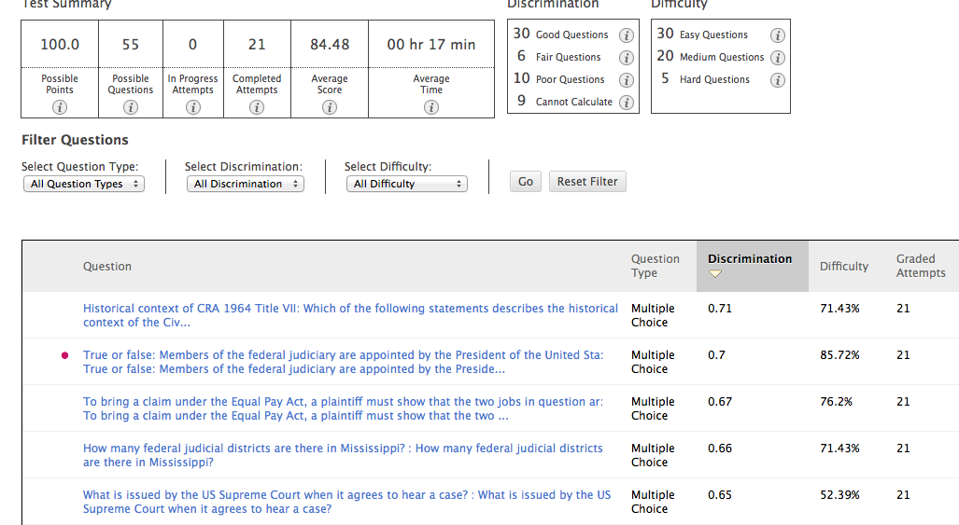
Blackboard Item Analysis
AState.edu
/ArkansasState
@ArkansasState

Slide 21
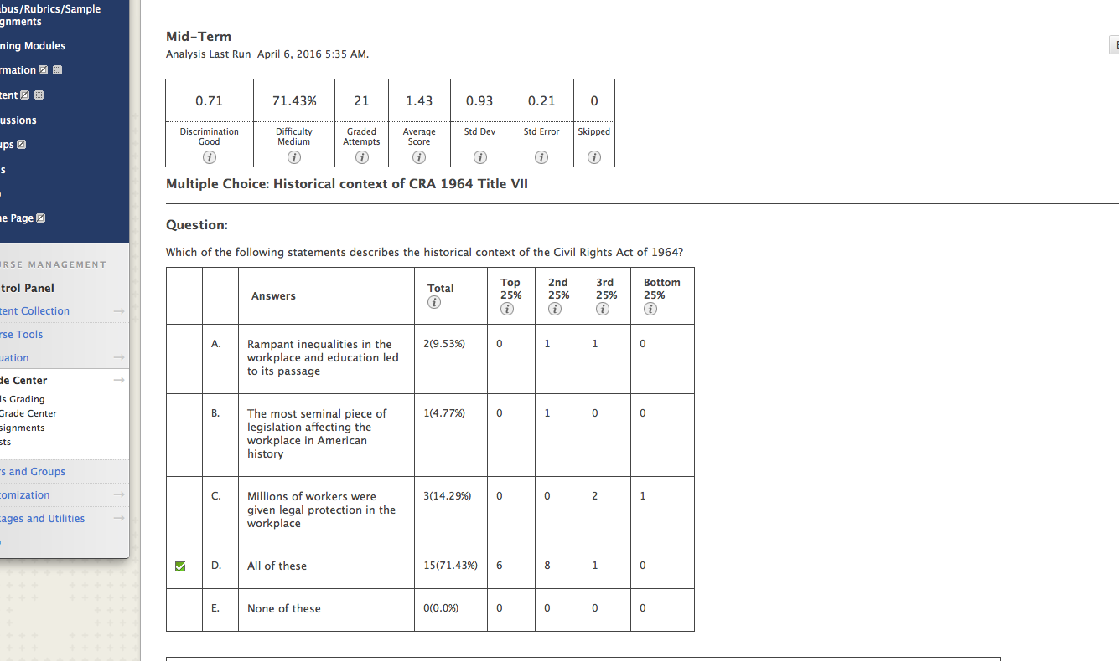
Blackboard Item Analysis
AState.edu
/ArkansasState
@ArkansasState

Slide 22
EAC Item Analysis
AState.edu
/ArkansasState
@ArkansasState

Slide 23
EAC Item Analysis
AState.edu
/ArkansasState
@ArkansasState

Slide 24
Before you start, check the checkpoints
  Does the data speak to the faculty?
  How many students included in the data?
  How many cycles/years of data included?
  Does the process have efficacy?
  Find the curriculum map?
AState.edu
/ArkansasState
@ArkansasState

Slide 26
Then, find all indirect data….
  Check your graduation, alumni, and/or employer surveys/focus group to be sure questions are connected to the learning outcomes
  Check any other indirect data you are using
  If so, then use the indirect data to corroborate or refute the direct measure data
  Check the industry changes
  Check graduate school admission changes/expectations
AState.edu
/ArkansasState
@ArkansasState

Slide 27
What does this mean for the assignment, course, program?
The data analysis will land in one of three buckets:
  Target student performance is met and the process of collecting the data is trusted
  Target student performance is not met
  Data is found to invalid and unreliable due to the process in which it is collected
Assessment Leader Questions to ask:
  Does the data speak to the faculty?
  How many students included in the data?
  How many cycles/years of data included?
  Does the process have efficacy?
  Where is that curriculum map?
AState.edu
/ArkansasState
@ArkansasState

Slide 28

Session Q & A
AState.edu
/ArkansasState
@ArkansasState

Slide 29
References
Bresciani, Marilee & Oakleaf, Megan & Kolkhorst, Fred & Nebeker, Camille & Barlow, Jessica & Duncan, Kristin & Hickmott, Jessica. (2009). Examining Design and Inter-Rater Reliability of a Rubric Measuring Research Quality across Multiple Disciplines. School of Information Studies Faculty Scholarship. 14.
Gwet, K.L. (2014). Inter-rater Reliability. In Wiley StatsRef: Statistics Reference Online (eds N. Balakrishnan, T. Colton, B. Everitt, W. Piegorsch, F. Ruggeri and J.L. Teugels). doi:10.1002/9781118445112.stat06882
AState.edu
/ArkansasState
@ArkansasState

