Slide 1
Social for Academics: A Guide for Using Social Media
Bill Smith, PhD
Executive Director of Marketing and Communications
Arkansas State University
Arkansas State
Faculty Development
Wednesday, Sept. 3, 2014
Jonesboro, Ark.

Slide 2
Mission Statement
The social media platforms of Arkansas State become the first stop for information about Arkansas State and our educational community.
Integrate the A-State platforms into the daily lives of our community.
Promote interaction with potential students and regain/maintain engagement with former students.

Slide 3
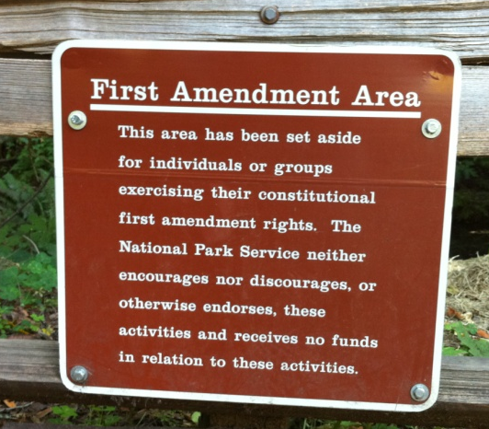
A-State Guidelines
Evaluation and formulation continuing
Guidelines, not policies
Best practices
Professional suggestions
State employee legal issues
Limits of federal student privacy
Ethical behavior
2+2 administration for official accounts
Two FTE in unit, two FTE in univ. communications

Slide 4
Legal Things to Consider
What is legal in Arkansas & ASU system
Trademarks
Proprietary information
Endorsements
Personal privacy violations
University computing codes
FERPA & HIPPA
“Astroturfing”
Emergency/crisis response

Slide 5
Academic Things to Consider
Defining your social relationship
Consider adding to your syllabus
Understand the power dynamic
Use of social in classroom
Potential ADA compliance issues
Individual student privacy concerns

Slide 6
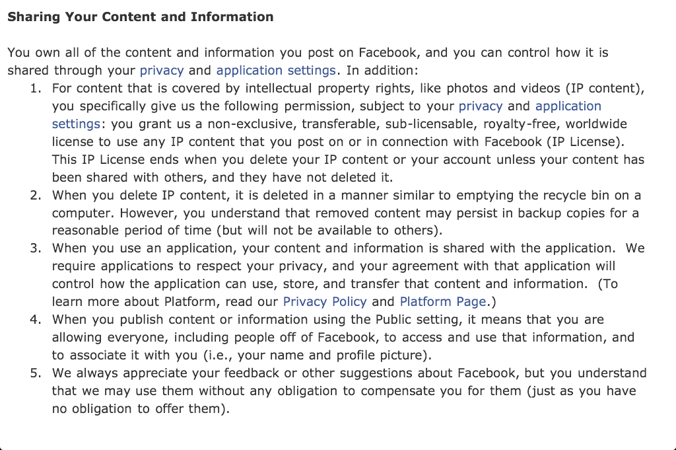
So What is Facebook?
The greatest intelligence gathering and consumer data mining tool
in the history of mankind

Slide 7
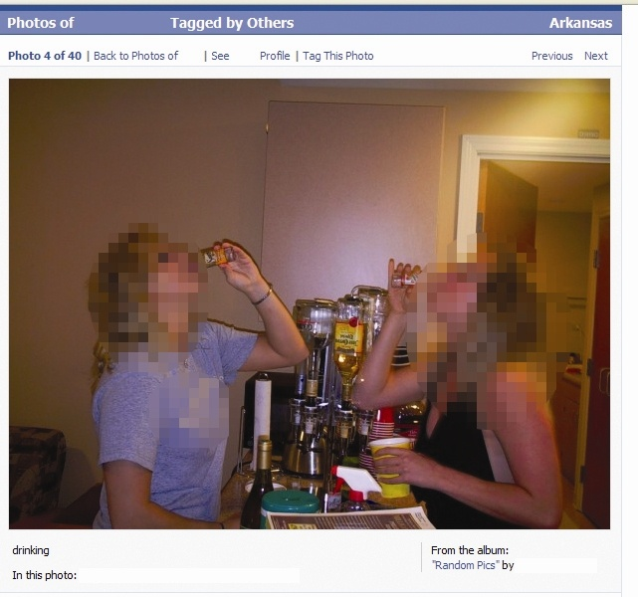
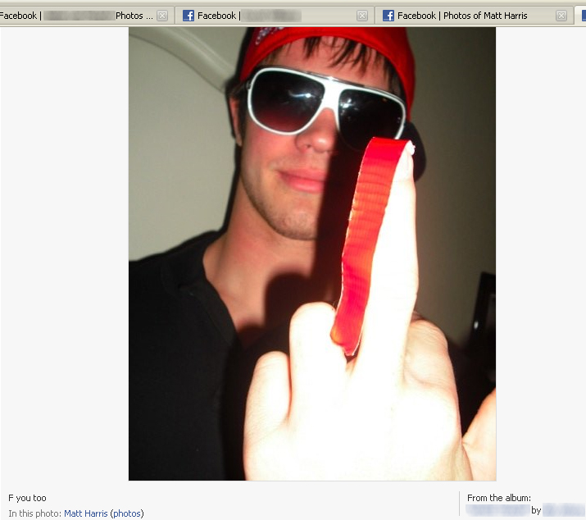
When Bad Things Happen
Foul, graphic or lewd language
Disparaging about others
Revealing too much inside information
Thinking you are talking with “just friends”

Slide 8
Kids Those Days?

Slide 9
Kids These Days

Slide 10
Maybe Grown-Ups These Days

Slide 11
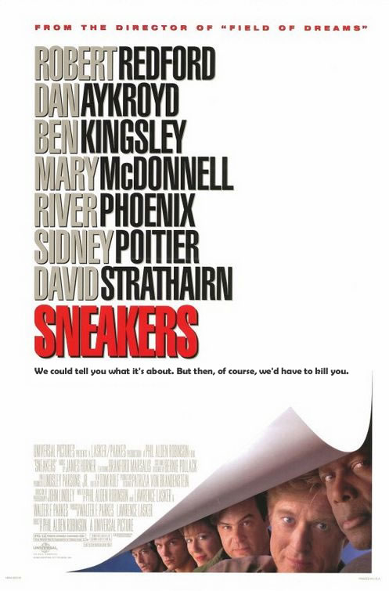
Security
There isn’t any (but use it anyway)
Digital assets are extremely portable
Easily copied and widely disseminated
Once posted, always available
There is no delete key online

Slide 12
The Gallery of Horrors

Slide 13
The Gallery of Horrors

Slide 14
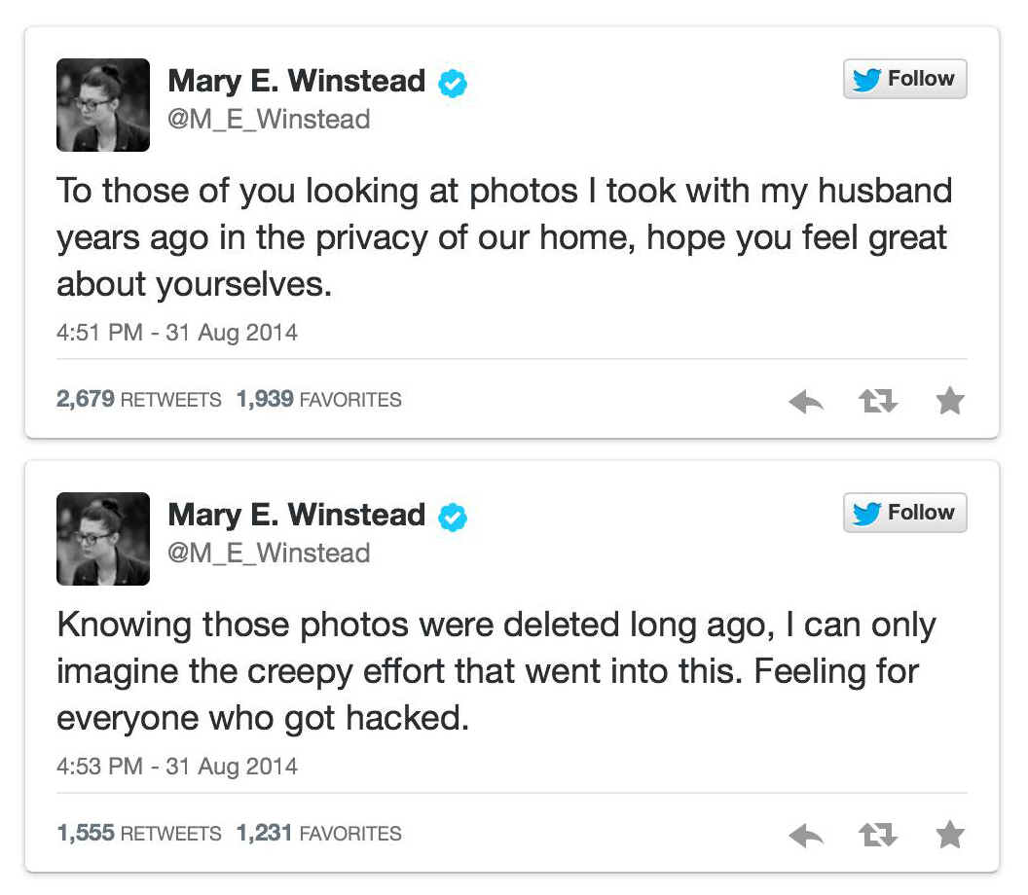
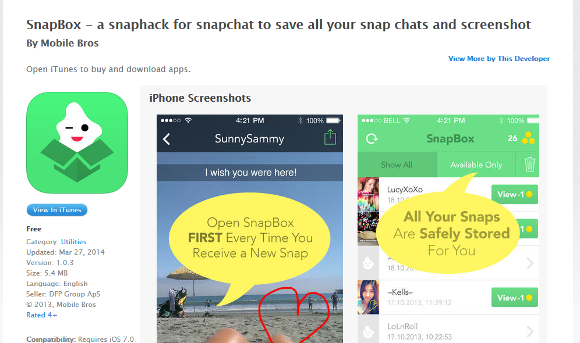
How Secure?

Slide 15
“Breaches” of Your Security
Ignorance of system
“Only for my friends”
Self-inflicted wounds
The tone-deaf nature of digital communication
Ultimately . . .
Your privacy does not depend on your settings
It depends on your friends

Slide 16
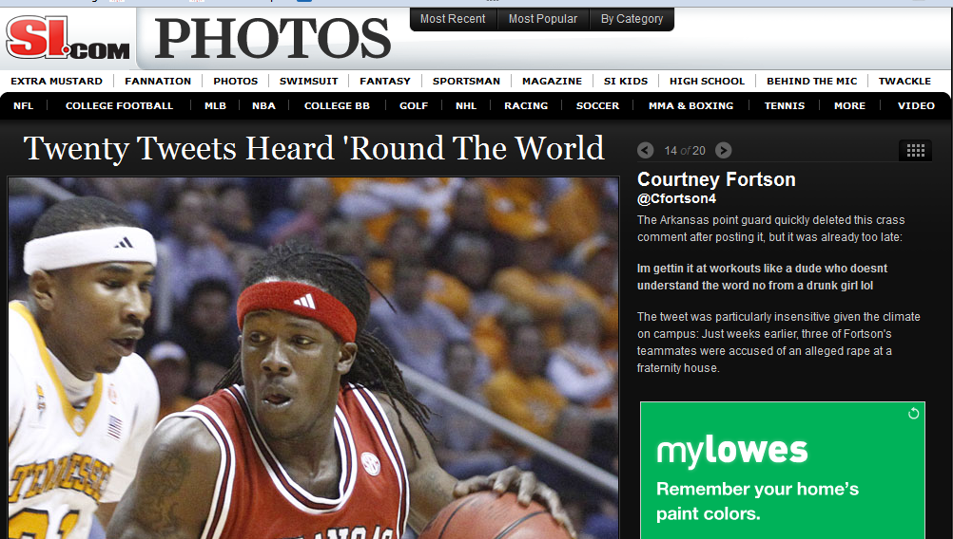
Ignorance of the System

Slide 17
Ignorance of the System

Slide 18
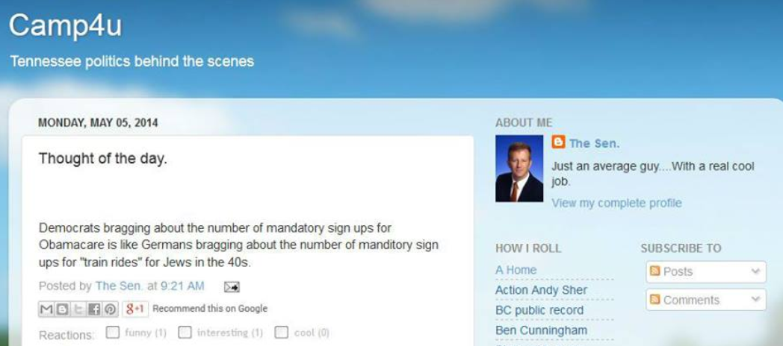
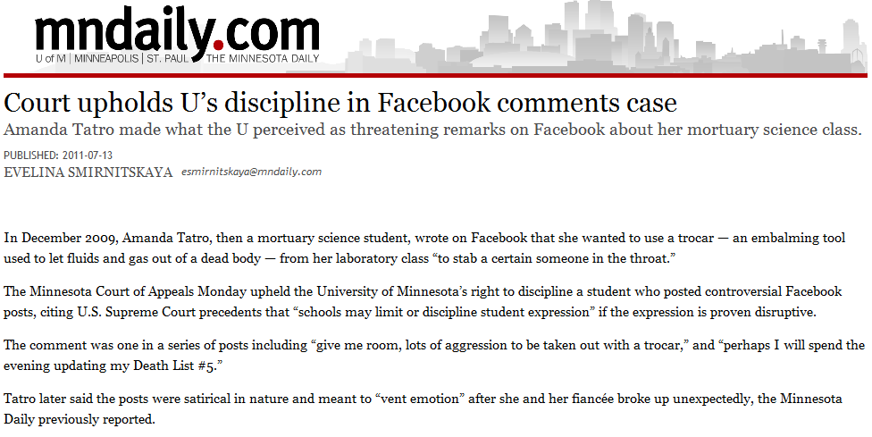
Self-Inflicted Wounds
Said in the heat of the moment, but lasts forever

Slide 19
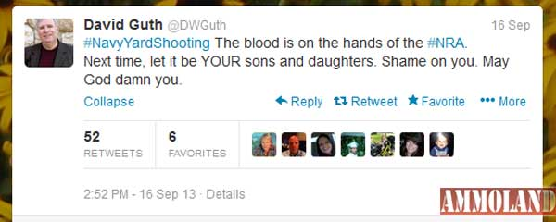
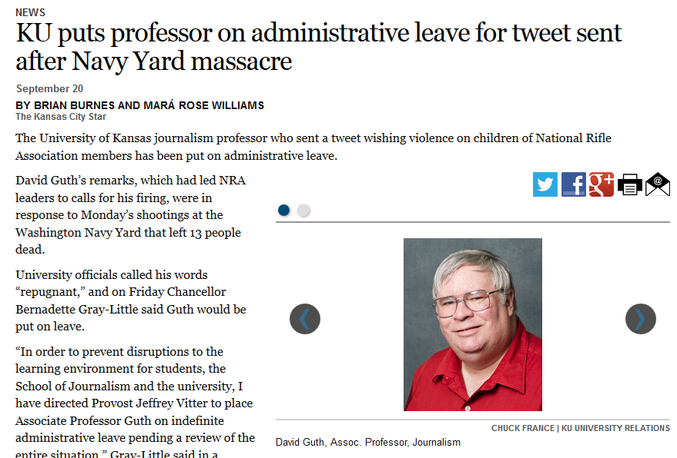
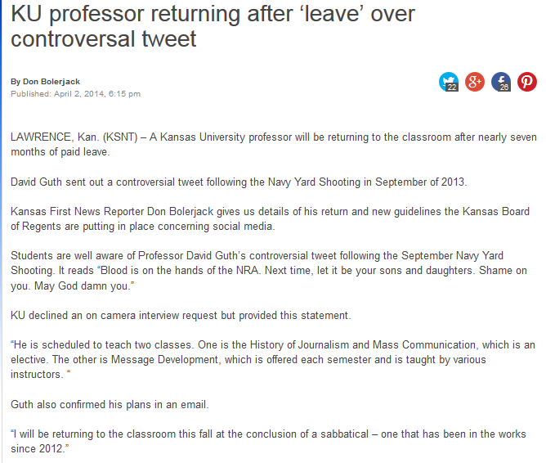
Self-Inflicted Wounds

Slide 20
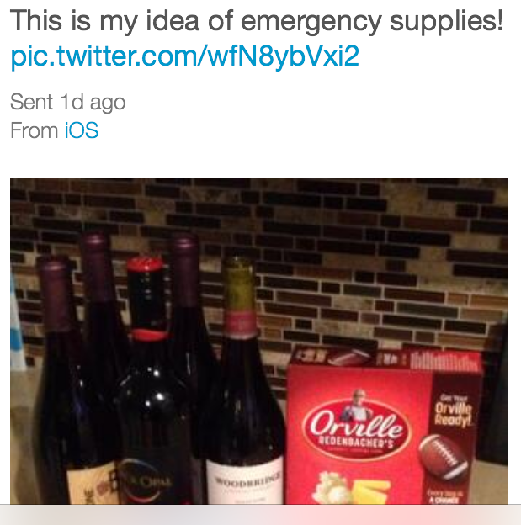
Self-Inflicted Wounds

Slide 21
The Gallery of Horrors

Slide 22
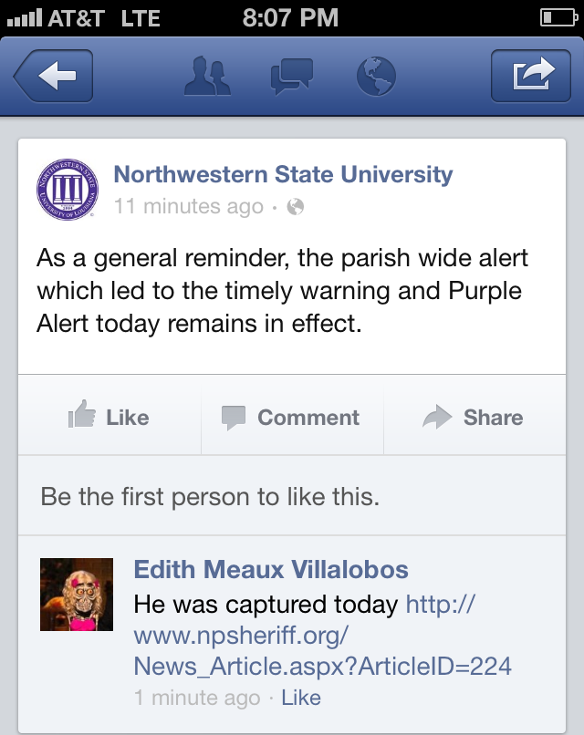
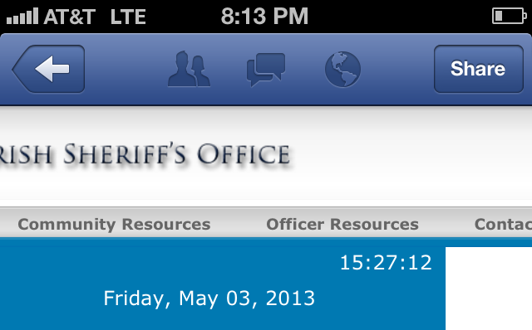
Trust in God; Verify Everyone Else

Slide 23
Attention to Details

Slide 24
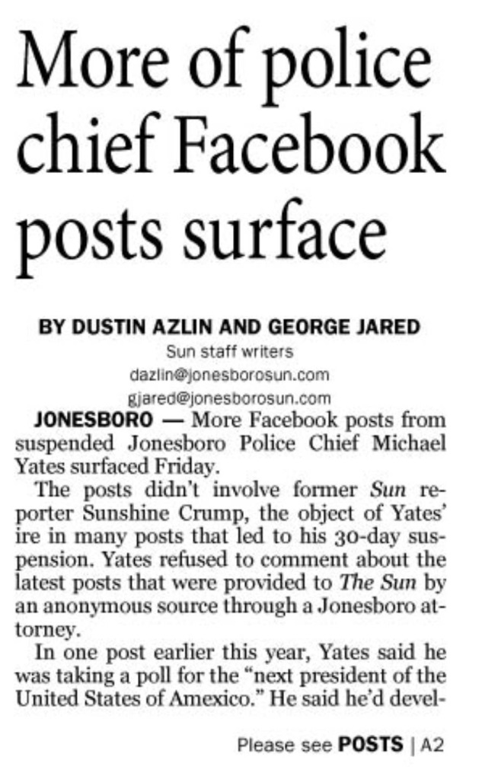
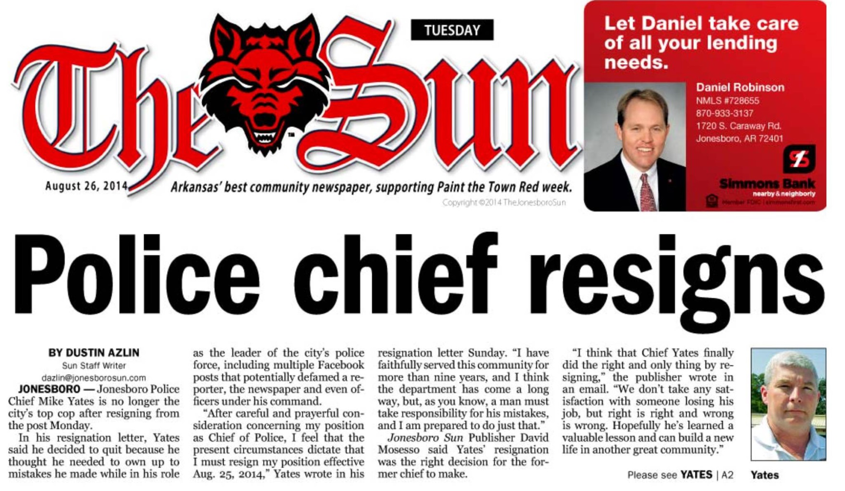
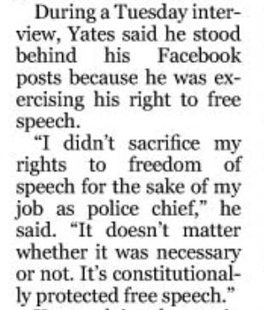
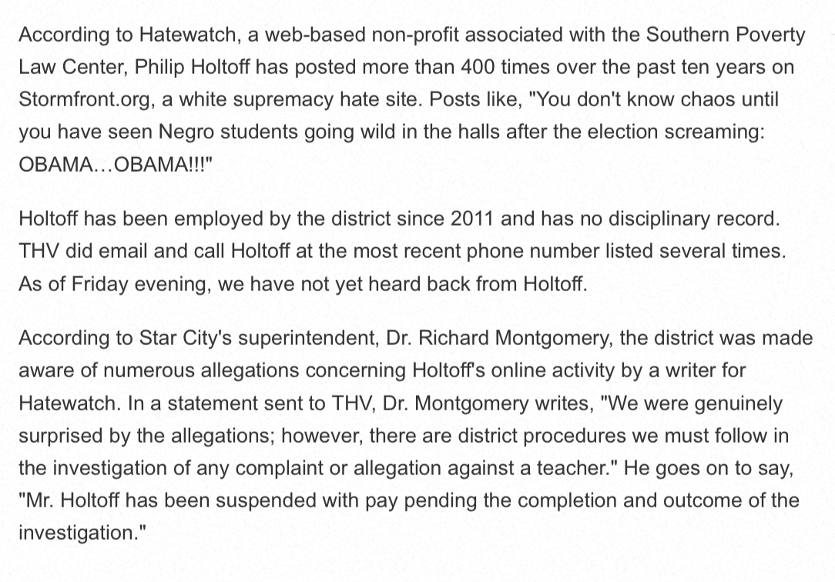
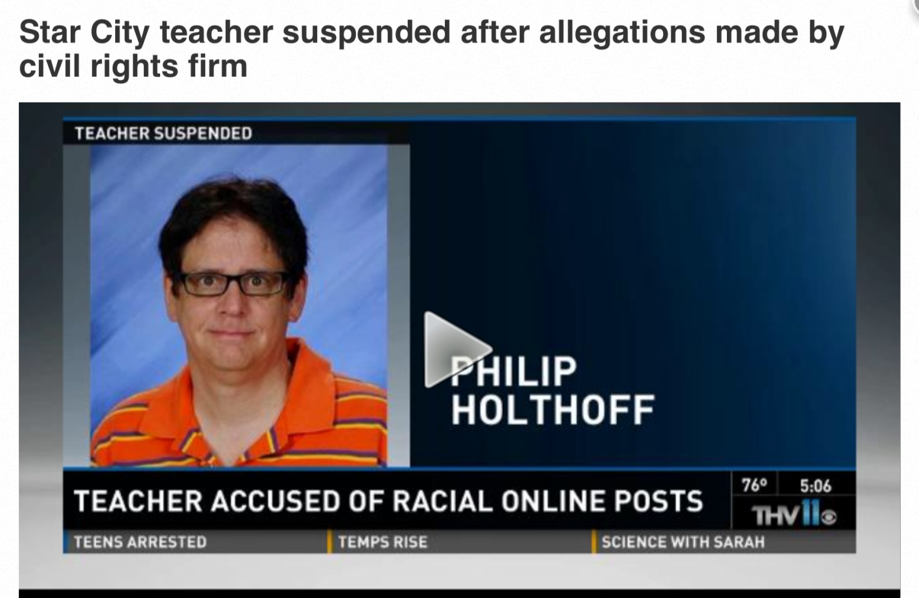
Your First Amendment Rights
You are the writer, editor and publisher

Slide 25
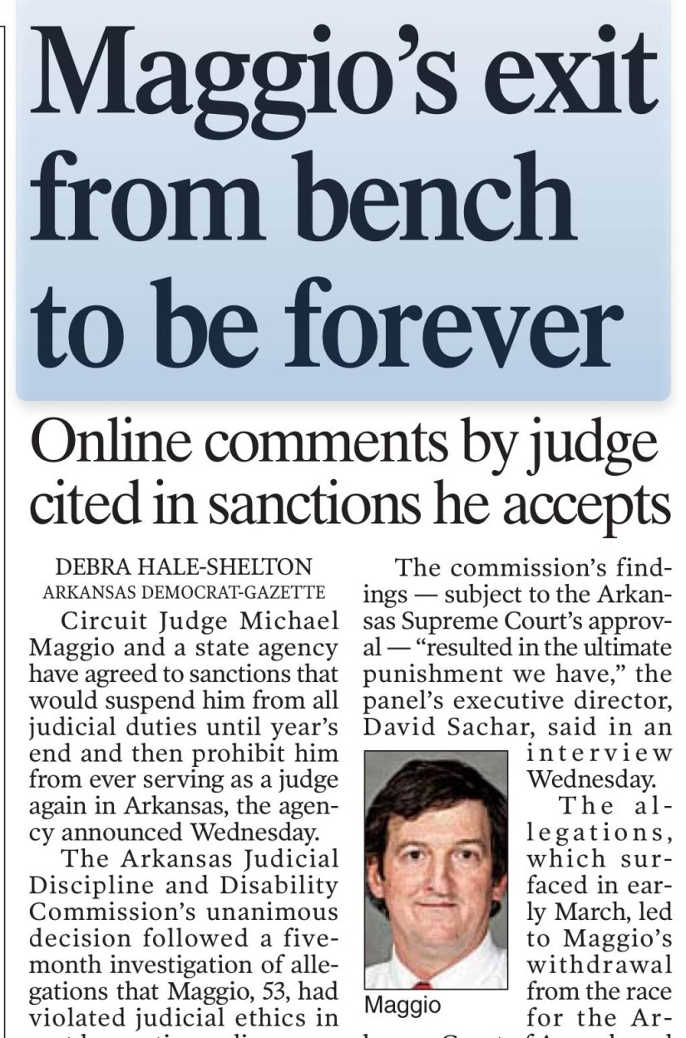
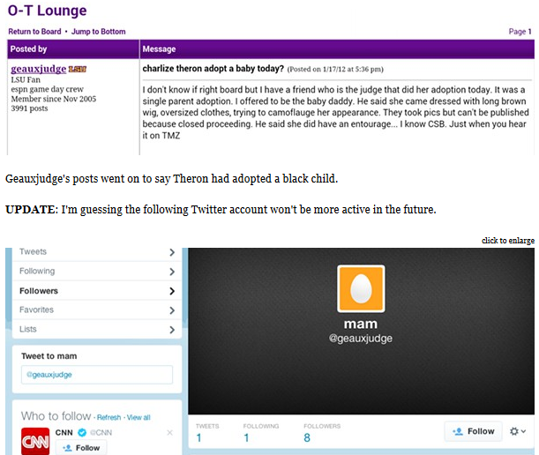
The Ultimate Combination

Slide 26
Key Things to Remember
Security is depends on what you post
Use the settings to your advantage
Nothing you wouldn’t want to read in the paper
Nothing you would want your grandmother to read in the paper
“Once it’s on the internet, it’s the God-awful truth whether it is or it isn’t”

Slide 27
The Facebook Five
Immediate
Post in the moment; nobody really likes leftovers
Sentiment
Everybody loves their grandma
Visual
Whenever possible, show, don't tell
Mobility
There is no substitute for being there
Brevity
Don't waste a friend's most valuable commodity: time

Slide 28
Facebook 5: Bring it all together
Sentiment
Visual
Mobility
Brevity
Immediate

Slide 29
Automation Kills Content

Slide 30
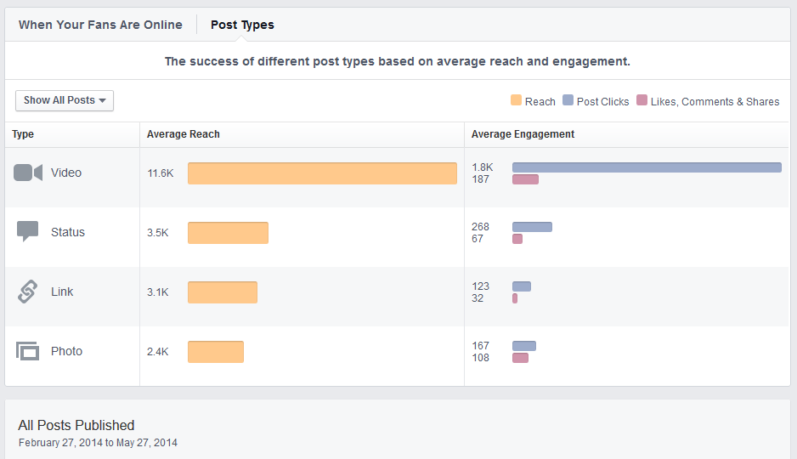
What Works in Social

Slide 31
The Lightning Round
What platform & why?
Define your boundaries
Consider the syllabus
Set goals
Take care with your reputation
“Living Social”
Show don’t tell
Don’t feed the trolls
Respect opinion, counter with facts

Slide 32
Action Items
Review your security
Review or create your roadmap
Consider academic guidelines
Create content that tells the story
And above all . . . .

Slide 33
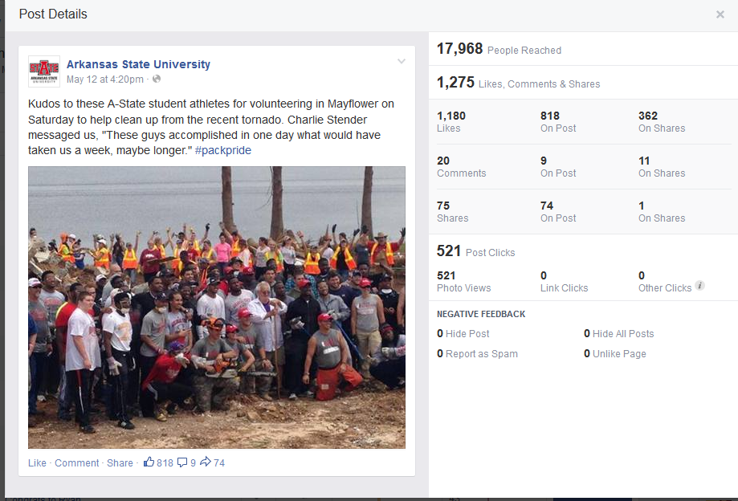
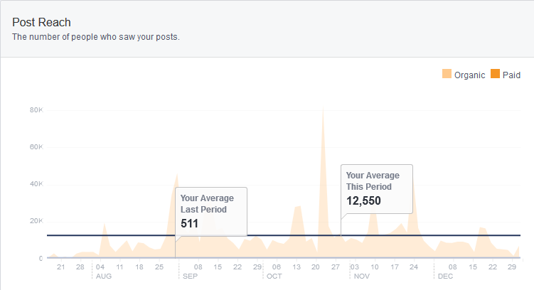
Take Them There
Engagement

Slide 34
How to Reach Me
Bill Smith
103-B Administration Building
Arkansas State University
870.972.2169 o | 870.253.8495 c
billsmith@AState.edu
bismith75@gmail.com
@doctor_bs | Facebook.com/wabac

