Slide 1
Budget Basics
Presented by Sponsored Programs Accounting and the Office of Research

Slide 2
Objectives
What is a budget and why do I need one?
How do I get started?
Direct costs vs. Indirect Costs
How to write a budget justification
Cost Sharing
Questions?

Slide 3
What is a budget?
The budget is the financial aspect of your proposal
It is a detailed statement that outlines the estimated project costs to support the proposed work

Slide 4
Why do I need one?
Sponsors want to know the details of how their funds will be used
Reviewers need to know if the costs are reasonable in relation to the proposed work
Notes:
If the budget does not seem sufficient to cover the proposed work, the sponsor may question whether the work can be performed as stated. Also, the PI should have a detailed budget on file even when the agency only requests a lump sum budget (such as NIH modular).
Finally, your budget provides you, as PI, assurance that the costs of the proposed research will be covered.

Slide 5
How do I get started?
The ultimate responsibility of creating the budget lies with the PI.
  Your Department and College approves
  ORTT approves
Notes:
Initially the PI should create the budget as needed based on the project. Once a draft is created, work with ORTT to make sure all costs are met and that the budget reflects the Sponsors requirements. After ORTT approves, Chair and Dean will need to sign off as well.

Slide 6
Budget Checklist
Sponsor guidelines
Direct cost limit?
Indirect costs (F&A) restrictions?
Projected start and end dates?
How many years?
Who will be involved with the project and what will their roles be?
Will there be consultants? Subawardees?
Notes:
Always start by reading the guidelines. Look for specific budget restrictions – some have a limit on how much you can request; some won’t allow purchases such as computers; is there a limit to F&A costs?

Slide 7
Budget Checklist (cont)
What will need to be purchased?
  Any equipment? (over $2500)
  Supplies, materials, GA tuition?
Any travel?
  How many people and to where?
  For what purpose?

Slide 8
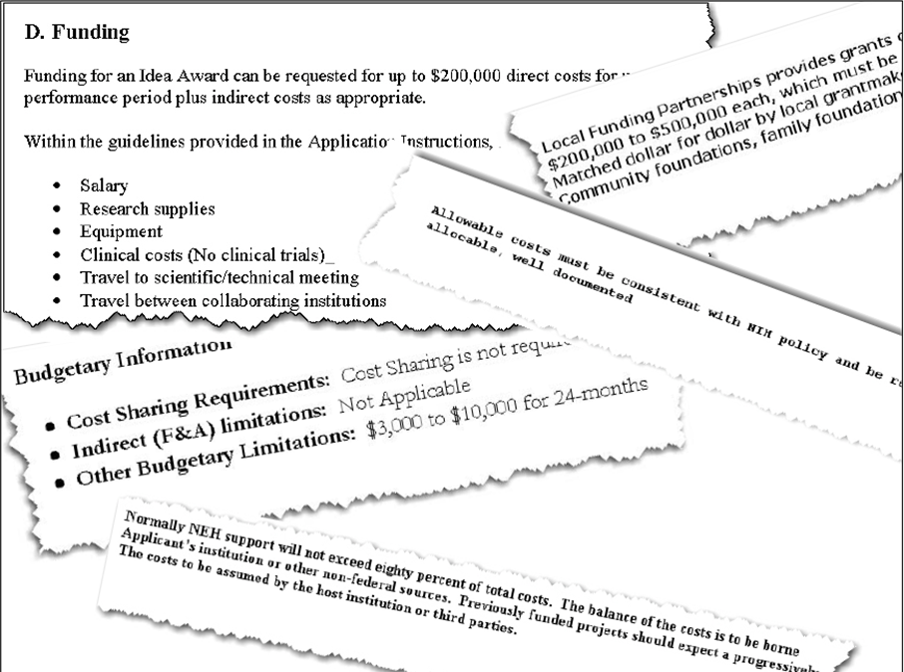
Guidelines vary
Every sponsor has their own budget restrictions. Read the guidelines carefully to make sure that you understand what they want to see.

Slide 9

How to plan a budget
Where do the numbers come from?
  Actual sources
  Pay scales
  Historical experience
  Quotes from vendors
Notes:
Actual sources – Banner HR
Pay scales – college level of pay for certain positions, ie post-docs
Historical experience – supplies, travel
Quotes – equipment
Budget costs are not just ‘made up’

Slide 10
Main budget categories
Direct Costs
  Salaries & Fringe benefits
  Equipment
  Travel
  Supplies
  Tuition remission
  Subawards
  Other
Indirect Costs
  Also called F&A
  Overhead cost of research
  Based on a rate negotiated with the Federal Gov’t
Notes:
F&A rates MUST be included in your budget unless 1) the sponsor doesn’t allow them, or 2) your total budget is less than $10,000

Slide 11
Direct vs. Indirect costs (not an inclusive list)
Person-nel
Supplies
Equip-ment
Direct Costs
Utilities
Admin
Staff
Mainten-ance
Indirect Costs
Can be specifically applied to one project
Cannot be tied to one particular project

Slide 12
Budget Justification
Rationale for each budget category
Should be brief and project-related
Should follow the same line item format as the budget form
One of the most important non-technical sections
Notes:
Does not need to list all the qualifications of the personnel, but explain what they are doing on the project. Same for other expenses – needs to show why they are critical to the project.

Slide 13
Should justify:
Personnel
  Each employee’s role and what tasks they will perform
  Effort required (person months or % effort)
  Do NOT write an extensive bio about why the person is qualified.
  ASU employees CANNOT be consultants
Materials & supplies; equipment
  Be less specific regarding ‘pieces’ or ‘brands’

Slide 14
Should justify:
Any requests for items normally covered by F&A
  Paper, toner
  Mailing
  Secretarial/clerical staff
Costs that fluctuate between years or appear in only a single year
Unusual items
Notes:
Budget & Justification are dictated by sponsor guidelines

Slide 15
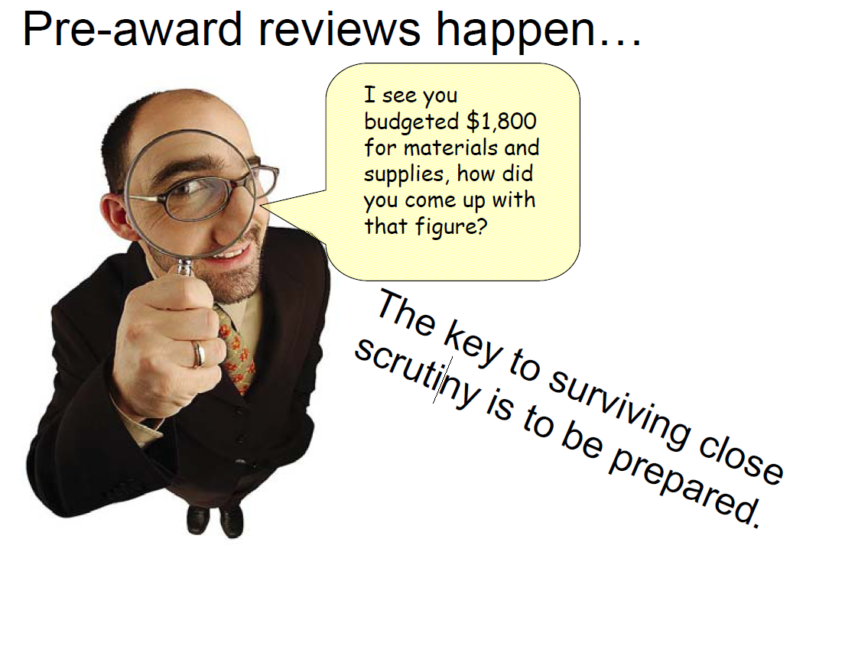

Slide 16
OMB Circular A-21
Defines allowable costs
Specifically identifies direct and indirect costs
Identified those costs that cannot be charged to a grant, contract or cooperative agreement
Sets accounting standards
  Reasonable, allocable, consistent & allowable
Notes:
ASU must comply with A-21.
Big question – if your purchases were to be published on the front page of the Sun would you be comfortable?

Slide 17
Reasonable (A-21 Sec. C-3)
“A cost may be considered reasonable if the nature of the goods or services acquired or applied, and the amount involved, reflect action that a prudent person would have taken under the circumstances prevailing at the time the decision to incur the cost was made.”
Notes:
Where travel expenses are generally accepted, paying to go on a cruise would not be.

Slide 18
Allowable
Is the cost in compliance with the terms of the award, sponsor’s policy, A-21 and ASU policy?
  Some sponsors will not allow computer purchases

Slide 19
Specific Unallowable Costs
Alcoholic beverages
Entertainment
Fines & penalties
Fund raising/alumni activies
Internal interest charges
Subscriptions
Advertisement or public relations costs
Travel tickets in excess of coach

Slide 20
More Unallowable Costs
Salaries for admin/clerical staff
General office supplies
Exception – when a project is classified as a ‘Major Project’

Slide 21
Major Project Status
Large, complex programs
Extensive data collection, analysis and entry
Projects requiring making travel arrangements for large numbers of people
Projects that are geographically inaccessible
Projects that focus on preparation and production of manuals and large reports, books or monographs

Slide 22
Major Project expenses
Performance of tasks that are significantly greater than routine level provided by ASU;
Expense can be specifically identified with the project with ease and accuracy
The approved proposal budget explicitly lists the expense and its justification
The budget justification should state the costs are normally treated as F&A but are being requests due to a special purpose which is clearly explained.

Slide 23
Allocable
Is the cost benefiting the project?
If the cost benefits the project, but also other ASU projects, cost should be pro-rated
Is the cost incurred solely to advance the work of the project?
Notes:
Although costs for research mice is an allowable cost, purchasing mice on a grant that doesn’t require animals would not be an allocable cost

Slide 24
Consistent
Is the cost consistent with ASU’s policies, procedures and practices?
Is the cost incurred for the same purpose, in like circumstances and treated consistently as direct or F&A?
Notes:
If it is unallowable for ASU, it’s unallowable for a grant. IE 2% raises weren’t authorized by ASU, so grant employees couldn’t get them either.

Slide 25

Cost Sharing – its a commitment

Slide 26
What is cost sharing?
Cost share & matching are often used interchangeably
The part of the project not paid by the sponsor
A-21 guidance:
  Matching funds must follow the same conditions as sponsored funds
  Costs claimed at match/cost share cannot be claimed on other projects
Notes:
If it’s unallowable on the grant, its unallowable as cost share.
Can’t match Federal with Federal

Slide 27
Types of cost sharing
Mandatory
  Required by the sponsor
  Often expressed as a percent of the budget
  Should not exceed amount required
Voluntary committed
Voluntary uncommitted
  PI effort above that which was promised
  Unanticipated contributions that were not pledged in the proposal
Notes:
Mandatory must be tracked and reported to sponsor
Voluntary committed must be tracked and reported
Voluntary uncommitted does not need to be reported

Slide 28
Voluntary committed
Not required but something offered to enhance the proposal’s competitiveness
  Must be accounted for and reported
  Even if its not in the budget, rather promised in the proposal, it is still a commitment
  ASU does NOT encourage voluntary cost sharing

Slide 29

Cost sharing approval
Cost share must be approved by Chair and Dean
Cost share form must be completed and submitted to ORTT with your proposal

Slide 30
Contacts:
ORTT
SPA
Phone: 972-2694
Julie Thatcher
(jthatcher)
Sheri Walls
(swalls)
Cheryl Goad
(cgoad)
Latonya Tidwell
(ltidwell)
Phone: 972-2400
Brandy Hampton
(bhampton)
Nikki Turner
(anturner)
Sylvia Torres
(storres)
Whitney Cox
(wcox)

Slide 31
Questions?

