Slide 1
ASUJ: IACUC Guidelines
Malathi Srivatsan
Chair, IACUC

Slide 2
What Does IACUC Stand for?
Institutional Animal Care and Use Committee
IACUCs are required by…..
Federal Law (Animal Welfare Act) Regulations - United States Department of Agriculture (USDA)
Policies - Public Health Service (PHS)

Slide 3
What are the Functions of IACUC?
To assist investigators and instructors in maintaining the institution’s compliance with the Animal Welfare Act and federal animal welfare regulations
Review of research and teaching activities involving the use of vertebrate animals
Review/monitor welfare of vertebrate animals maintained by the institution (housing and care)

Slide 4
Who are concerned with animal welfare?
Governmental Agencies
- USDA- Animal and Plant Health Inspection Service (APHIS)
- Health and Human Services (HHS) Public Health Service (PHS)
National Institutes of Health (NIH)
Office of Laboratory Animal Welfare (OLAW)
Food and Drug Administration (FDA)

Slide 5
Who else is concerned with animal welfare?
Scientists
- Scientists’ Center for Animal Welfare (SCAW)
- American Association for Laboratory Animal Science (AALAS)
- Association for the Accreditation and Assessment of Laboratory Animal Care (AAALAC, International)
- Institute for Laboratory Animal Research (ILAR)
- Federation of Animal Science Societies (FASS)

Slide 6
Who else is interested?
Public Animal-Centric Organizations American Humane Association (AHA) Humane Society of the United States (HSUS)
Society for the Prevention of Cruelty to Animals (SPCA)
Health Care Consumers (medical treatments, vaccines, cures for disease)
Agricultural Operations (Meat and Dairy Producers)
Consumers-Public

Slide 7
Animal Welfare and Animal Rights
USDA, PHS, OLAW and IACUCs are concerned with the safe, appropriate and humane use of animals for agricultural and biomedical research and teaching. Our focus is animal welfare.
Many animal rights groups, based on the views of individuals, are opposed to the use of animals for research, education, transportation, recreation, or exhibition, to name a few.

Slide 8
What information is available to Public?
Under Freedom Of Information Act (FOIA)
The following can be requested by the public:
USDA Inspection Reports
Approved Protocols
Minutes of IACUC meetings
Assurance Statement
Animal Care Program reviews
Facility inspection reports

Slide 9
Why do Universities need IACUCs?
Laws, Regulations, and Policies
These committees were established in accordance with the Animal Welfare Act (1966, 1970) and the 1976, 1985, and 1990 AWA Amendments
Mice, Rats, and Birds were originally excluded from the act
In 1999 a petition was filed with the USDA Secretary of Agriculture to remove this exclusion
The Helms amendment to the 2002 Agriculture Bill specifically exempts Mice, Rats and Birds

Slide 10
Why do Researchers need IACUC approval?
Institutions can establish policies requiring all vertebrate animal use subject to IACUC review and approval.
Federal Funding Agencies require IACUC approval of proposals if vertebrate animals are used before releasing their funds.
Many journals insist on IACUC approval if vertebrate animals are used in the study to be published.

Slide 11
What can happen if an institution is out of compliance with federal regulations?
Federal funding (USDA, NIH, PHS, NSF etc.) could be withdrawn from an institution found to be noncompliant with the AWA and federal regulations. The Animal Welfare Assurance Statement that ASU has on file with OLAW assures the federal government that ASU will comply with the AWA and all federal regulations. Also institution can incur heavy fines including in rare instances, prison sentences.

Slide 12
Oversight of Animal Use
AWA administered by USDA-APHIS
http://www.aphis.usda.gov/animal_welfare/index.shtml
Regulations
Policies
Conducts annual inspections
PHS (OLAW) http://grants.nih.gov/grants/olaw/olaw.htm
Animal Welfare Assurance Statements
AAALAC for accredited institutions (Optional)

Slide 13
…down to ASU
Vice Provost for Research and Graduate Studies (our Institutional Official)
Relies on the IACUC reports
IACUC
- Reviews and approves, or disapproves proposed animal use; monitors conditions of animal housing and use areas through facility inspections; conducts semiannual program reviews; reports to the Institutional Official

Slide 14
Composition of IACUC
PHS policy states that IACUCs must consist of no less than 5 members, including:
A veterinarian
A practicing scientist experienced in animal research
A member whose primary concerns are in a nonscientific area
A member who is not affiliated with the institution and is not a member of the family of an IACUC member
One individual may fulfill more than one requirement

Slide 15
How do we do it?
Appropriate Training
Interpretation and utilization of the regulations and guidelines
Defining Pain and Distress
Implementation of Institutional policies
Accepted Animal Care Guidelines

Slide 16
IACUC Considerations for Animal Use
In reviewing a proposal, IACUC considers the following:
What is the Rationale provided for using Animals
What is the significance of this research that can justify animal use?
Appropriateness of the Species
Why use this species? Justification of the species and the number of animals to be used
For Category of use under D and E, required Search for Alternatives
Were alternatives such as use of cell lines for cell cultures, use of mathematical models, computer simulations etc considered for this research?
Consideration of the “Three Rs”
Replacement
Reduction
Refinement
Literature Search
Other information services
Search methods used
Summarize and justify findings

Slide 17
Reference Guides for Animal Care and Use
Guide for the Care and Use of Laboratory Animals (8th Ed, National Academy Press, 2011) available at
http://grants.nih.gov/grants/olaw/Guide-for-the-care-and-use-of-Laboratory-animals.pdf
Guide for the Care and Use of Agricultural Animals in Agricultural Research and Teaching (FASS, 3rd Ed, 2010) available at
http://www.fass.org/docs/agguide3rd/Ag_Guide_3rd_ed.pdf
AVMA Panel Report on Euthanasia (American Veterinary Medical Association, 2007) available at
http://www.avma.org/issues/animal_welfare/euthanasia.pdf

Slide 18
Links at ASU
Go to Research and Technology at
http://www.astate.edu/a/ortt/research-compliance/compliance-committees/institutional-animal-care-use/index.dot
At the bottom of the page, you will see links for IRBNet and CITI Training
As a student or faculty member of ASU, You can register, set up username and password for both
Then you need to log into CITI and take the training modules for “Investigators, Staff and Students, Basic Course”. Once you complete it, it will inform the administrators that you have completed the training. Also you can print out your certificate of training for your own records.
Then obtain the IACUC Protocol form at IRBNet once you login and fill out. The form needs to be submitted via IRBNet.
Completing the training before filling out the form will help you in your protocol preparation. If you have questions, please contact Malathi Srivatsan, msrivatsan@astate.edu , Kellie Kaletsch <kkaletsch@astate.edu> , Phone: 870.680.4298, Kimberly Marshall, Phone: 870.680.8568 E-Mail: kmarshall@astate.edu

Slide 19
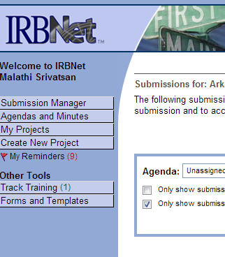
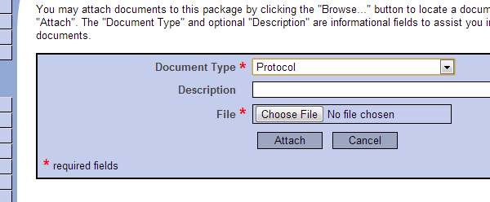
Protocol Submission
Log into IRBNet
Click on ‘Create new Project, Provide the required information and continue
In the next window,
make sure to select the library Arkansas State University IACUC
Click on Add new Document
Choose document type, Protocol, Give it a name in Description window, choose file to upload the
Protocol.

Slide 20
A big question…
How long does it take to get IACUC approval?
The answer is, “It depends on the proposal, work load of reviewers etc.” Therefore researchers need to submit the protocols well in advance to assure a timely review and approval. If your protocol is reviewed by IACUC before you submit your grant, it will help you to write a better experimental design and protocol in your grant.
Contacts: Malathi Srivatsan, msrivatsan@astate.edu
Kellie Kaletsch kkaletsch@astate.edu
Kimberly Marshall, E-Mail: kmarshall@astate.edu

