Slide 1
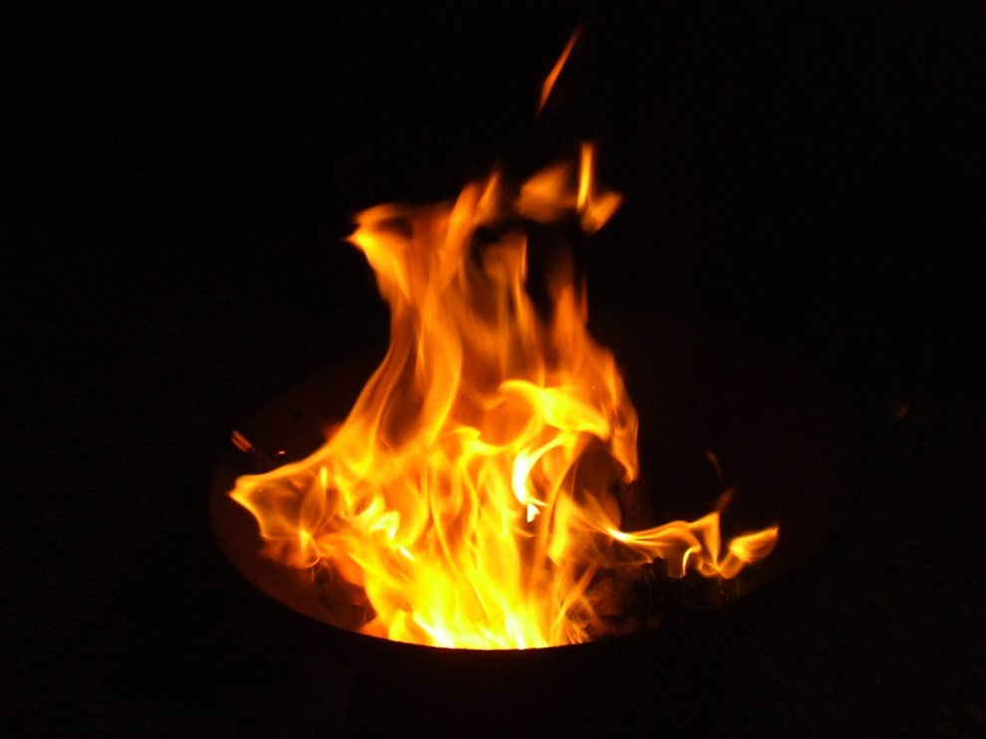
Fire safety basics
Fire Extinguishers & Basic Safety

Slide 2
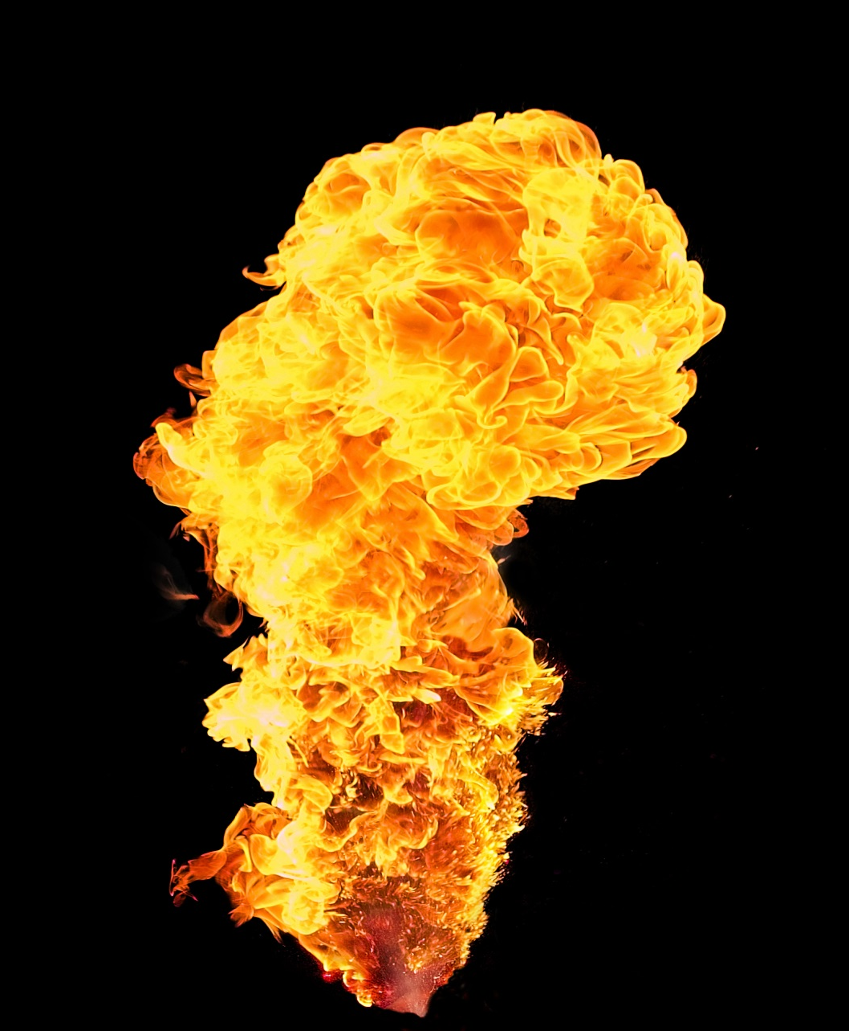
Topics
Safety Precautions
Types & Classes of Fire
Fire Extinguisher Use
Evacuations

Slide 3
Your Personal safety
Your personal safety is the NUMBER 1 priority
Make sure authorities are notified and on the way BEFORE you attempt to extinguish a fire
You are NOT required to fight a fire
Make sure fire or other obstructions will not impede a quick exit
Be sure the fire extinguisher is designed to fight the type of fire you encounter…

Slide 4
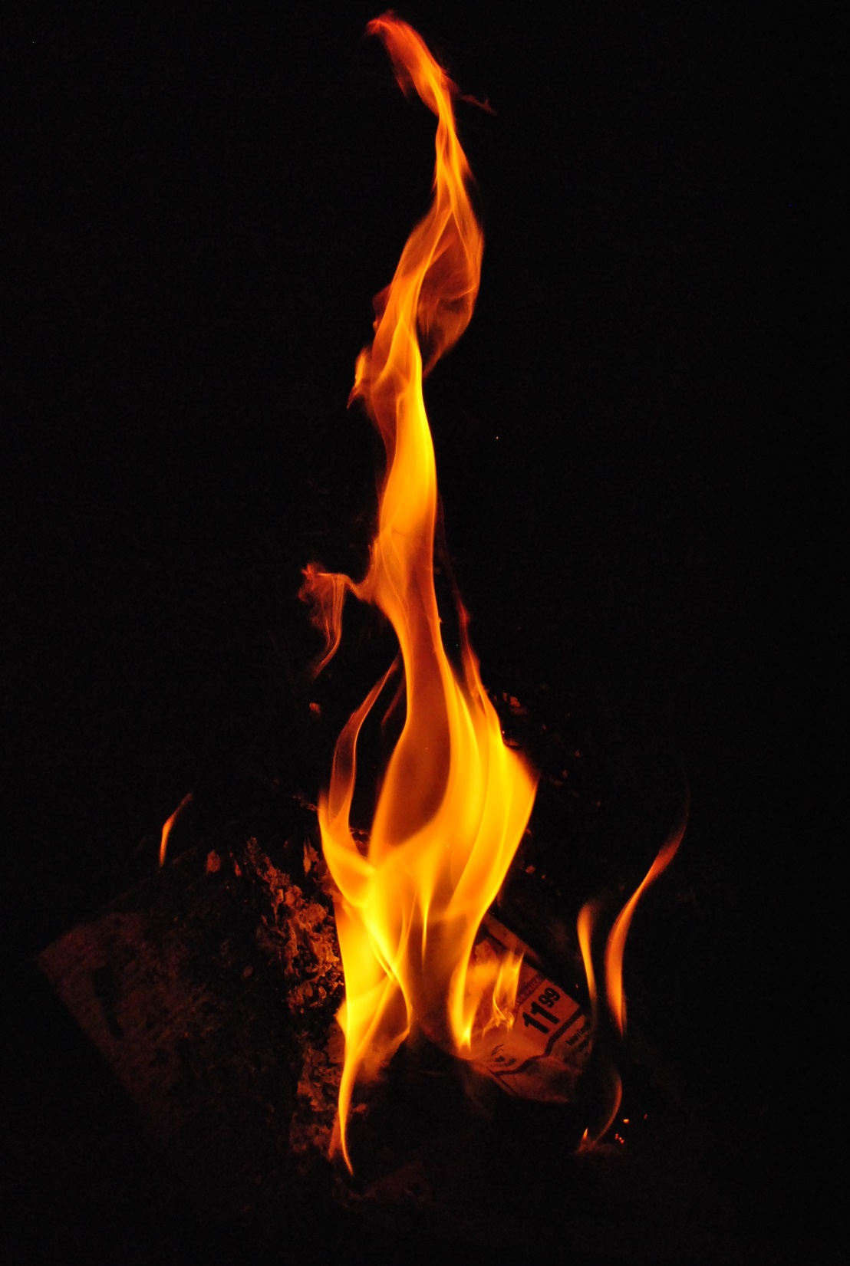
Types & CLASSES of fires Depends on fuel source
Class A – Ordinary Combustibles
Wood, paper, cloth, rubber
Class B – Flammable Liquids
Gasoline, paint thinners, propane
Class C – Electrical
Appliances, switches, power tools
Class D – Combustible Metals
Magnesium, potassium, sodium (volatile reaction to water)
Class K – Kitchen
Oil, grease, fat
The most common fire extinguishers are designed to fight these classes of fire
A, B, C

Slide 5
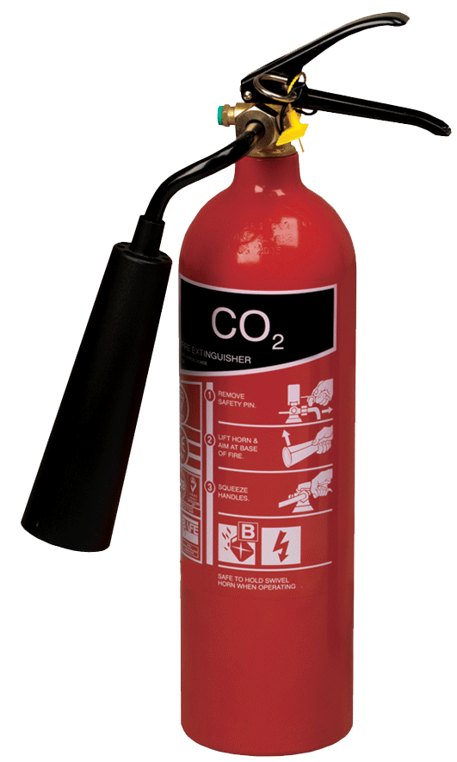
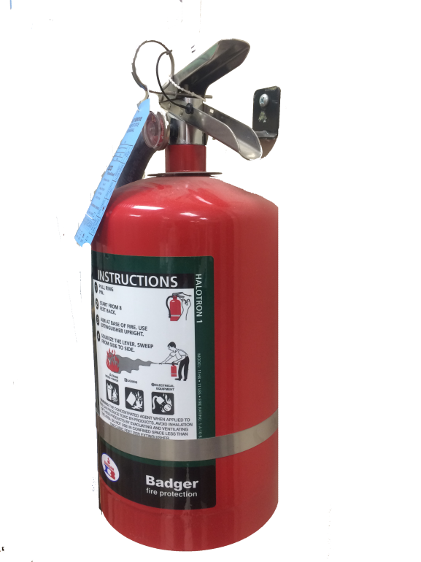
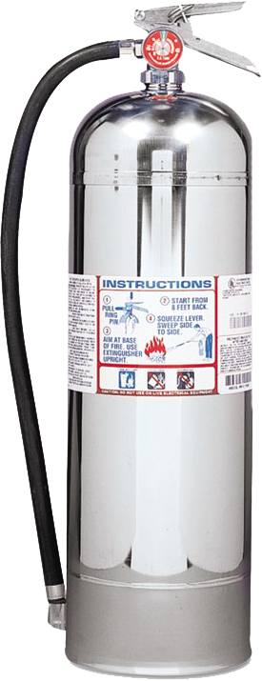
special extinguishers
CO₂ – For Class B & C
Usually has a bell-shaped cone attached to the end of the hose Class A fires will reignite
Halogenated – For Class A, B & C
Generally used to protect sensitive equipment, such as computers and electronics
Both of these types do not leave a residue, which can harm electronics
Water Extinguishers – For Class A Only Less common, typically silver, and much larger. Can cause flammable liquids to spread, and creates shock hazards on electrically charged equipment and circuits

Slide 6
A special note on chemical fires:
In fires involving chemicals, the fumes and reactivity of the chemical(s) is often more dangerous than the flames.
If unsure of the nature of chemicals involved in a fire, do not attempt to extinguish it

Slide 7
Fire Class labels Old - vs - new
=
=
The class of fire an extinguisher is designed for is indicated by symbols on the cylinder label
New extinguishers use pictograms instead of shapes & letters (old style)
A Red Line over a pictogram means the extinguisher cannot be used on that class of fire
(The example to the right indicates the extinguisher is not designed for an electrical fire)
=
=
=

Slide 8
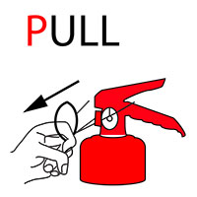
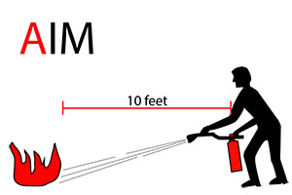
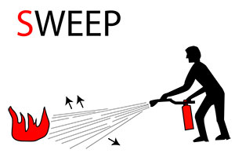
Using a fire extinguisher Remember P.A.S.S. Acronym
Pull the pin – this pin keeps the extinguisher from discharging accidentally
Aim at the base of the fire, stay 10 feet back
Squeeze the handle to release the extinguishing agent
Sweep from side to side at the base of the fire until it is out

Slide 9
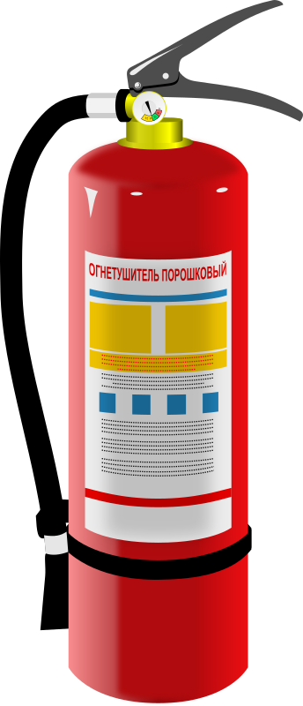
Fire extinguisher tips
Familiarize yourself with extinguishers today. Don’t try to read through instructions in an emergency
Attack a fire within the first two minutes to increase your chances of bringing the fire under control
Never fight a fire larger than a waste basket
Most extinguishers function for less than 40 seconds
When in doubt, GET OUT!

Slide 10
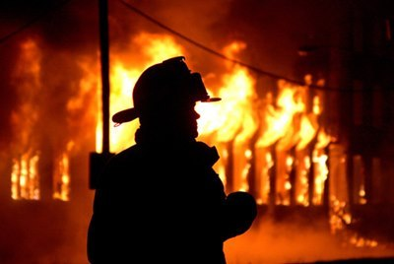
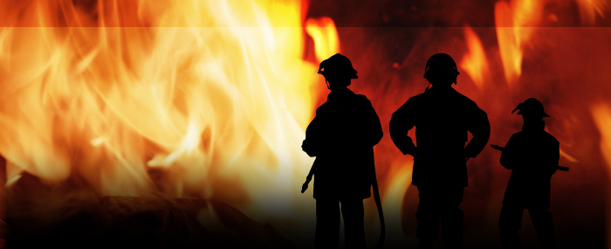
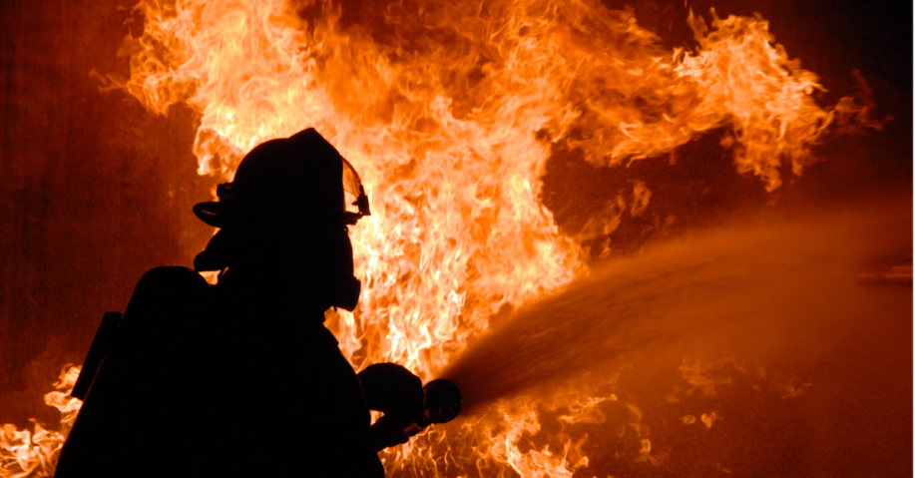
When in doubt…
Leave the fire fighting to the professionals!

Slide 11
EVACUATION
BEFORE AN EVACUATION
DURING AN EVACUATION
Review Emergency Procedures Handbook, page 9
Learn the Emergency Evacuation Checkpoint for your building
Familiarize yourself with all building exits and stairwells
Keep alarm pulls and extinguishers clear of obstructions
Plan multiple escape routes
Use Evacuation Plan diagrams, usually posted near the elevator
Leave immediately
Avoid smoke
Follow building evacuation plan
Do not use elevators
Feel doors for heat before opening. If hot, do not proceed
Close, but do NOT lock, doors as you exit. This hinders search & rescue.
Proceed down stairs to ground or exit floor. Never go up.

Slide 12
EVACUATION (cont.)
IF TRAPPED:
AFTER AN EVACUATION
Take shelter in an enclosed stairwell. They are designed to burn last.
Stuff clothes, towels or use tape to cover cracks around doors and vents.
Stay low to the floor. Breathe though a damp rag if available.
Call 911 or University Police (972-2093) and tell them where you are.
Signal for help from a window. Do not jump. Do not break the window.
Be patient and do not panic.
Once out, stay out
Report to your Emergency Evacuation Checkpoint
Report locations of anyone trapped in the building to authorities
Only re-enter after the fire department gives the all-clear

Slide 13
review
Stay Safe:
YOUR PERSONAL SAFETY always comes first
Notify authorities before attempting to control a fire
Be Ready:
Familiarize yourself with building layouts, exits and evacuation plans
Learn about fire extinguishers in your building, and the classes of fire they are designed to fight
Know Your Limitations:
Remember, you are NOT required to fight a fire
If the fire is larger than a waste basket, leave it to the fire department

Slide 14
Questions?
Contact University Safety & Emergency Management:
Phone – 870-680-4705
Email – jcarvell@astate.edu

