Slide 1
Winter Weather & Cold Stress
- Safety & Emergency Management

Slide 2
Topics:
Precautions for Working in the Cold
Identify Types of Cold Stress
Protecting Yourself & Your Co-Workers
“Nothing burns like the cold. But only for a while. Then it gets inside you and starts to fill you up, and after a while you don't have the strength to fight it.” ― George R.R. Martin, A Game of Thrones

Slide 3
Precautions:
Shovel Properly
Avoid Slips
Take Breaks
Watch Out Below

Slide 4
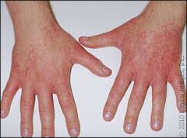
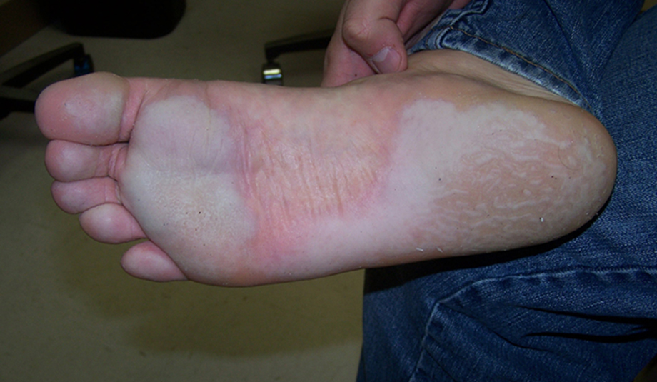
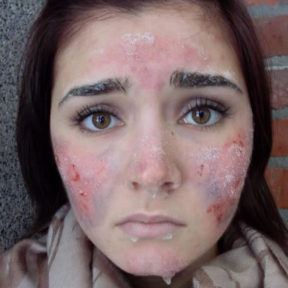
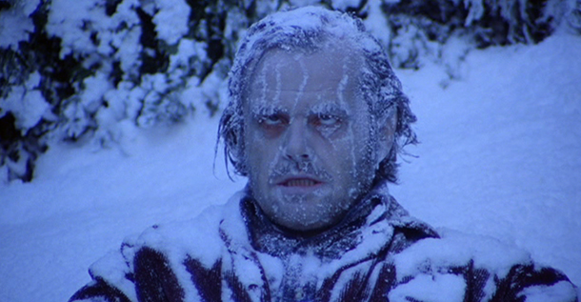
Types of Cold Stress
Cold hives
Trench foot
frostbite
From bad to worst…
hypothermia

Slide 5
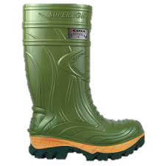
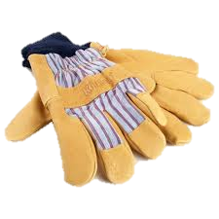
Avoiding Cold Stress with PPE:
Consider Conditions
Layer Up
Keep Blood Pumping
Stay Dry

Slide 6
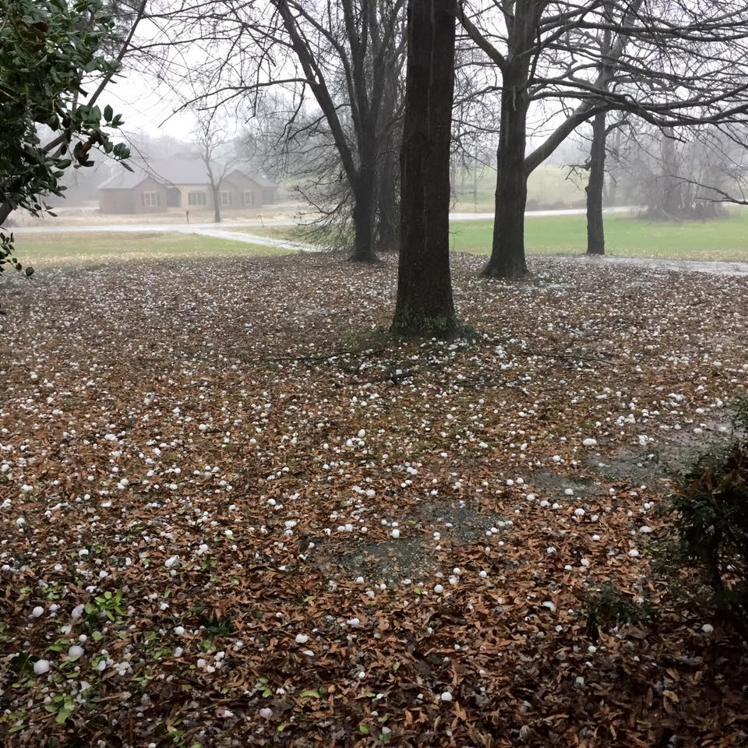
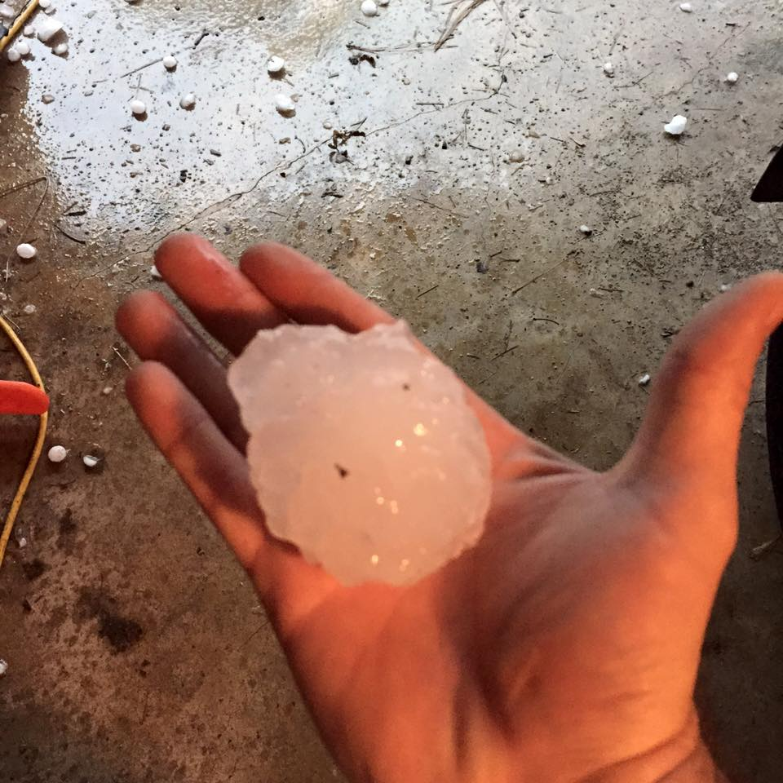
2017 Winter Outlook
Warmer than usual, leads to the unusual…

Slide 7
Resources:
Cold Stress Info - OSHA Web site
www.osha.gov – Search “Winter Weather”
Cold Hives Info Mayo Clinic Web site
www.mayoclinic.org – Search “Cold Hives”
National Weather Service
www.noaa.gov – Search “Climate Prediction Center”
Instructor Contact:
Jon Carvell - 680-4705 or jcarvell@astate.edu

