Slide 1
Ergonomics
For Office Staff

Slide 2
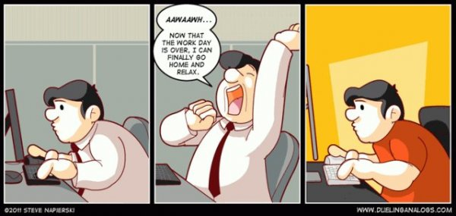
Common Office Injuries
Hands, wrist or arms
Neck and shoulder strains
Back strains
Eye strain
Headaches

Slide 3
Video 1: Workstation Fit

Slide 4
Video 1: Review
Monitor position
Head/neck posture
Shoulder position
Elbow position
Lower back
Wrists & hands
Position of feet

Slide 5
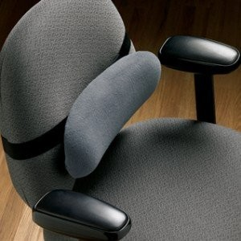
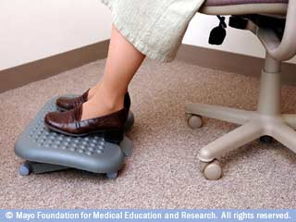
Simple Solutions for Workstation Fit
Pillow for Lumbar Support
Platform for Footrest

Slide 6
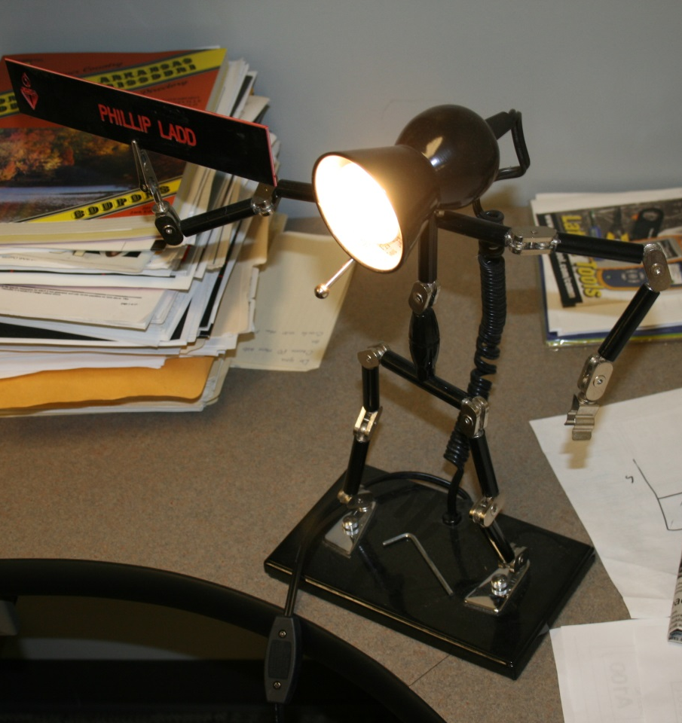
Other Considerations
Pinch Points
Calf - Front of Seat
Wrist – Keyboard/Mouse
Thigh – Seat
Breaks
Micro (30 seconds)
Take a Walk (15 minutes)
General Movement
Task Lighting

Slide 7
Video 2: Cell Phone Use

Slide 8
Video 2: Review
Frequency
Freedom of movement
Hands-free devices
Fingers & thumbs

Slide 9
Screen Zooming
Keyboard shortcuts
Mouse and Keyboard Combo
Microsoft Magnifier

Slide 10
Office Ergonomics Resources
Instructor contact
Jon Carvell, 680-4705 or jcarvell@astate.edu
OSHA
https://www.osha.gov/SLTC/etools/computerworkstations/index.html
Humanscale
http://www.humanscale.com/form_function/fourpillars-video.cfm
UCLA Health
https://www.youtube.com/watch?v=9AcFBbd1pUM

