Slide 1
Polycom Video Conferencing Equipment
General Operations

Slide 2
Using the Polycom equipment in
a traditional classroom setting
(no remote sites connected)

Slide 3
This is the ‘Home Screen.’ It is the default screen when not connected to Distance Sites. This screen can also be accessed by pressing the ‘Home’ icon.

Slide 4
To show the PC or Elmo (document camera), press the ‘Show Content’ icon.

Slide 5
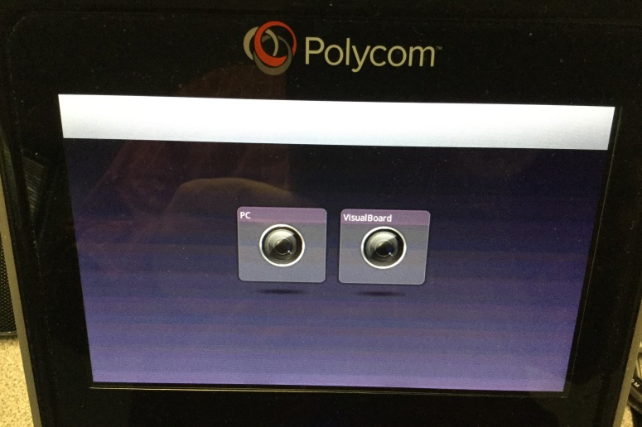
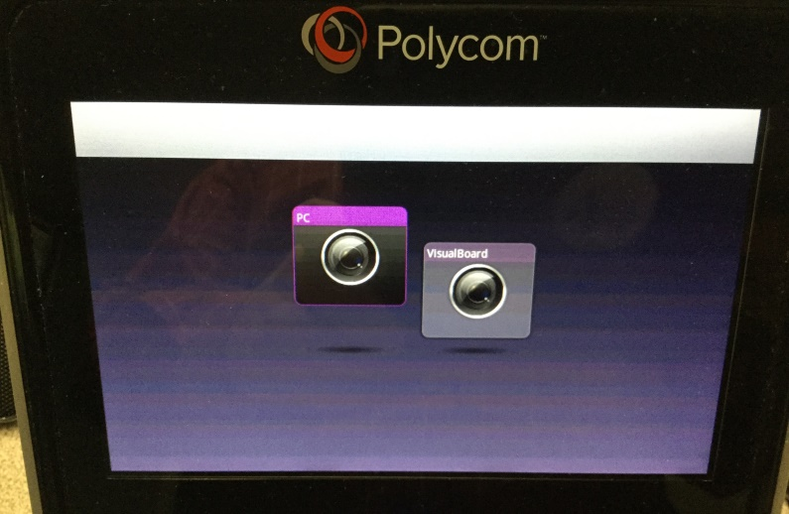
Showing Content
Once the “Show Content” icon is pressed, this screen will appear.
Select the PC icon. Once selected the PC icon will be raised, indicating the current selection.

Slide 6
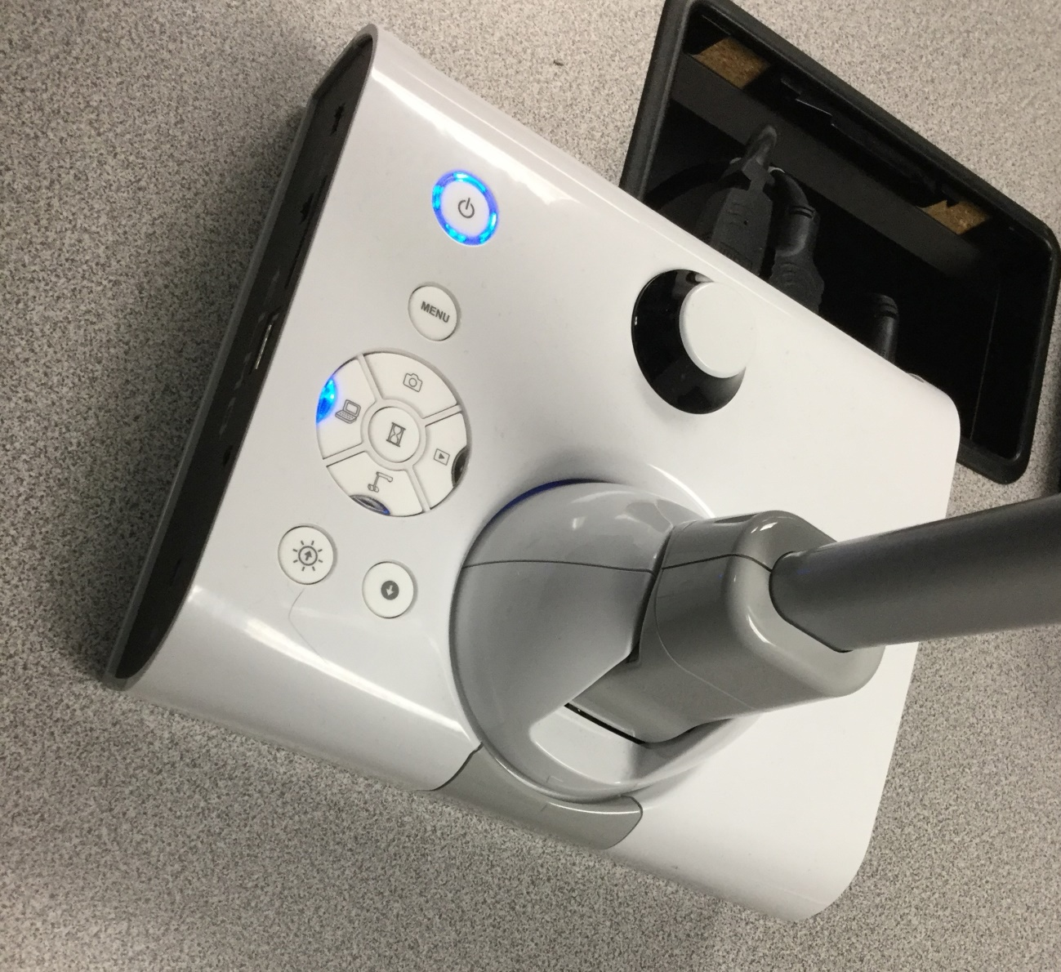
Using the ELMO
To switch to the PC content press button with the computer screen icon
Press the bottom button symbol for document camera or ELMO

Slide 7
To adjust the volume of the unit, press the right arrow to access the ‘Audio’ icon.

Slide 8
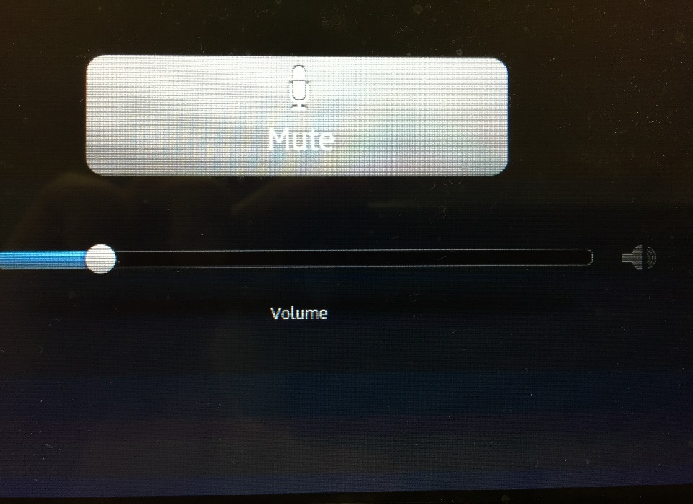
Next, press the ‘Audio’ icon and slide the volume bar to the desired setting.

Slide 9
Please be advised that the touch panel is not always instantaneous. It may take a second or two for processing. Be careful not to press the red HANGUP button when pressing back to call!

Slide 10
Polycom General Instructions With a Connection(s) to Distance Sites

Slide 11
This is the ‘Call Screen.’ This screen indicates a connection(s) to remote sites.
Call Screen

Slide 12
To view the remote sites connected to the conference, select the ‘Cameras’ icon.

Slide 13
Once the ‘Cameras’ icon is selected, press the ‘Far’ button in the top left of the screen.

Slide 14
Next, select the ‘Up Arrow’ one time to see students at the remote sites.

Slide 15
To return to the home screen, select the ‘Back to the Call’ bar at the top of the screen.

Slide 16
You should now be back to this screen.

Slide 17
To show the PC or Elmo (document camera), press the ‘Content’ icon at the bottom of the screen.

Slide 18
This is the content screen. Press PC to show content.

Slide 19
When the PC is selected the icon is raised above the other.

Slide 20
Once again, to return to the ‘Call Screen’ simply press the green bar.

Slide 21
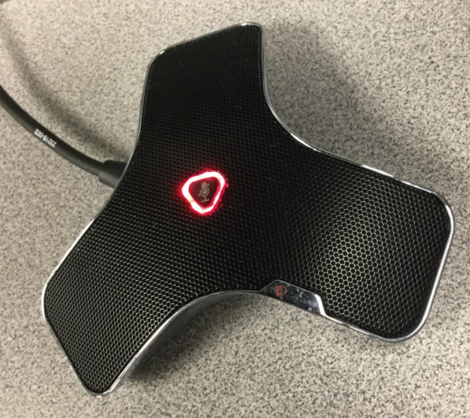
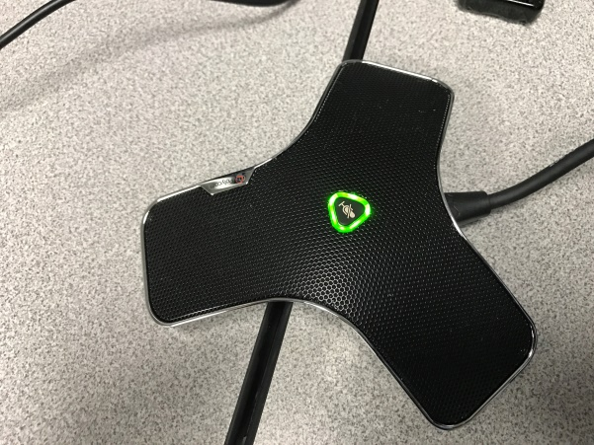
To unmute the microphone
Do not forget to unmute the speaker on the desk so your distant site(s) can hear you.
If the light is RED the mic is on mute
Press the button on the mic
A GREEN light indicates the mic is unmuted

Slide 22
Please be advised that the touch panel is not always instantaneous. It may take a second or two for processing. Be careful not to press the red HANGUP button when pressing back to call!

