Slide 1
Policy Perspectives on GME Development in Arkansas
Mismatch between types of physicians needed and types of physicians trained
Growing burden of debt for physicians in training
Geographic maldistribution of GME positions and primary care physicians in practice. Rural areas in Arkansas are markedly underserved

Slide 2
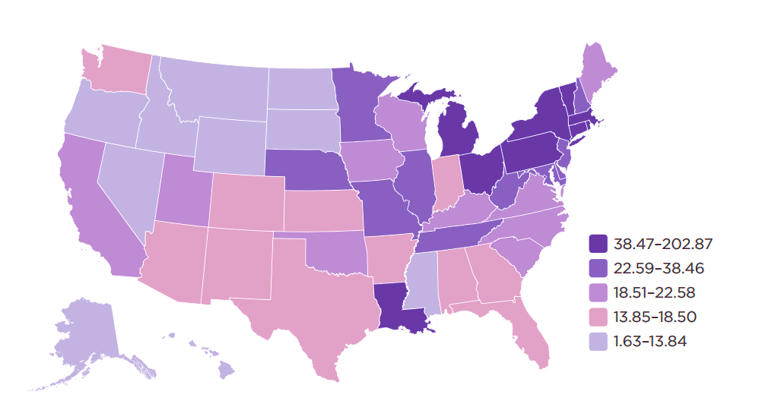
Medicare –funded training positions per 100,000 population. 2010

Slide 3
Policy Perspectives on GME Development in Arkansas
Lack of trained physicians from minority groups
Primary care physicians are trained to a major extent in hospitals but their work is primarily in the clinic
Primary care physicians should be trained to be leaders of team-based care, to use telemedicine, mid level providers and community health workers.

