Slide 1
Social for Scholars: Quick Guidelines for Using Social Media
Bill Smith, PhD
Executive Director of Marketing and Communications
Arkansas State University

Slide 2
Mission Statement
The social media platforms of Arkansas State become the first stop for information about Arkansas State and our educational community.
Integrate the A-State platforms into the daily lives of our community.
Promote interaction with potential students and regain/maintain engagement with former students.

Slide 3
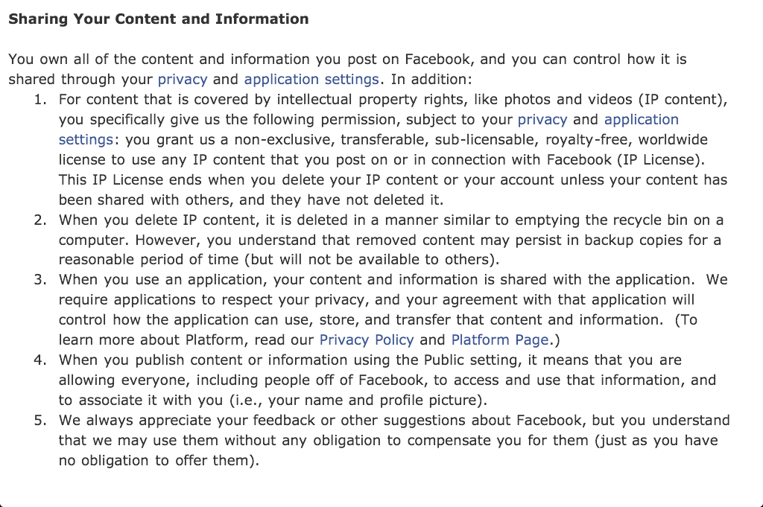
So What is Facebook?
The greatest intelligence gathering and consumer data mining tool
in the history of mankind

Slide 4
Security
There isn’t any
Digital assets are extremely portable
Easily copied and widely disseminated
Once posted, always available
There is no delete key online
Personal safety
Your privacy does not depend on your settings
It depends on your friends

Slide 5
The Gallery of Horrors

Slide 6
The Gallery of Horrors

Slide 7
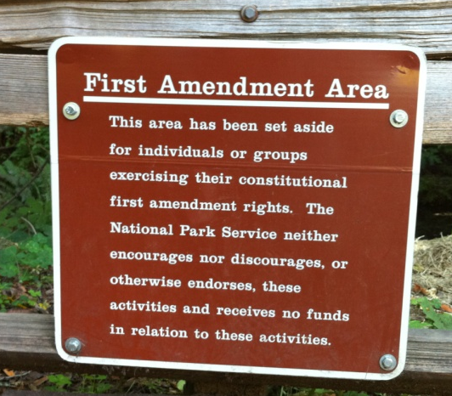
A-State Guidelines
Evaluation and formulation begins soon
Guidelines, not policies
Best practices
Professional suggestions
State employee legal issues
Limits of federal student privacy
Ethical behavior

Slide 8
Legal Things to Consider
What is legal in Arkansas & ASU system
Trademarks
Proprietary information
Endorsements
Personal privacy violations
University computing codes
FERPA & HIPPA
“Astroturfing”
Emergency/crisis response

Slide 9
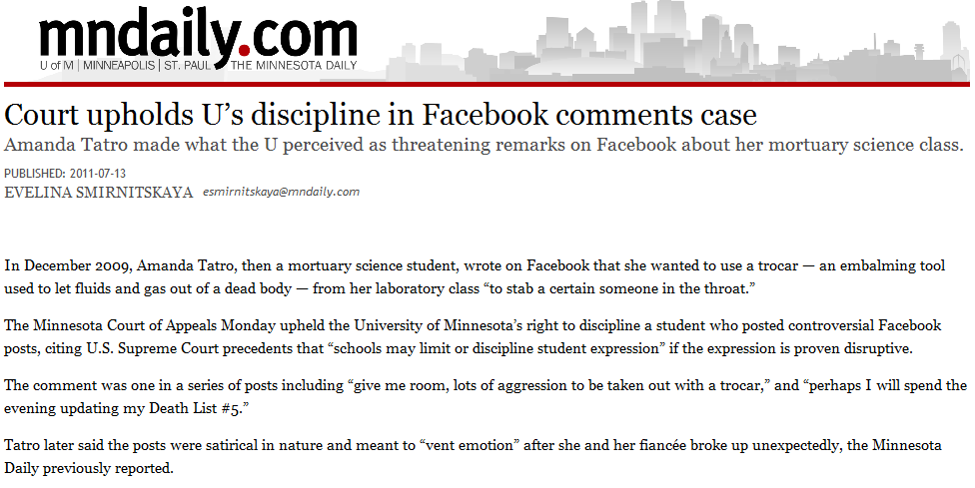
The Gallery of Horrors

Slide 10
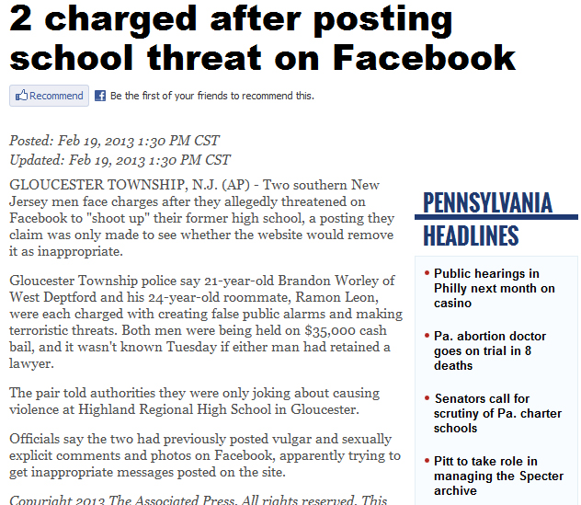
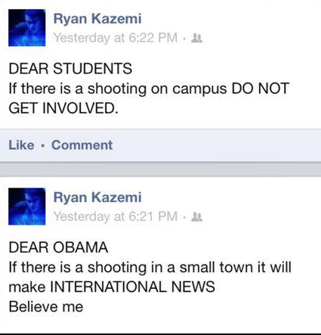
The Gallery of Horrors

Slide 11
The Gallery of Horrors

Slide 12
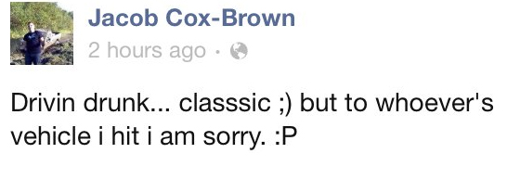
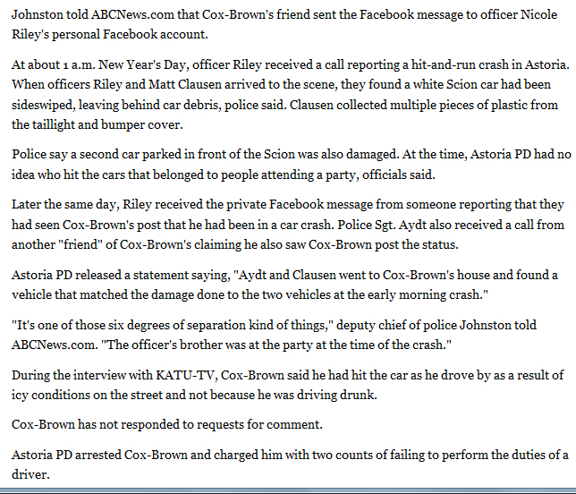
The Gallery of Horrors

Slide 13
Academic Things to Consider
Defining your social relationship
Consider adding to your syllabus
Understand the power dynamic
Use of social in classroom
Potential ADA compliance issues
Individual student privacy concerns

Slide 14
Formula for Success
2C=2E
Content
Original to platform
Concert
Orchestra, not soloists
Engagement
Facebook Five
Enrollment
The Fab Four

Slide 15
Living Social

Slide 16
What One Photo Can Do

Slide 17
The Facebook Five
Immediate
Post in the moment; nobody really likes leftovers
Sentiment
Everybody loves their grandma
Visual
Whenever possible, show, don't tell
Mobility
There is no substitute for being there
Brevity
Don't waste a friend's most valuable commodity: time

Slide 18
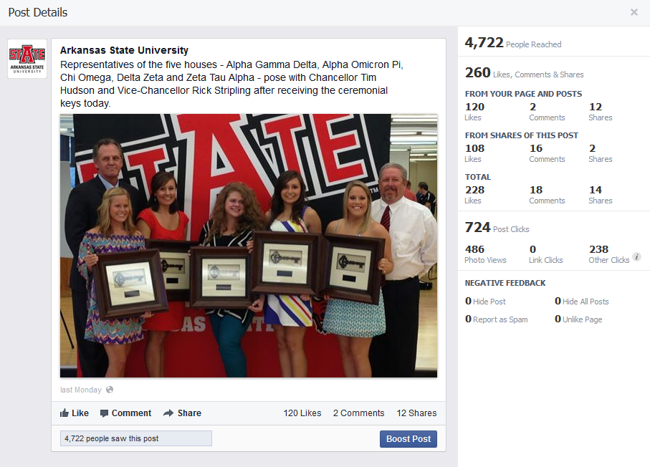
The Facebook Five: Immediate

Slide 19
The Facebook Five: Sentiment

Slide 20
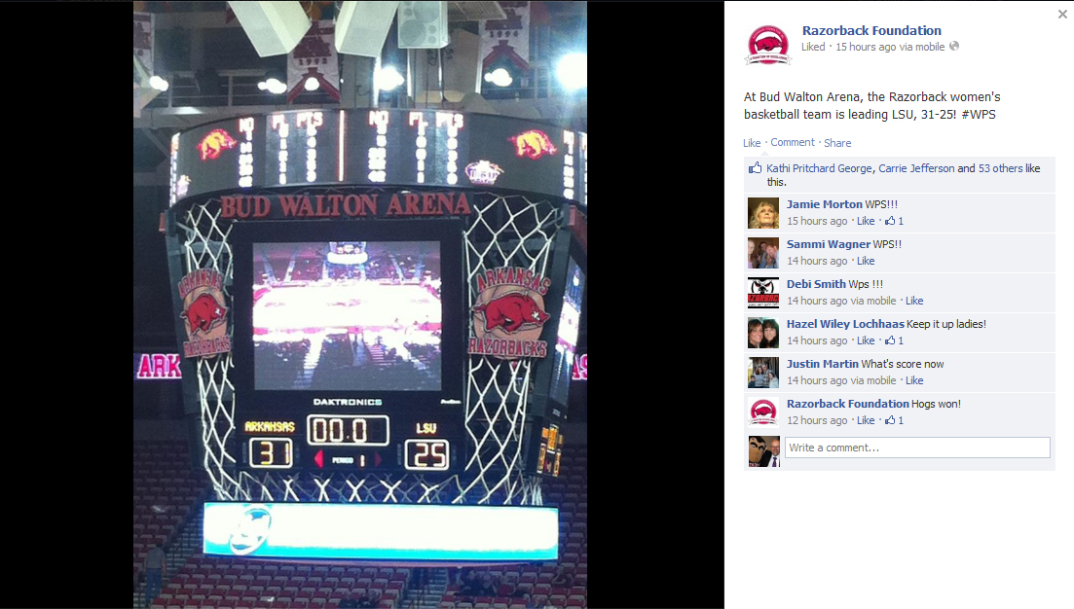
The Facebook Five: Visual

Slide 21
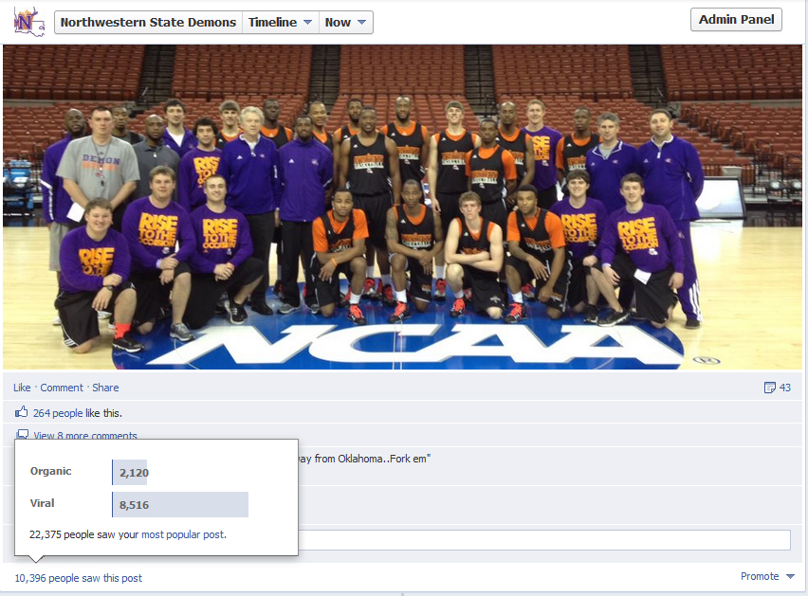
The Facebook Five: Mobility

Slide 22
The Facebook Five: Brevity

Slide 23
Facebook 5: Bring it all together

Slide 24
Key Things to Remember
Security is up to what you post
Use the settings to your advantage
You stand in the public square
Know your legal impacts
Nothing you would want your grandmother to read in the paper
“Once it’s on the internet, it’s the God-awful truth whether it is or it isn’t”

Slide 25
Logos and Visual Guidelines
Coming soon to AState.edu

Slide 26
How to Reach Me
Bill Smith
103-B Administration Building
Arkansas State University
870.972.2169 o | 870.253.8495 c
billsmith@AState.edu
bismith75@gmail.com
@doctor_bs | Facebook.com/wabac

