Slide 1
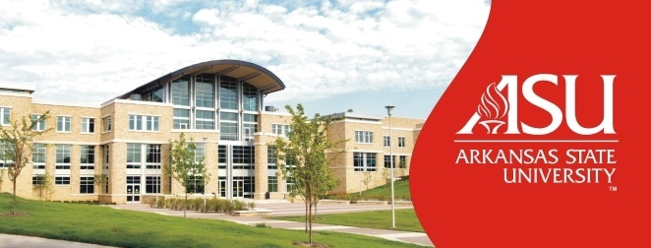
“Bringing the World to ASU, Taking ASU to the World” Tugrul Polat Executive Assistant to Chancellor for International Relations

Slide 2
International Student Enrollment at ASU

Slide 3
International Student Enrollment at ASU
Classification | Number of International Students Spring 2010 | % of Total
ESL | 334 | 42.28%
Undergraduate | 246 | 31.14%
Graduate | 210 | 26.58%
Total | 790 | 100.00%

Slide 4
Leading Place of Origin at ASU
Country | Number of Students | % of Total
China | 240 | 30.38%
Saudi Arabia | 131 | 16.58%
India | 81 | 10.25%
Japan | 39 | 4.94%
Turkey | 33 | 1.90%

Slide 5
Financial Impact of International Students in the State & at ASU
Total number international students 3,349 (up 1.0 %) in Arkansas
Estimated international student expenditure in the state $68m
Institutions with the highest number of international students in the state
Annual average total cost of attendance at ASU is $15,000 per student
≥ 1,000 international students anticipated to be enrolled Fall 2010
Total financial benefit $15m
2.5 times direct multiplier benefit to local economy is $37.5m per year
Institution | City | Total # of Students
University of Arkansas Main Campus | Fayetteville | 1,086
Arkansas State University | Jonesboro | 790
Arkansas Tech University | Russellville | 294
Harding University | Searcy | 265
Southern Arkansas University | Magnolia | 182

