Slide 1
Inactivation of Mycobacterium smegmatis following Exposure to 405-Nanometer Light
OR
“Killing Bugs Without Drugs”
J. Stephen Guffey – Physical Therapy
William Payne – Clinical Laboratory Science
Leslie James – DPT Student
Zhuoyuan Qian – DPT Student

Slide 2
Guiding Statement
“The investigation of novel non-antibiotic approaches for the prevention of and protection against infectious diseases should be encouraged, and such approaches must be high-priority research and development projects.”
  Bush, K., P. Courvalin, G. Dantas, et al (2011). Tackling antibiotic resistance. Nat Rev Microbiol 9:894-896.

Slide 3
Our Ongoing Activity
Began with Electrotherapy
  Guffey JS & Asmussen MD (1989) In vitro bactericidal effects of high voltage pulsed current versus direct current against Staphylococcus aureus. J Clin Electrophysiol: 1:5–9.
Moved to Blue Light (405 and 470 nm)
  Guffey JS, Wilborn J (2006) In vitro bactericidal effects of 405nm and 470nm blue light. Photomedicine and Laser Surgery, 24:684-688.
  Guffey JS, Wilborn J (2006). Effects of combined 405nm and 880nm light on Staphylococcus aureus and Pseudomonas aeruginosa in vitro. Photomedicine and Laser Surgery 24: 680-683.

Slide 4
Our Ongoing Activity
Considered Resistance Formation
  Guffey JS, Payne W, Jones T & Martin K. (2013). Rate of Inactivation of Staphylococcus aureus in an In-Vitro, Multiple Stage Application of 405-Nanometer Light from a Supraluminous Diode Array. Photomedicine and Laser Surgery, 31(4): 179-182.
Modulated Resistance Formation
  Guffey, JS, Payne W, Martin K & Dodson C. Delaying the Onset of Resistance Formation: Effect of Manipulating Dose, Wavelength and Rate of Energy Delivery of 405, 464 and 850-Nanometer Light for Staphylococcus Aureus. Manuscript in Review – WOUNDS Journal.

Slide 5
Our Ongoing Activity
New Bacterium (Today’s Presentation)
  Guffey JS, Payne W, James L & Qian Z. (2013). Inactivation of Mycobacterium smegmatis following Exposure to 405-Nanometer Light from a Supraluminous Diode Array. WOUNDS. 25(5): 131-135.

Slide 6
Our Ongoing Activity
Included Fungi
  Guffey, JS, Payne W, Qian Z, Martin K, James L & Dodson C. Enhancing the Effectiveness of Light as an Inhibitor of Candida albicans: Combination 624-nm and 850-nm Wavelengths Delivered at Low Rates. Manuscript in Review – Antimicrobial Agents and Chemotherapy.
  Guffey, JS, Payne W, James L, Qian Z & Dodson C. Inactivation of Candida albicans following Exposure to 624-Nanometer Light from a Supraluminous Diode Array. Manuscript in Review – Advances in Skin and Wound Care.

Slide 7
Our Ongoing Activity
Discovered Energy Delivery Rate as a Factor
  Guffey JS, Payne W, Bednar A. The Interaction of Dose and Rate of Delivery Using Visible and Infrared Light to Inhibit Pseudomonas aeruginosa in vitro. Manuscript in Review – Clinical Laboratory Science.

Slide 8
Our Ongoing Activity
Moved to Human Applications
  Guffey JS, Head P, Bowman A, Kaloghirou A. (2013). Effects of light on pain and function in patients with plantar fasciitis: A pilot study. Journal of Athletic Medicine. 1(1): 37-44.
  Guffey JS & Motts S – Effects of IR Light on Symptoms Associated with Peripheral Neuropathy. Data Collection Begun Summer 2013.

Slide 9
Mycobacterium smegmatis
  Guffey JS, Payne W, James L & Qian Z. (2013). Inactivation of Mycobacterium smegmatis following Exposure to 405-Nanometer Light from a Supraluminous Diode Array. WOUNDS. 25(5): 131-135.
  Became interested when we read about infections associated with tattoos.
    Tattoo ink had become contaminated.
    Occurred in the Northeast US, fall of 2012.

Slide 10
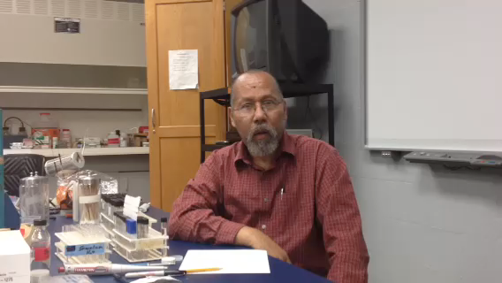
Mycobacterium smegmatis

Slide 11
Methods
10 microliter aliquots of the 1/1000 dilution of M. smegmatis were inoculated onto Middlebrook 7H10 agar plates (60 X 15 mm).
The experimental treatment consisted of seven subcomponents. The organism was prepared (n = 10 plates, 5 treatment and 5 control) and treated at one dose (Jcm⁻²) on one day. The process was repeated a total of seven times (seven different doses) on separate days. Treated plates received 405 nm exposures of 60, 90, 120, 150, 180, 215 and 250 Jcm⁻².
The treated and control plates were incubated at 35°C under aerobic conditions. M. smegmatis is a slow-growing, nonphotochromogenic Mycobacterium species and therefore required an extended incubation period as long as 3 – 4 days for mature colonies to be observed

Slide 12
Results

Slide 13
Take Away
Current approaches to treating infection are becoming less effective.
  Alternative treatment methods are needed.
  Light, visible and IR wavelengths, hold the potential to contribute to decontamination and infection control.

